Slide 1
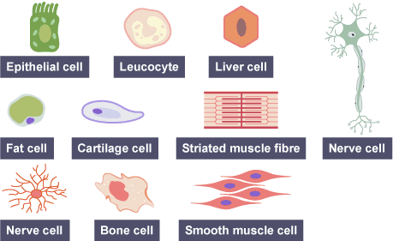
Where do all types of cells come from?

Slide 2
Lesson 5 – Stem Cells
Learning Objectives:
Describe stem cells as an undifferentiated cell capable of producing cells of many different types.
Compare and contrast embryonic and adult stem cells.
Analyse the potential impact of therapeutic uses for stem cells in treating disease.
Evaluate the practical risks and benefits, as well as social and ethical issues, of the use of stem cells in medical research and treatments.

Slide 3
What are stem cells? What are they for?
https://www.youtube.com/watch?v=2-3J6JGN-_Y
Watch the video and write a short summary answering the following questions.
What are stem cells?
What are the different types?
What can they be used for?

Slide 4
Stem Cells

Slide 5
Fill in the worksheet as we learn about stem cells
http://outreach.mcb.harvard.edu/animations/thera7c.swf
Notes:
Focus on spinal cord and diabetes, not necessary to go over all the different possibly therapy possibilities

Slide 6
Therapeutic Cloning
Therapeutic cloning is another way to use stem cells for medical treatment.
No cloned human is actually created!
Stem cells can be artificially created using a patient’s own cells so there is no chance of rejection of the transplant.
Notes:
http://www.explorestemcells.co.uk/therapeuticcloning.html

Slide 7
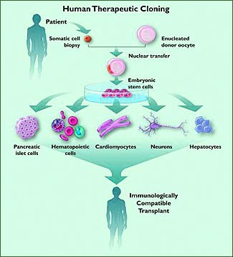
Remove the nucleus from an unfertilised donor egg cell.
Take the nucleus from the patient’s body cell and implant into the egg cell.
Stimulate the egg cell to divide and form a mass of cells.
Stem cells harvested and transplanted into the patient to help regenerate organs.

Slide 8
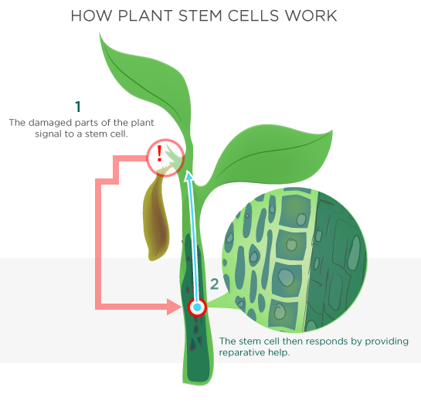
Use of Stem Cells in Plants
Stem cells from meristems in plants can be used to produce clones of plants quickly and economically.
• Rare species can be cloned to protect from extinction.
• Large numbers of identical crop plants with special features such as disease resistance.

Slide 9
Stem Cell Controversy
Briefly summarise the arguments for and against stem cell research including both ethical/moral reasons and potential medical problems.

Slide 10
Recap: BrainPop Video
https://www.brainpop.com/health/diseasesinjuriesandconditions/stemcells/

Slide 11
Extra Videos/Resources
http://www.eurostemcell.org/films
https://www.tes.com/teaching-resource/teachers-tv-ks3-4-science-stem-cell-research-6047949
http://www.theguardian.com/science/stem-cells

