Slide 1
What situations would diffusion not work to transport materials into or out of the cell?
Notes:
Low to high concentration diffusion would not work

Slide 2
Lesson 8 – Active Transport
Learning Objectives:
Describe active transport as the movement of materials against a concentration gradient (from low to high concentration).
Explain how energy is required for active transport.
Compare and contrast diffusion, osmosis, and active transport.

Slide 3
Video: Active Transport
https://www.youtube.com/watch?v=kfy92hdaAH0
(First 3 minutes)
NOTE: ATP = energy
Watch the video and answer the following question
Compare and contrast active transport with diffusion.
What are the similarities? What are the differences?

Slide 4
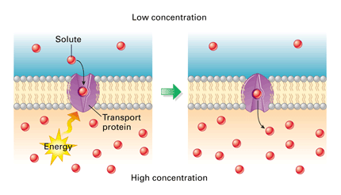
Active Transport (Opposite of Diffusion)
Some materials necessary for cell function are needed in high concentrations.
In this case, the cell CANNOT absorb these materials by diffusion because it would be against the concentration gradient.
Active transport = the movement of particles against the concentration gradient (from low to high concentration).
LOW
HIGH

Slide 5
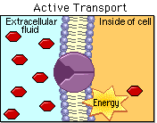
Active transport requires energy
Cells obtain these materials through active transport.
Special protein molecules in the cell membrane “pump” materials into the cell.
However, active transport requires energy.
This energy comes from respiration.

Slide 6
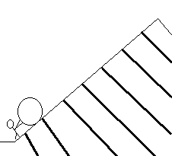
Analogy
Active transport is like rolling a stone uphill (against the gradient).
This requires energy.
However, diffusion is like the stone rolling downhill on it’s own.
This does NOT require energy.

Slide 7
Active Transport at Work
Roots absorb water through osmosis.
Active transport allows mineral ions to be absorbed into plant root hairs from very dilute solutions in the soil.
Plants require ions for healthy growth.

Slide 8
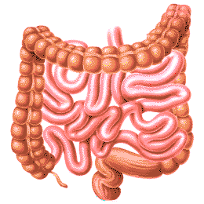
Active Transport at Work
It also allows sugar molecules to be absorbed from lower concentrations in the small intestines into the blood which has a higher sugar concentration.
Sugar molecules are used for cell respiration.

Slide 9
Quiz Time!
Match the phrase with one (or more) of the types of transport in cells.
Diffusion
Osmosis
Active Transport
Notes:
Can use Transport in Cells Review Questions WS

Slide 10
1. From low to high concentration
Active transport

Slide 11
2. The movement of water molecules
Osmosis

Slide 12
3. The movement of solute in the direction of the concentration gradient.
Diffusion

Slide 13
4. Causes cells to shrink or swell.
Osmosis

Slide 14
5. How oxygen enters the bloodstream in the lungs.
Diffusion

Slide 15
6. The movement of solute particles AGAINST the concentration gradient.
Active Transport

Slide 16
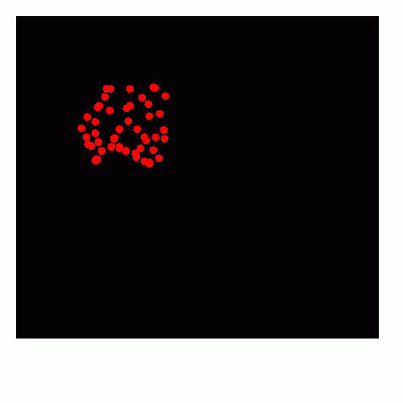
7. What is shown in the diagram?
Diffusion

Slide 17
8. Involves a protein on the cell surface membrane.
Active Transport

Slide 18
9. When particles passively pass through the cell membrane.
Diffusion

Slide 19
10. Requires energy from respiration
Active Transport

Slide 20
11. Movement of a molecule through a semi-permeable membrane from dilute solution to a concentrated solution.
Osmosis

Slide 21
12. How roots absorb mineral ions from the soil.
Active Transport

Slide 22
13. How urea is removed from blood during dialysis.
Diffusion

Slide 23
14. How glucose is absorbed into the bloodstream in the small intestine.
Active Transport

Slide 24
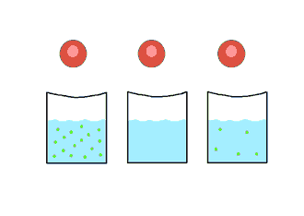
15. What is shown in the diagram.
Osmosis

Slide 25
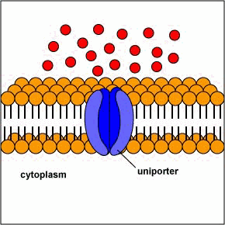
16. What is shown in the diagram?
Active Transport

