Slide 1
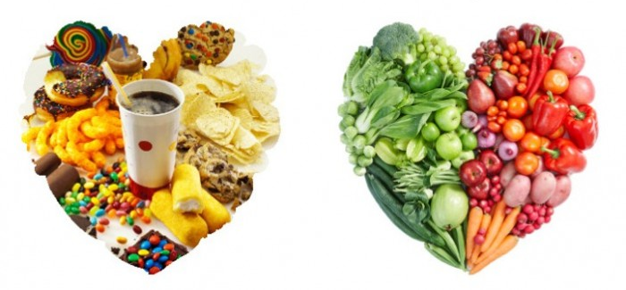
Why are some foods healthier than others?

Slide 2
Starter
Brain pop – Nutrition
http://www.brainpop.com/health/nutrition/nutrition/

Slide 3
Lesson 1 Balanced Diet
Lesson Objectives:
Recall that a balanced diet should include carbohydrates, proteins, fats, vitamins, minerals, fibre and water.
Recall that energy is measure in joules.
Most students should:
Explain the role of each nutrient in the body.
Compare the energy requirements of different people.
Some students could:
Describe how healthy their own diet is

Slide 4
Thinking About Your Food
Write down everything you ate for dinner last night
Can you take the components of your meals and organise them into one of the seven food groups?
Do you think this was a balanced meal? Yes/no
If no, how could you modify it?
Draw and label a well balanced dinner meal

Slide 5
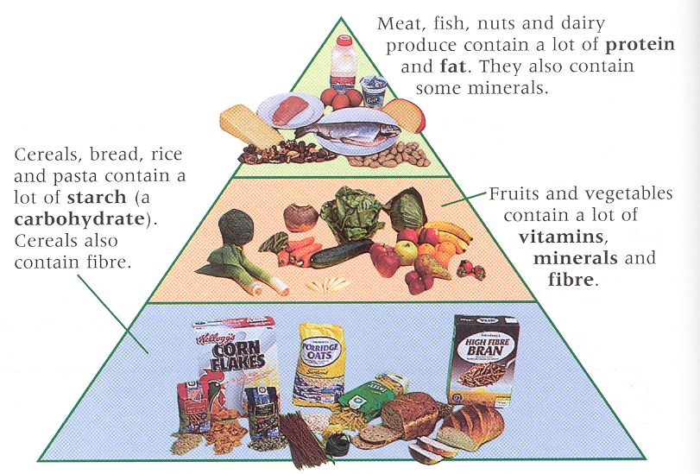

Slide 6
Copy down the recommended daily amounts of the different nutrients.

Slide 7
Restaurant Menus
1) Fish and Chips
2) The ‘pasta special’ is pasta with a creamy sauce containing chicken and spinach. It also comes with a side salad.
3) The ‘all day breakfast’ contains fried eggs, sausages, bacon, bread and butter.
Explain which one is the best example of a balanced meal and say why (detailed answers!!)
Notes:
Extension:
Explain why the other two are NOT good examples of a balanced diet. Explain the effects on the body using scientific detail.

Slide 8
Food Groups
Nutrients WS

Slide 9
SUBSTANCE NEEDED | EXAMPLES | WHY IT’S NEEDED | GOOD SOURCES
Carbohydrate | Starch, sugars | To release energy (through respiration) | Pasta, bread
Protein | x | For growth and repair | Meat, beans
Vitamins | Vitamin C | Helps to form tissue that helps join other tissues together | Citrus fruits
Minerals | Calcium | Formation of bones | Dairy products
Fats | Animal, vegetable | Energy store, insulation under the skin | Olive oil, oily fish
Fibre | x | To prevent constipation | Wholemeal bread
Water | x | Water is an important solvent in the body | Drinks

Slide 10
HW: Writing Task
Draw a balanced meal and explain why it is balanced.

Slide 11
Energy is NOT a nutrient.

Slide 12
Energy
Food stores energy.
Our body breaks down food and releases that energy.
Energy is measured in joules.
1 kilojoule (kJ) = 1000 joules (J)

Slide 13
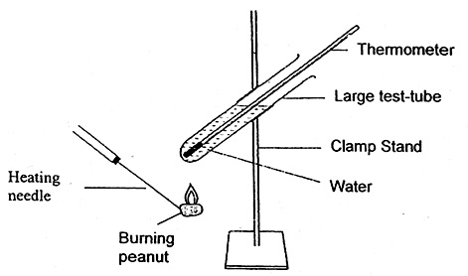
Different Foods
Different foods store different amounts of energy.
We are going to demonstrate this by burning three different foods.
How will we know which food contain the most energy?

Slide 14
Unused energy
Where do we get energy from?
What do we use energy for?
What happens if we eat more energy than we use up?
If energy from food is not used up, it is stored as fat. Too much can lead to health problems, such as heart disease.

Slide 15
How much energy in food?
Food labels tell you how much energy is stored in the food.
The amount of energy stored in different foods varies greatly.
When you choose which foods to eat you need to consider the nutritional value of the food as well as the amount of energy.
Food | Energy(kJ) per 100 g
Apple | 200
Banana | 340
Peas | 250
Chips | 1000
Cooked Beef | 1000
Chocolate | 1500
Notes:
Information only – discussion perhaps

Slide 16
Energy Questions
Suggest why there might be a difference between the daily energy requirements of an average adult woman and a pregnant woman.
Suggest why males generally need more energy per day than females.
Predict how the energy requirements of an elderly man compare with that of an average adult man. Explain your answer.
How do you think the energy requirements of an elderly man compare with those of an elderly woman? Explain your answer.
Notes:
Support the developing foetus as well as the mother
They tend to be larger and have more muscle mass which uses more energy in respiration
Elderly men are less mobile/active and use less energy
Elderly women are usually smaller and have less muscle mass therefore lower energy demands

Slide 17
Homework
Record what you eat in a “typical” day. Look up the nutritional data (if you have the food label, copy it or look it up using the website). Calculate your daily nutritional values and compare to the recommended amounts.
http://www.nutritionvalue.org/
1 calorie = 4.2 kJ (so multiply by 4.2 to get kJ)

