Slide 1
Atomic structure and radioactive decay
Including isotopes

Slide 2
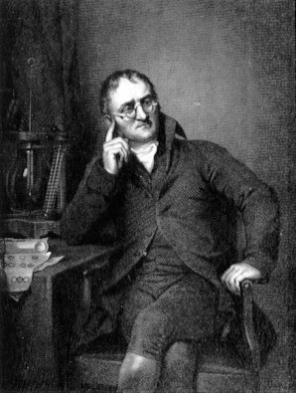

Models of the atom
We now know that all matter is made of atoms, but ideas about atomic structure have changed over time.
The idea of atoms was first suggested in 450 BC by the Greek philosopher Democritus.
In 1803, John Dalton reintroduced the idea that everything is made of atoms.
He said atoms were solid spheres of matter that could not be split.
Dalton also suggested that each element contained identical atoms. For example, gold is an element made up of only gold atoms.
Notes:
2
Image credit: this image is in the public domain

Slide 3

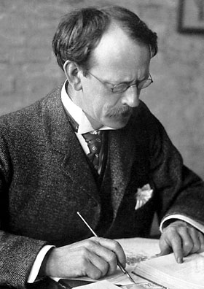
JJ Thomson
In 1897, whilst studying cathode rays, JJ Thomson discovered tiny particles with a negative charge.
These negative particles were given out by atoms and were much smaller than atoms.
Thomson had discovered
the existence of electrons.
This discovery contradicted Dalton’s theory that atoms were solid spheres of matter.
This led Thomson to propose a new model of the atom.
Notes:
Image credit: this image is in the public domain

Slide 4
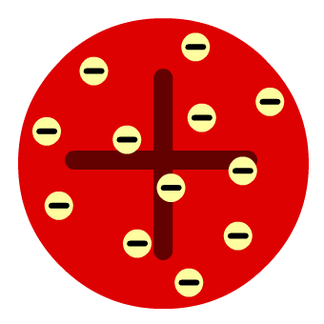
The plum pudding model
Thomson suggested that an atom is a positively-charged sphere with negative electrons distributed throughout it.
This model became known as the plum pudding model, because the electrons in the atom were thought to be like raisins in a plum pudding.
Electrons had been proved
to exist but there were still doubts about this model.

Slide 5

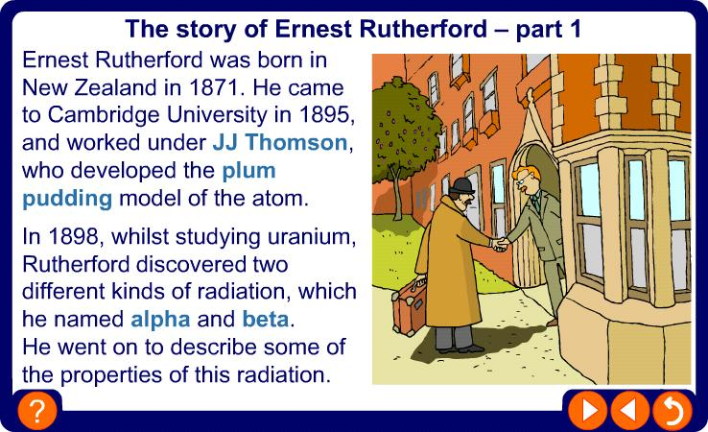
Ernest Rutherford

Slide 6
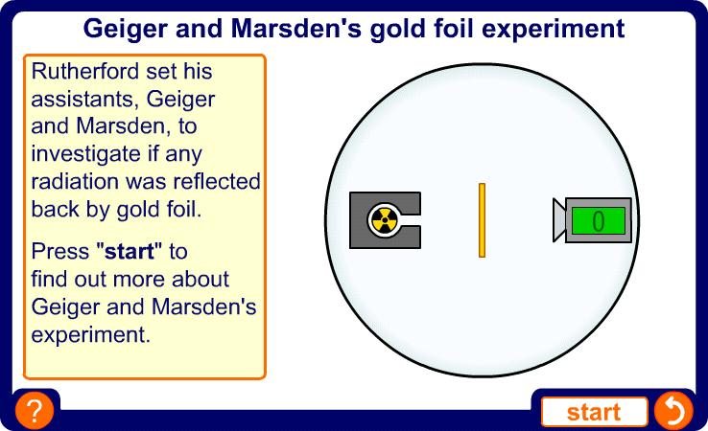
Geiger and Marsden’s experiment

Slide 7
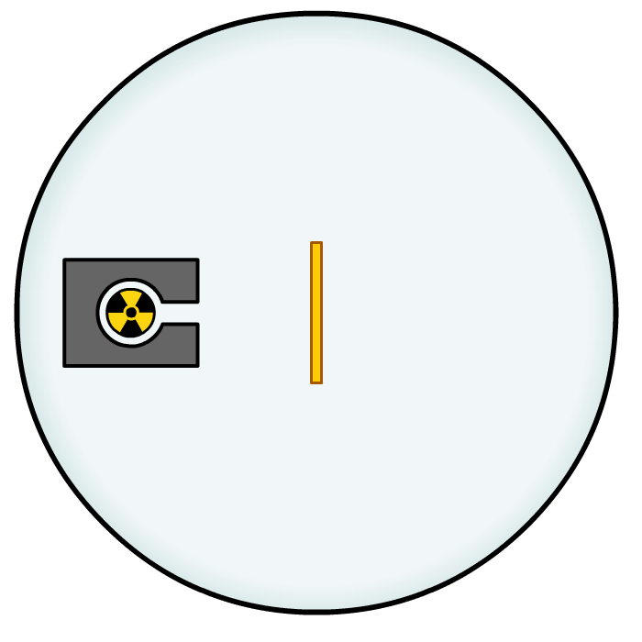

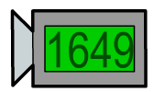

The results
The results of Geiger and Marsden’s experiment were:
2. Some alpha particles
were slightly deflected
by the gold foil.
1. Most alpha particles
went straight through
the gold foil, without
any deflection.
3. A few alpha particles were bounced back from the gold foil.
The experiment was carried out in a vacuum, so deflection of the alpha particles must have been due to the gold foil.
How can these results be explained in terms of atoms?

Slide 8
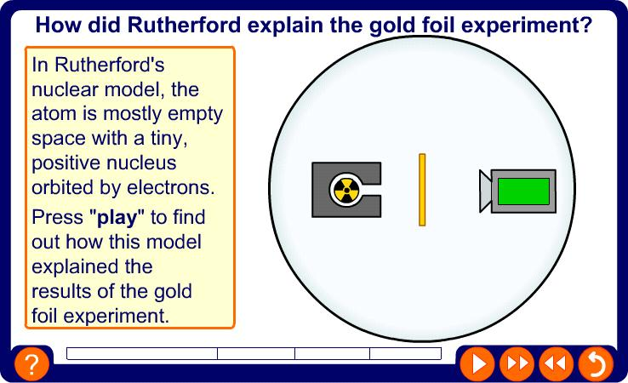
Rutherford’s explanation

Slide 9
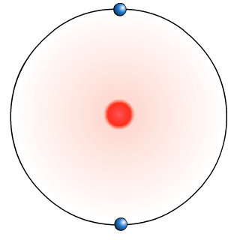
Rutherford’s interpretation
Rutherford had expected all the alpha radiation to pass through the gold foil. He was surprised that some alpha particles were deflected slightly or bounced back.
The plum pudding model could not explain these results, so Rutherford proposed his nuclear model of the atom.
He suggested that an atom is mostly empty space with its positive charge and most of its mass in a tiny central nucleus.
Electrons orbited this nucleus at a distance, like planets around the Sun.

Slide 10
Most of an atom is empty space!
If an atom was the size of a football pitch, then the nucleus
would be about the size of an apple in the centre!

Slide 11
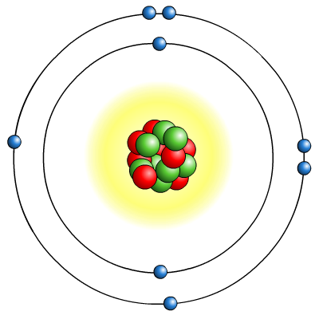
The modern model
Experiments showed that Rutherford’s atomic model (a tiny, positively-charged nucleus orbited by electrons) was correct.
Further developments in understanding about atomic structure followed, but Rutherford’s nuclear model still
forms the basis of the modern model of the atom.
The nucleus is where most of the mass of the atom is found. It contains protons and neutrons.
The electrons orbit the nucleus in shells.

Slide 12




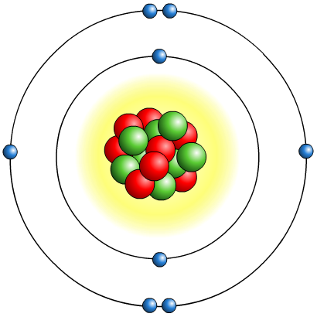
What are atoms made of?
Atoms are made up of three smaller particles:
protons
neutrons
electrons
The protons and neutrons exist in a dense core at the centre of the atom. This is called the nucleus.
The electrons are spread out around the edge of the atom. They orbit the nucleus in layers called shells.
Notes:
Teachers note
Students should be reminded that an atom is mostly empty space, and that this diagram is not to scale.
Protons and neutrons are held together in the nucleus by a strong force. This balances the repulsive electrostatic force between the protons.

Slide 13
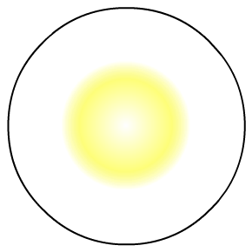

Mass and electrical charge
There are two properties of protons, neutrons and electrons that are especially important:
mass
electrical charge.
particle
mass
charge
proton
1
+1
neutron
1
0
electron
almost 0
-1
The atoms of an element contain equal numbers of protons and electrons and so have no overall charge.

Slide 14
MASS NUMBER = number of protons + number of neutrons
4
He
SYMBOL
2
ATOMIC NUMBER = number of protons

Slide 15
Name the elements shown and calculate the numbers of protons, neutrons and electrons for the elements:
12
C
6
75
As
33
127
I
53

Slide 16
Isotopes
An isotope is an atom with a different number of neutrons:
Notice that the mass number is different. How many neutrons does each isotope have?
16
17
18
O
O
O
8
8
8
Each isotope has 8 protons – if it didn’t then it just wouldn’t be oxygen any more.
A “radioisotope” is simply an isotope that is radioactive – e.g. carbon 14, which is used in carbon dating.

Slide 17
Calculate the number of protons, electrons and neutrons shown below -
12
C
6
13
C
6
14
C
6
These are all the element carbon, what is the difference between them?
They have different numbers of neutrons.
What do we call atoms of the same element with different numbers of neutrons?
What do we call isotopes that are unstable and emit radiation to become more stable?
Isotopes
Radioisotopes

Slide 18
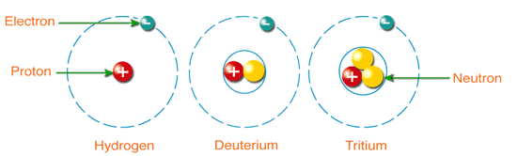
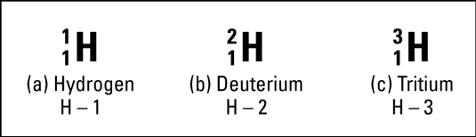
Isotopes of hydrogen

Slide 19
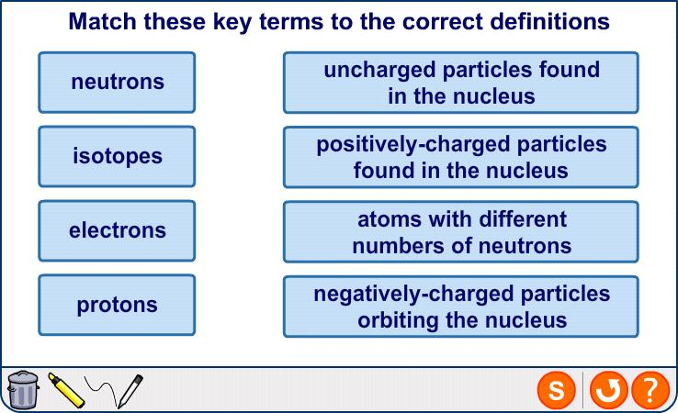
Key terms
Notes:
Teacher notes
This matching activity could be used as a plenary or revision exercise on atomic structure. Students could be asked to complete the questions in their books and the activity could be concluded by completion on the IWB.

Slide 20
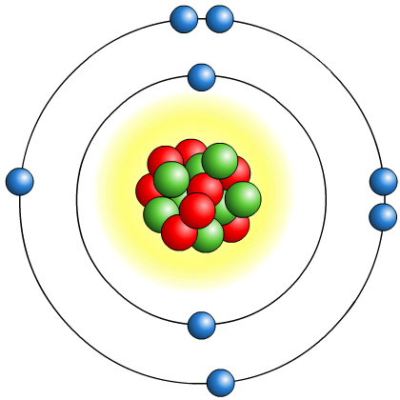
What are ions?
An ion is an atom or group of atoms that has
an electrical charge, either positive or negative.
Atoms have an equal number of protons and electrons and so do not have an overall charge.
Atoms with incomplete outer electron shells are unstable. By either gaining or losing electrons, atoms can obtain full outer electron shells and become stable.
When this happens, atoms have an unequal number of protons and electrons and so have an overall charge.
This is how atoms become ions.
How does an atom become a positive or negative ion?

Slide 21
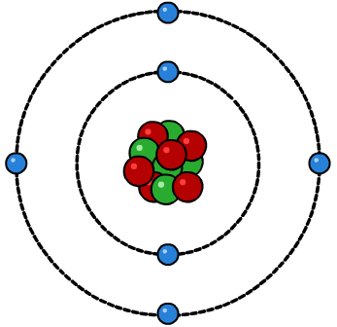
What is radiation?
The term radiation (also known as nuclear radiation) refers to the particles or waves emitted by radioactive substances.
electron
An atom has a central nucleus, which is made up of protons
and neutrons. Electrons surround the nucleus in shells.
proton
neutron
Nuclear radiation comes from the nucleus of a radioactive atom. In a radioactive atom, the nucleus is unstable and
so it emits particles or waves to form a more stable atom.
This process is called radioactivity or radioactive decay. It is a natural and completely spontaneous process.
Notes:
21
Teacher notes
See the Atoms and Isotopes presentation for more information on atomic structure.
See the Radioactive Substances presentation for more information on radiation.

Slide 22
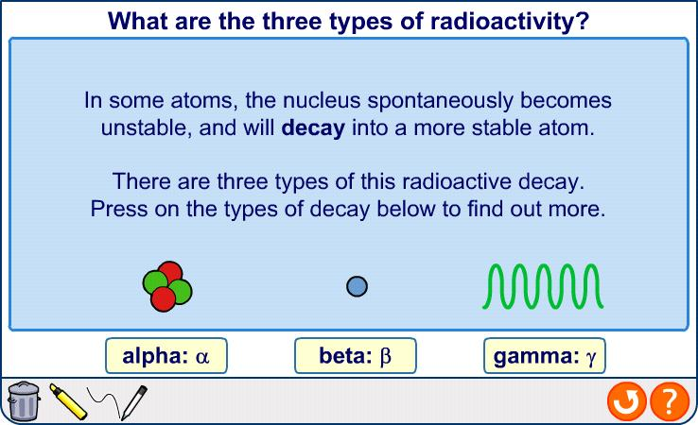
Alpha, beta and gamma
Notes:
Teacher notes
See the Radioactive Substances presentation for information on the discovery of radiation.

Slide 23



Alpha decay
An alpha particle consists of two protons and two neutrons. It is the same as a helium nucleus.
When an atom’s nucleus decays and releases an alpha particle, it loses two protons and two neutrons.
mass number decreases by 4
238
234
4
U
Th
+
α
92
90
2
atomic number decreases by 2
The number of protons has changed, so the decayed atom has changed into a new element.

Slide 24
Alpha decay
Type of decay:
What is emitted?
Description of decay:
Example of decay:
Effect on A and Z:
Alpha particle (helium nuclei)-charge=2+
2 neutrons and 2 protons are emitted from the nucleus.
₂₃₈ ₂₃₄ ₄
U → Th + α + energy
92 90 2
Mass number decreases by 4, atomic number decreases by 2

Slide 25
Alpha, beta and gamma
Notes:
Teacher notes
See the Radioactive Substances presentation for information on the discovery of radiation.

Slide 26
Beta decay
An beta particle consists of a high energy electron, which is emitted by the nucleus of the decaying atom.
When an atom’s nucleus decays and releases a beta particle, a neutron turns into a proton, which stays in the nucleus,
and a high energy electron, which is emitted.
mass number remains the same
14
14
C
N
+
β
6
7
atomic number increases by 1
The decayed atom has gained a proton
and so has changed into a new element.

Slide 27
Beta decay
Type of decay:
What is emitted?
Description of decay:
Example of decay:
Effect on A and Z:
High energy electron-charge=1-
A neutron in the nucleus decays into a proton and a high energy electron which is emitted.
₁₄ ₁₄ ₀
C → N + β + energy
6 7 -1
Mass number stays the same, atomic number increases by 1

Slide 28
Alpha, beta and gamma
Notes:
Teacher notes
See the Radioactive Substances presentation for information on the discovery of radiation.

Slide 29
Gamma decay
Gamma radiation is a form of electromagnetic radiation, not a type of particle.
When an atom’s nucleus decays and emits gamma radiation, there is no change to the make-up of the nucleus and so a new element is not formed.
Gamma rays are usually emitted with alpha or beta particles. For example, cobalt-60 decays releasing a beta particle.
The nickel formed is not stable and so emits gamma radiation.
60
60
60
γ
Co
Ni*
+
β
Ni
+
27
28
28
The nickel does not change into a new element.
Notes:
Teacher notes
The ‘*’ symbol next to the nickel in the middle of the equation indicates that the nickel is still unstable and needs to release more radioactivity to become stable.

Slide 30
Gamma decay
Type of decay:
What is emitted?
Description of decay:
Effect on A and Z:
High energy electromagnetic radiation.-no charge
Nucleus changes shape into a more stable shape. Gamma radiation emitted as a result.
Mass number stays the same, atomic number stays the same

Slide 31
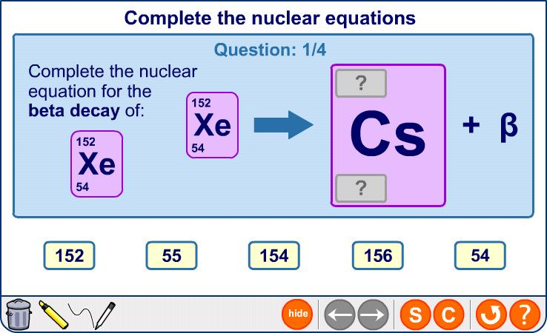
Nuclear equations
Notes:
This content is higher tier for AQA, OCR Gateway and OCR 21st Century GCSE Additional Science.

