Slide 1
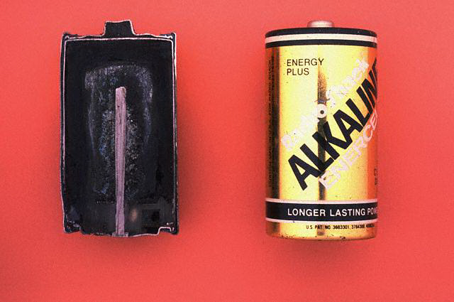
Circuit Symbols

Slide 2
What is this circuit symbol?
A lamp (or bulb)

Slide 3
What is this circuit symbol?
A cell

Slide 4
What is this circuit symbol?
A switch

Slide 5
What is this circuit symbol?
A
An ammeter

Slide 6
What is this circuit symbol?
A battery of two cells

Slide 7
What is this circuit symbol?
V
An voltmeter

Slide 8
What is this circuit symbol?
A resistor

Slide 9
What is this circuit symbol?
M
A motor

Slide 10
What is this circuit symbol?
A buzzer

Slide 11
What is this circuit symbol?
A fuse

Slide 12
What is this circuit symbol?
A variable resistor

Slide 13
What is this circuit symbol?
A light-dependent resistor

Slide 14
What is this circuit symbol?
A diode

Slide 15
What is this circuit symbol?
A light-emitting diode (LED)

Slide 16
What is this circuit symbol?
A thermistor

Slide 17
Using models to describe the way electricity works
We use models to help us understand things that we can’t see
by trying to explain what happens with things we can imagine
and understand.
Model 1
Pupils are the electrons in the wires.
The person representing the cell puts energy cards into their hands
as they pass by.
The pupils pass the energy cards to the person representing the lamp
And continue back to the ‘cell’ for more.

Slide 18
Animation 7.1

Slide 19
Animation 7.2

Slide 20
A circuit is like a central heating system in a house:
There is a pump that pushes water round the system. The water everywhere starts to move AT THE SAME TIME
There are pipes that CARRY the water.
In the pipes the water is FLOWING.
low pressure
High pressure
Boiler
and
pump
radiator
Flow
of
water
Notes:
Model three.

Slide 21
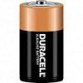

Current is a measure of how many charges flow past in a certain time
What is current
Bakery
Empty vans collect bread at the bakery
Charges collect energy at the battery
Charges return to the battery
These vans are full of bread
These charges have energy
These vans are empty
Charges deliver energy to the bulb
The vans deliver bread to the supermarket
Supermarket
What is this like in the supermarket model?

Slide 22
Current is a measure of how many charges flow past in a certain time
What is current?
Bakery
Count the number of vans going past in 10s
Count the number of vans going past in 10s
Supermarket
What is this like in the supermarket model?
How many vans go past in a certain time

Slide 23
Voltage is a measure of how much energy each charge carries
What is voltage?
What is this like in the supermarket model?

Slide 24
Voltage is a measure of how much energy each charge carries
What is voltage?
Bakery
Supermarket
What is this like in the supermarket model?
How much bread each van carries

Slide 25
We measure the current in a circuit using an
ammeter
The ammeter is measuring how much charge is passing through
every second
Charge is measured in Coulombs

Slide 26
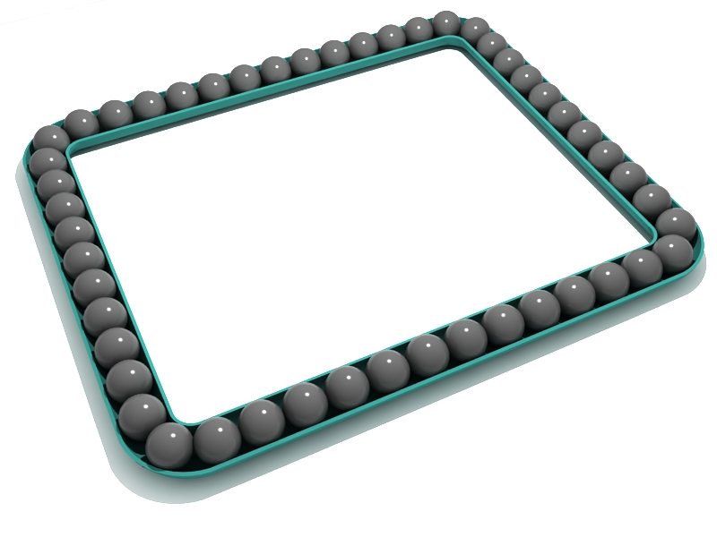
1 Coulomb every second = 1Amp

Slide 27
Charge is measured in Coulombs.
If one Coulomb (C) of charge passes a point in the circuit
every second then the current flowing is 1Amp
1 Amp = 1 Coulomb per second

Slide 28
When a current of 1Amp is flowing in a circuit,
6000000000000000000 (6X 10¹⁸) electrons flow past
a point in the circuit every second!

Slide 29
We use the letter ‘I’ for current in our equations.
We use the letter ‘Q’ for charge.
We use the letter ‘t’ for time .
Coulombs
Q
I =
t
Amps
secs
(Current is how quickly charge is flowing)

Slide 30
A current of 2 A flows for 30 seconds through a lamp.
How much charge has moved?
A current of 12 A flows for 20 minutes into an electric cooker.
How much charge has the cooker used?
If 18400 C of charge flows through an air conditioning unit every hour, what current does it draw?
A current of 3 A flows into a television set. For how long would it take 1500 C of charge to flow through it?

Slide 31
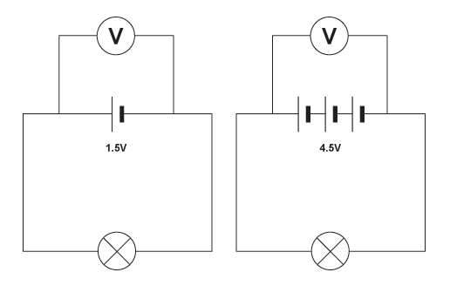
The voltage of a cell tells us how much energy that cell
can give to each Coulomb of charge
We measure the voltage across a component with a
voltmeter

Slide 32
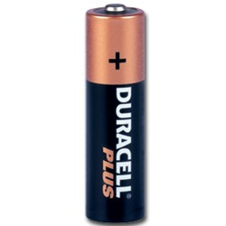

The Coulombs of charge flow from a place of high electrical
potential to lower electrical potential.
A 1.5V cell can give 1.5Joules of energy to each Coulomb of charge.
Each Coulomb of charge can do 1.5Joules of work in the circuit.

Slide 33
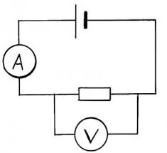
A voltmeter is put across a component to tell us how much energy
the charges are losing as they go through the component
1.5V

Slide 34
Circuit 1
Circuit 1 – basic series circuit
+
-

Slide 35
Circuit 2
Circuit 2 – basic series circuit with ammeter (move this around to and note the current at different points) and voltmeter
+
-
A
V

Slide 36
Circuit 3
Circuit 3 – basic parallel circuit with ammeter and voltmeter
+
-
A
V
V

