Slide 1
Colours
Learning Objectives:
Recall that white light is made of all the different colours.
Explain how we see colours.
Predict the colours of objects under different coloured filters.

Slide 2
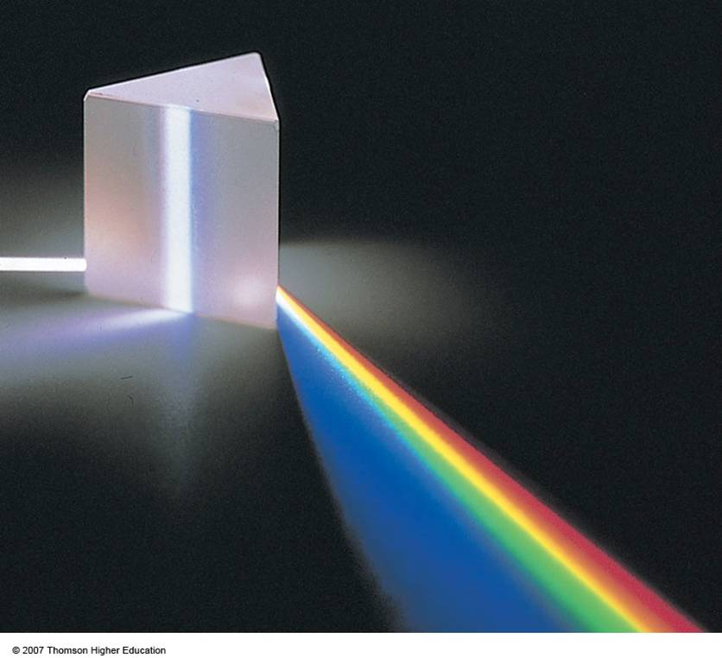
Colours
White light is actually a spectrum (range) of colours.
Dispersion – the separation of light into different colours
A prism can be used to disperse light into separate colours.

Slide 3
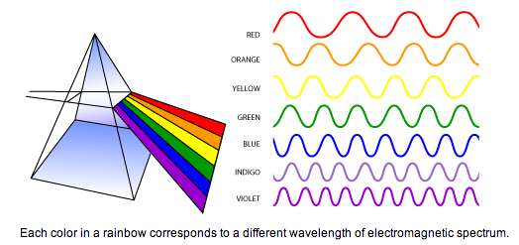
The Visible Light Spectrum (ROYGBIV)
Lowest Energy
Highest
Energy

Slide 4
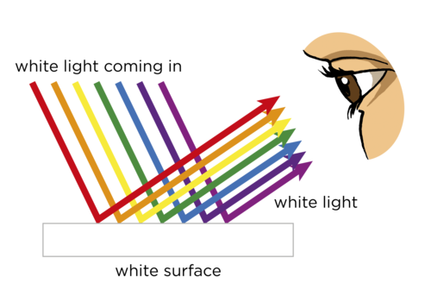

Slide 5
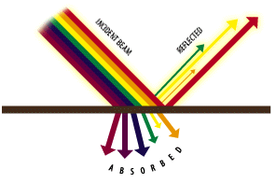
How do we see colours?
We see objects because light from a luminous object reflects off of the object.
Some of the colours of light are absorbed.
Only the colours that are NOT absorbed are reflected and enters our eyes.
This is the colour we see.

Slide 6
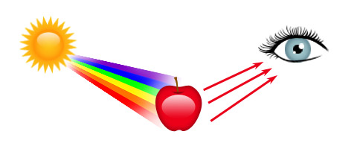
Colours are absorbed? Reflected?

Slide 7
Coloured Filters
Coloured filters absorb most colours of light.
Only one colour of light is transmitted.

Slide 8
How do coloured objects appear under a coloured filter?
In red light
White objects appear…
Red objects appear…
Green objects appear…

Slide 9
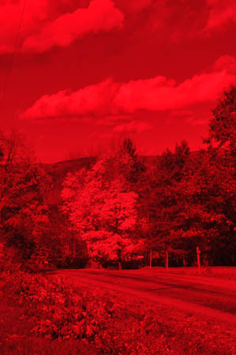
How do coloured objects appear under a coloured filter?
In red light
White objects appear… red
Red objects appear… red
Green objects appear… black!

Slide 10
Why?
A red filter only lets red light through.
A white object reflects all colours of light.
There is only red light, so that is all that is reflected.
The object appears red.
A green object only reflects green light.
There is NO green light (only red light).
So no colour shows. The absence of colour is black.

Slide 11
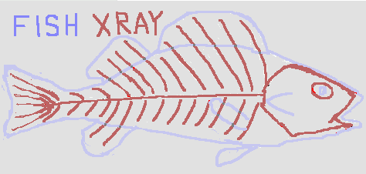

Slide 12
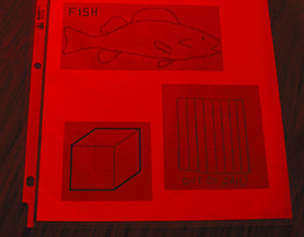
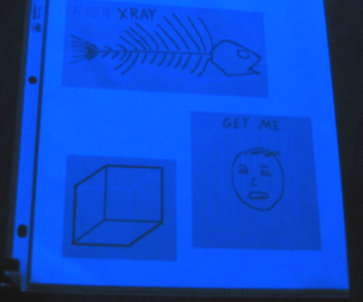
What lines are drawn in blue?
What lines are drawn in red?

