Slide 1
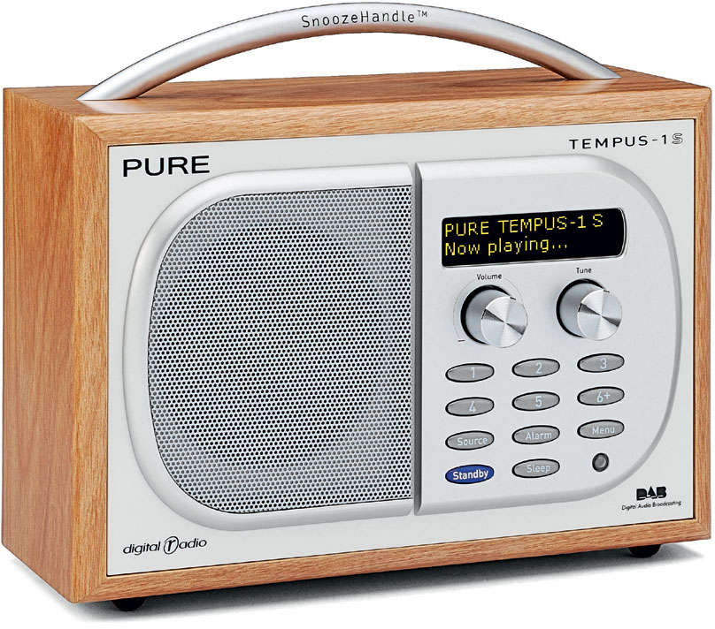
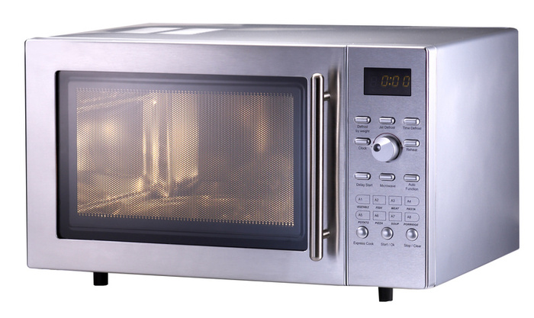
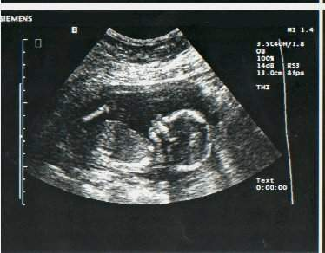
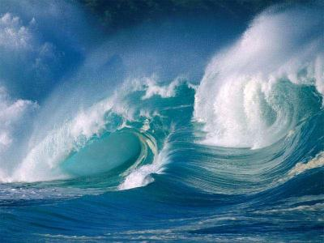
What do these have in common?

Slide 2
They all involve waves

Slide 3
Title: Waves
Learning Objectives:
Know what a wave is and what causes it
Know what a longitudinal and a transverse wave is
Know the definitions of amplitude, frequency and wavelength

Slide 4
Waves
In groups of 3, carry out the tasks at each station.
Read the instructions carefully then answer the questions on your sheet.
Don’t move to the next station until I tell you to.

Slide 5
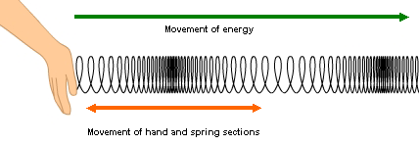
Station 1 – Longitudinal Waves
Station 2 – Transverse Waves
1) Draw an arrow on the picture below to show which direction the energy moved.
2) Areas where the spring is pushed together is a “compression” and areas where they are spread out is a “rarefraction”. Label these on the picture.
1) Draw an arrow on the picture below to show which direction the energy moved.
2) Is the energy moving in the same direction as the vibrations? Yes/No
Station 3 – Wave Measurements
_______________: The maximum movement (displacement) from the rest position to either a crest of a trough.
_______________: The length of a full cycle of a wave, such as the distance from crest to crest. Has the symbol λ and is measured in metres.
_______________: The number of complete waves passing a certain point per second. This is measured in hertz (Hz). 1 Hz is 1 wave per second.
Vibrations
Vibrations
Station 4 – Making Waves
Station 5 – Ping Pong Ball
1) Draw a picture of what happened:
1) Draw a picture of what happened:
2) The waves are caused by the v_____________ from the tuning fork.
2) The ball moves because e____________ is transferred by the sound waves.
Notes:
Print one for each pupil

Slide 6
Making Waves
The waves are caused by the vibrations from the tuning fork.

Slide 7
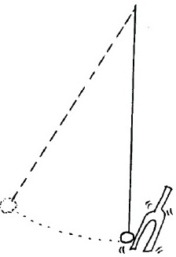
Ping Pong Balls
The ball moves because energy is transferred by the sound waves.

Slide 8
Longitudinal Waves
Compressions
Rarefactions
vibrations
Examples:
Sound waves and ultra sound
Some earthquake waves

Slide 9
Transverse Waves
Energy transfer of the wave moves perpendicular (90⁰) to the vibrations
Examples:
Light and all electromagnetic waves
Ripples on water
Vibrations
Movement of energy

Slide 10
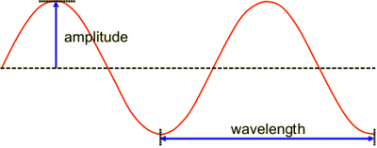
Wave Measurements
Amplitude: The maximum movement (displacement) from the rest position to either a crest of a trough.
Wavelength: The length of a full cycle of a wave, such as the distance from crest to crest. Has the symbol and is measured in metres.
Frequency: The number of complete waves passing a certain point per second. This is measured in hertz (Hz). 1 Hz is 1 wave per second.
crest
trough
Frequency = $\frac{Number of waves}{seconds}$

Slide 11
(seconds)
0
5
10
15
20
25
30
15
10
5
(mm)
0
-5
-10
-15
0
100
200
300
400
500
600
(mm)

Slide 12
Fill in the Blanks
Waves carry _______________ from one place to another. Waves are caused by ______________. Waves that go up and down are called _________________ waves. The vibrations travel _______________ to the direction of the energy transfer of the wave. Waves that vibrate backwards and forwards are called _______________ waves. The vibrations travel in the _________ direction as the direction of the energy transfer of the wave. In a longitudinal wave, areas where the particles are pushed together are called ______________ and areas where the particles are spread out are called _______________. Waves can be measured. The displacement from the rest position is called the ______________. The length of a full cycle of a waves is called the ______________. The number of complete waves passing a certain point in a second is called the _______________.
Words: frequency, energy, longitudinal, transverse, vibrations, same, perpendicular, rarefaction, compressions, amplitude, wavelength
Notes:
Print one for each pupil

Slide 13
Answers
Waves carry energy from one place to another. Waves are caused by vibrations. Waves that go up and down are called transverse waves. The vibrations travel perpendicular to the direction of the energy transfer of the wave. Waves that vibrate backwards and forwards are called longitudinal waves. The vibrations travel in the same direction as the direction of the energy transfer of the wave. In a longitudinal wave, areas where the particles are pushed together are called compressions and areas where the particles are spread out are called rarefactions. Waves can be measured. The displacement from the rest position is called the amplitude. The length of a full cycle of a waves is called the wavelength. The number of complete waves passing a certain point in a second is called the frequency.
Words: frequency, energy, longitudinal, transverse, vibrations, same, perpendicular, rarefaction, compressions, amplitude, wavelength
Notes:
Print one for each pupil

