Slide 1
Electricity
L1: Circuit Diagrams
Learning Objectives:
Recall the symbols and name for circuit components.
Draw circuit diagrams for simple circuits.
Describe what a conductor is.
Explain why you need a complete circuit for electricity to flow.

Slide 2
What do you already know about electricity?

Slide 3
What is electricity?
Electricity = the flow of charged particles (electrons).
Electricity can only flow through materials that are conductors in a complete circuit.
Conductor = materials that allow electricity to flow through (metals)
Insulator = materials that do NOT allow electricity to flow (plastic)
Complete circuit = a closed loop with no gaps

Slide 4
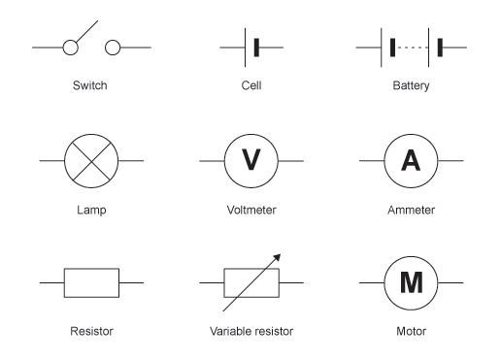
Component (Part of the Circuit) | Symbol | Function
Cell |  | Gives energy (voltage) to the circuit.
Wire |  | Conductor that allows electricity to flow.
Light Bulb |  | Uses electrical energy to give out light energy.
Switch |  | Makes a gap in the circuit to turn it on and off.

Slide 5
Component (Part of the Circuit) | Symbol | Function
Battery |  | Multiple cells put together, gives more energy (voltage) to the circuit.
Resistor |  | Makes it difficult for electricity to flow, decreases the current (amount of electricity).
Ammeter |  | Measures the current (amount of electricity) in the circuit.
Voltmeter |  | Measures the voltage (energy) in the circuit.
A
V

Slide 6
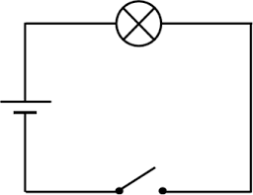
Circuit Diagrams
What components are in this circuit?

Slide 7
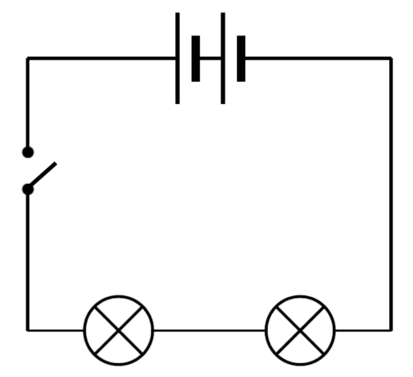
Circuit Diagrams
What components are in this circuit?

Slide 8
Rules for drawing circuit diagrams
The circuit should have a rectangular shape.
The circuit should not have any gaps (unless there is a switch).
Use straight lines (using a ruler) for the wires.
Do not put any components on the corners.

Slide 9
Draw the following circuit diagrams
A circuit with…
A cell, a lightbulb, and a switch.
A battery of two cells and two lightbulb.
A cell, a switch, and two light bulbs.
A battery of two cells, a resistor, a switch, and three light bulbs.

Slide 10
1.
2.
3.
4.

Slide 11
Practical: Building Circuits
Draw a circuit with a battery pack, a light bulb, a switch, and an ammeter.
Set your battery pack to the lowest setting (1.5 V).
Build the circuit, it does not matter which order you put them in as long as they are all in one big loop.
Write down the current (A) of the circuit (using the ammeter).
Turn the battery pack to 3V, 4.5V, and 6V. Record the current for each voltage and any observations about the light bulb.
Add another lightbulb to your circuit. Record the current for a circuit with two lightbulbs and any observations.

