Slide 1
Topic: Infection L1: Communicable Diseases
Learning Objectives:
Describe what communicable disease is.
Describe what a pathogen is and the different types.
Describe how disease is spread.
Explain how to prevent the spread of infection.
Describe examples of diseases caused by different pathogens.

Slide 2
Vocabulary List: Topic 3
Pathogen
Microorganism/microbe
Communicable disease
Infect/infectious
Bacterium/bacteria
Virus
Protists – single celled, eukaryotic organism that can cause disease
Fungus/fungi
Writing Task
Write a summary paragraph using all these terms correctly.

Slide 3
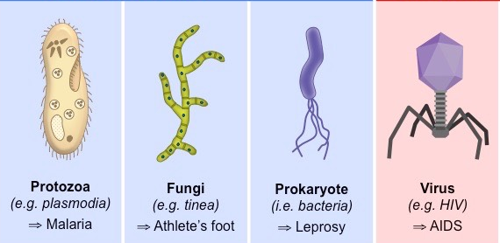
Pathogens
Pathogens are microorganisms that cause disease.
Types of pathogens:
Bacteria
Viruses
Fungi
Protozoa/Protist

Slide 4
Cells Size Comparison (Put the pathogens in order from smallest to largest)
fungus

Slide 5
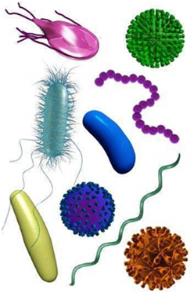
Spread of Disease
Communicable diseases can spread to plants and animals from infected organisms.
Organisms are infected when pathogens enter the body, reproduce, and make the organism ill.

Slide 6
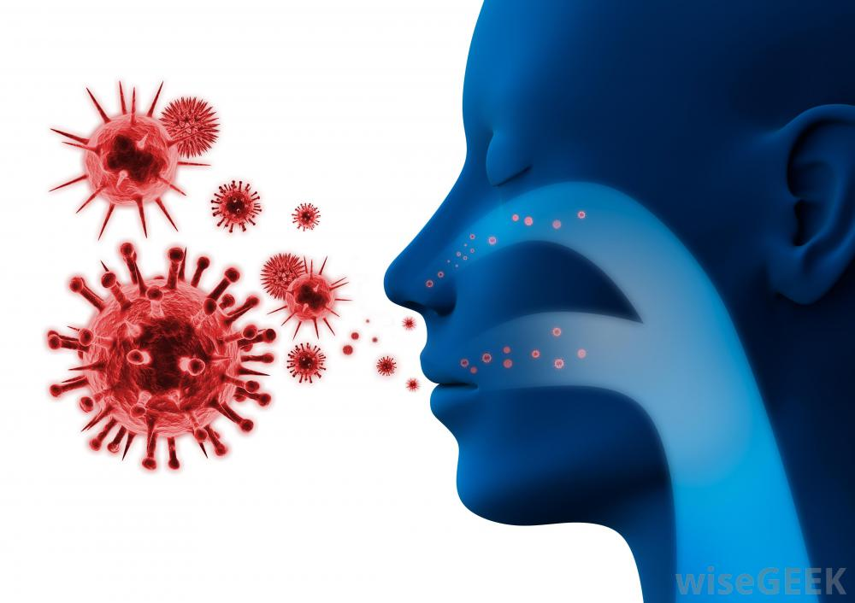
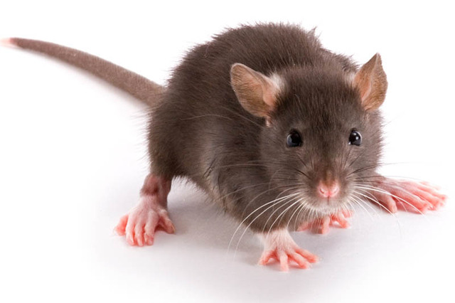
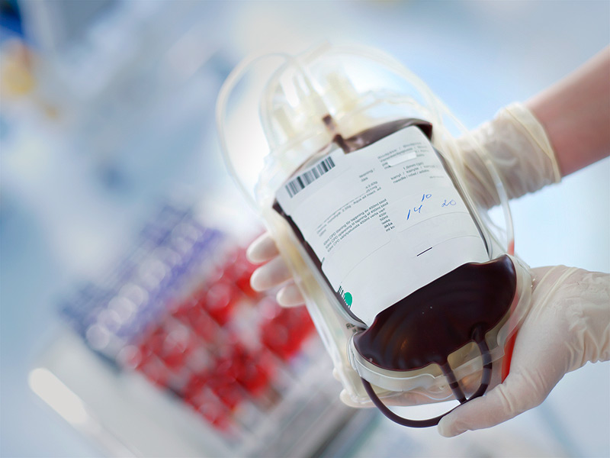
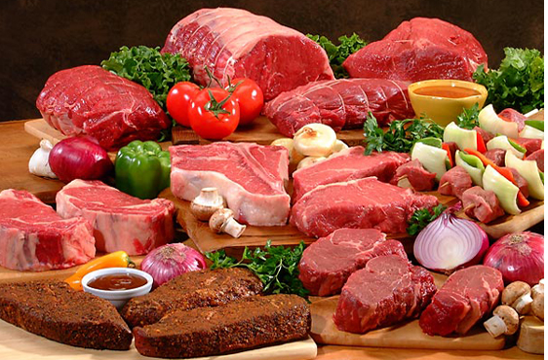
How does infection spread?
Direct contact
Food
Water
Air
Vectors (animal host)
Exchange of Bodily Fluids

Slide 7
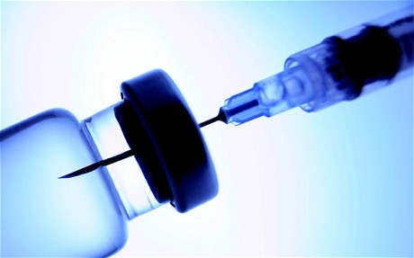
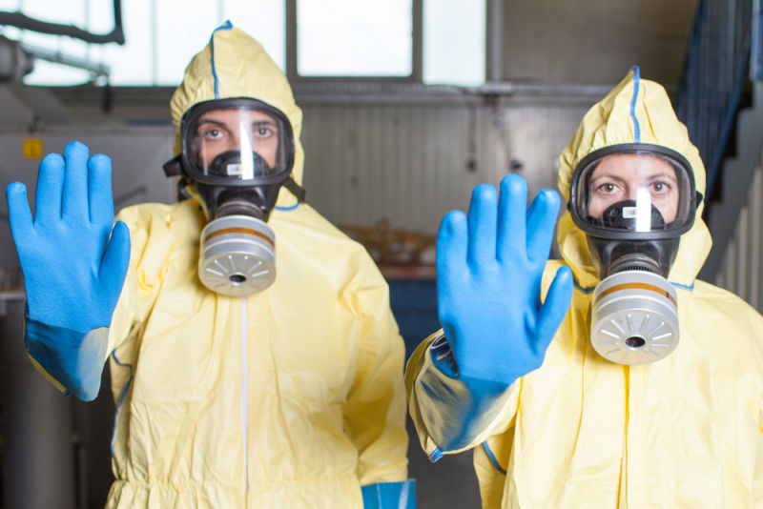
Preventing the Spread of Disease
Good hygiene
Example: washing your hands
Deal with vectors
Destroy
Protect against them
Quarantining
Isolating infected individuals
Vaccination
Become immune to disease

Slide 8
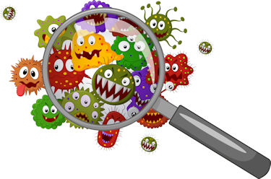
Different Pathogens and Different Diseases
Read the information on pg. 124-128 and fill in the table summarising the differences between pathogens and the diseases they cause.

