Slide 1
L1: Different Rocks and Weathering
Learning Objectives:
1. Recall the three different types of rocks
2. Describe the characteristics of the different types of rocks.
3. Compare chemical and physical weathering.
4. Explain how the structure of the different rocks links to their properties.

Slide 2
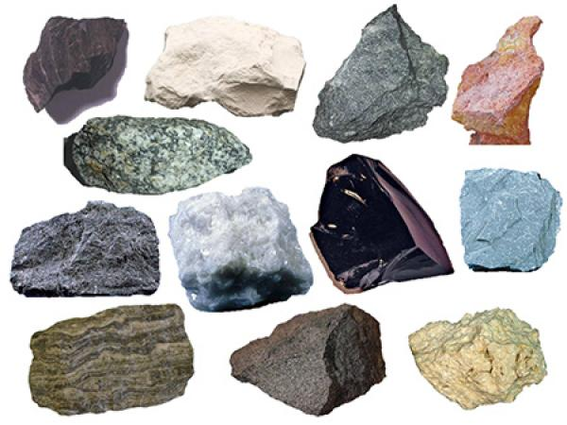
What is different about these rocks?

Slide 3
Types of Rocks
Sedimentary
Igneous
Metamorphic

Slide 4
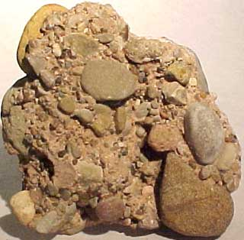
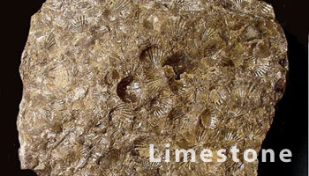
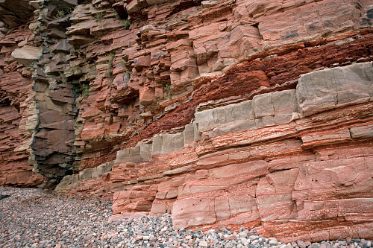
Sedimentary Rocks
Made of grains (little pieces of rock) with rounded edges
Gaps between grains
Porous = has gaps between grains, absorbs water
Found in layers
Can contain fossils

Slide 5
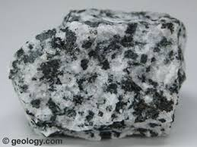
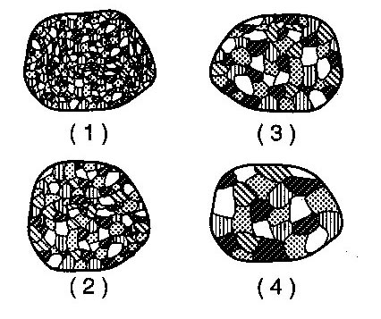
Igneous Rocks
Interlocking crystals
Pieces with sharp edges
No gaps
Not porous
No layers

Slide 6
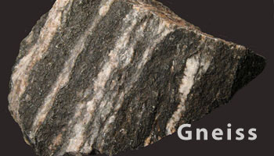
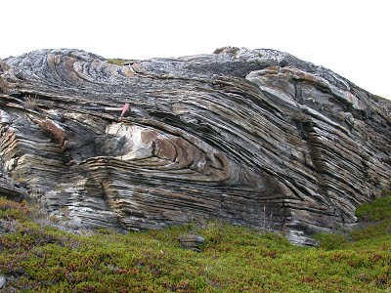
Metamorphic Rocks
Interlocking flattened crystals
Not porous
Found in layers

Slide 7
Can you identify the different rocks?
Look at the different rocks around the room and see if you can identify which rocks are:
Sedimentary
Igneous
Metamorphic

Slide 8
Name of Rock | Type of Rock
Basalt | Igneous
Chalk | Sedimentary
Conglomerate | Sedimentary
Gabbro | Igneous
Granite | Igneous
Limestone | Sedimentary
Marble | Metamorphic
Quartzite | Metamorphic
Rhyolite | Metamorphic
Sandstone | Sedimentary
Schist | Metamorphic
Slate | Metamorphic

Slide 9
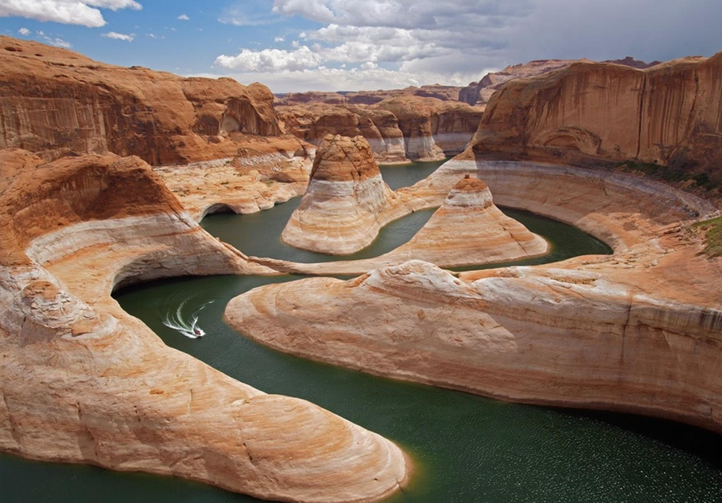
Weathering
Weathering = breaking up and wearing away
Types of weathering
Chemical
Physical

Slide 10
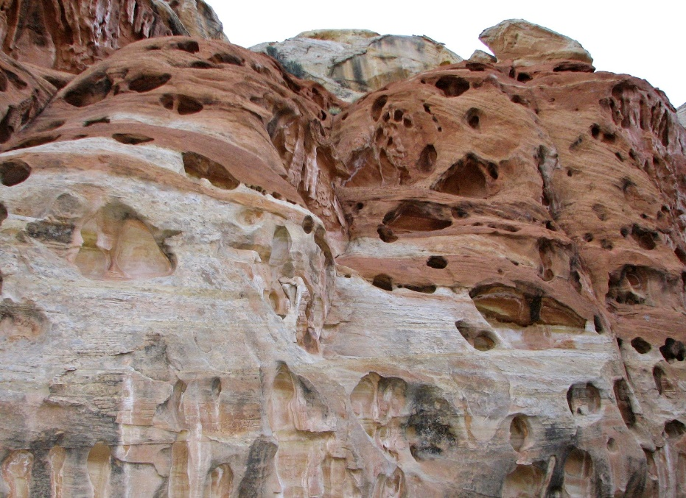
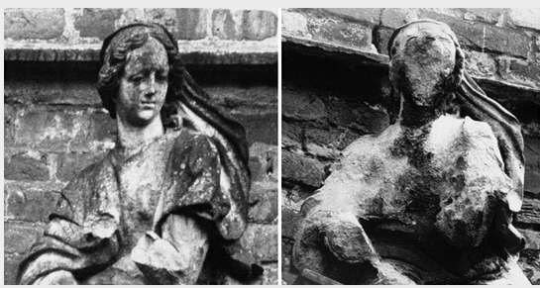
Chemical weathering = weathering caused by substances in air or water having a chemical reaction with the rock

Slide 11
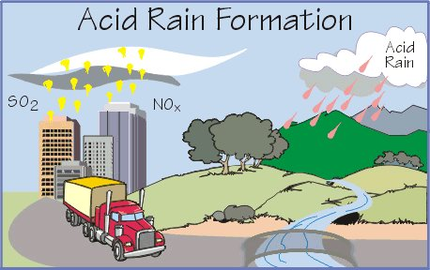
What type of chemical do you think weathers rocks?
ACID
Rainwater is slightly acidic because carbon dioxide reacts with water to form a weak acid.
However, acid rain from pollution is a stronger acid and weathers rocks more quickly.

Slide 12
Practical: Chemical weathering
Put a few drops of dilute acid onto the different types of rocks and write down your observations.

Slide 13
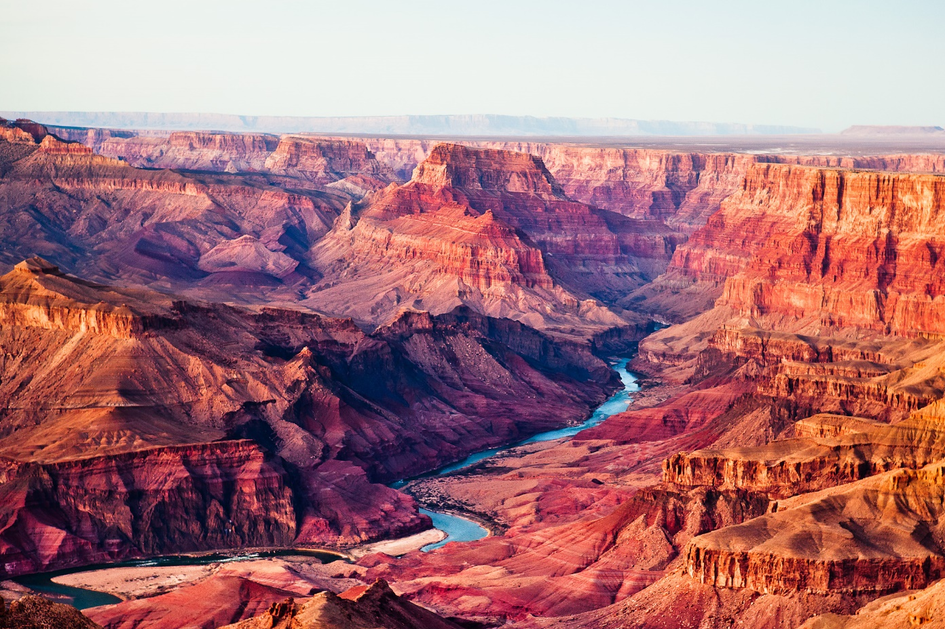
Physical weathering = weathering caused by physical changes such as:
changes in temperature
freezing and thawing
the effects of wind, rain, and water.

Slide 14
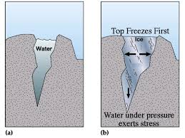
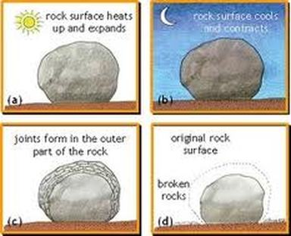
Physical Weathering Examples: Summarise Each Type of Physical Weathering
Freeze-Thaw Weathering
Onion Skin Weathering

Slide 15
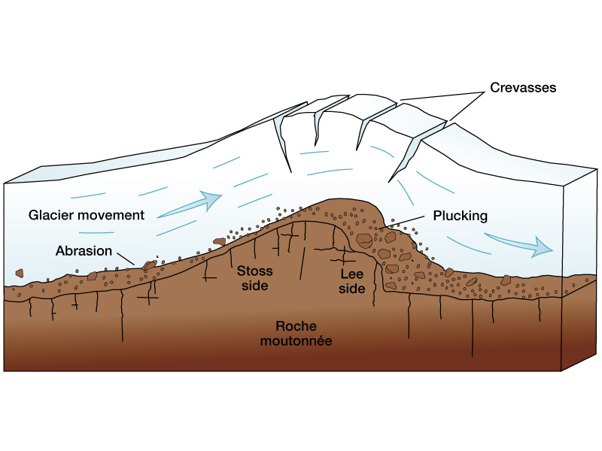
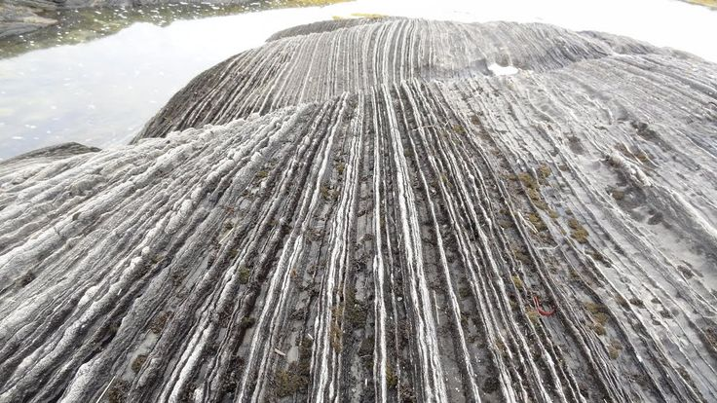
Physical Weathering Examples
Glacial Weathering (Caused by Abrasion – Damage by Scraping)

Slide 16
Weathering happens to all rocks
Suggest which type you think will weather the fastest and explain why.
Sedimentary
Weakest bonds between the grains
Porous, water/acid will get into the rock and weather from the inside or freeze and break the rock.

Slide 17
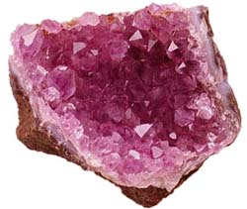
Which type of rock?

Slide 18
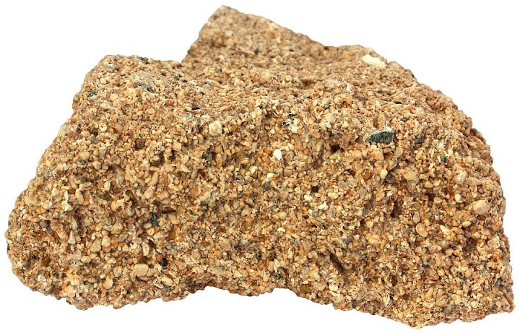
Which type of rock?

Slide 19
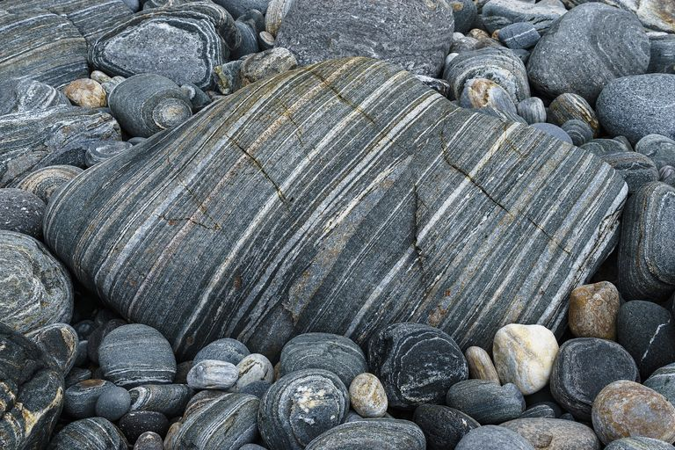
What type of rock?

