Slide 1
L2: Defence Against Disease
Learning Objectives:
Describe the body’s first line of defence against pathogens.
Describe the ways the immune system deals with pathogens.
Explain how white blood cells deal with pathogens in different ways.
Evaluate the effectiveness of vaccinations in preventing disease.

Slide 2

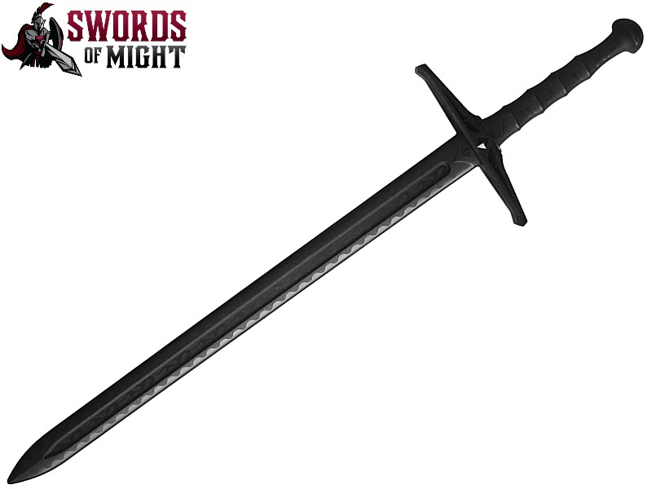
Defence Against Disease
The body has two main ways of defending itself against pathogens.
Non-specific defence system: prevents pathogens from getting in
Immune system: destroys pathogens that do enter

Slide 3
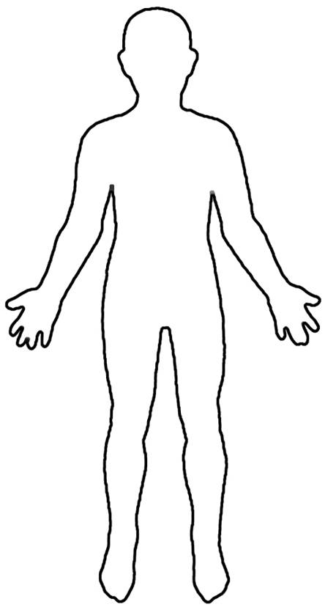
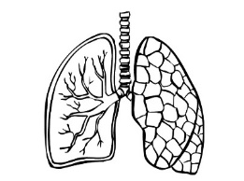
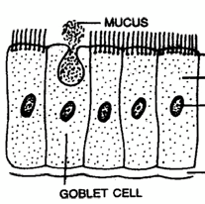

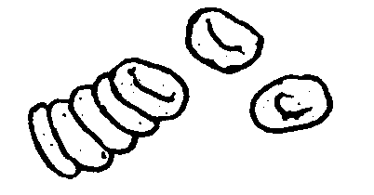
Enzymes in tears have antiseptic properties (kills bacteria).
Cells in the trachea and bronchi produce mucus. Pathogens get stuck to the mucus. Cilia (tiny hairs) sweep the mucus into the stomach.
The skin is the very first barrier to entry. Sweat also contains enzymes to kill bacteria.
The First Line of Defence:
Preventing Pathogens Getting In
CILIA
Blood clotting is very important in retaining the skins barrier function by forming a scab to stop pathogens entering.
Hydrochloric acid in the stomach kills bacteria.

Slide 4
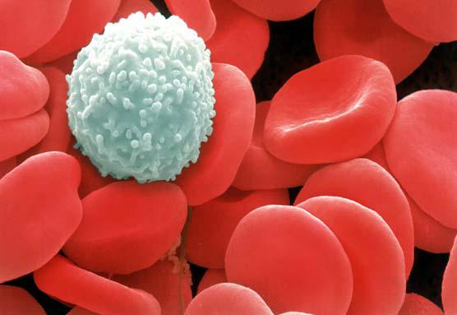
Second Line of Defence: Immune System
White blood cells are a vital part of the immune system as they deal with pathogens that do enter the body.

Slide 5
White Blood Cells
They deal with pathogens in three main ways:
Phagocytosis – ingesting pathogens
Producing Antitoxins – these counteract the toxins produced by pathogens
Producing Antibodies – these tag and disable pathogens (these also make you immune to a disease)

Slide 6
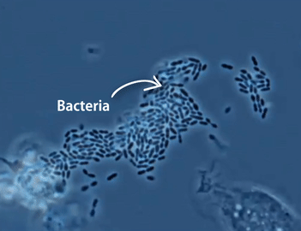
Phagocytosis

Slide 7
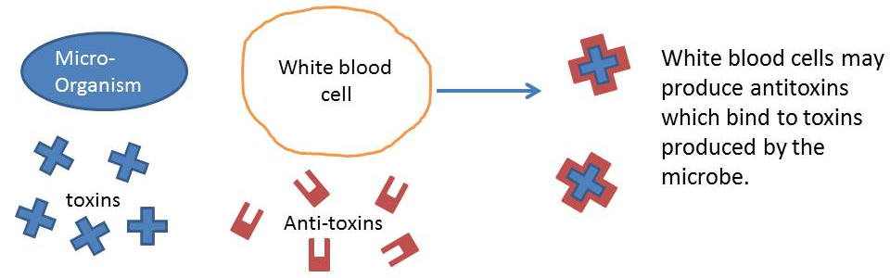
Produce Antitoxins

Slide 8
Antibodies
Read pg. 130-131 and describe the role of antibodies in destroying pathogens and making you immune to a disease.
Use the following vocabulary terms in your answer:
  Antibody
  Pathogen
  Antigen
  White blood cell
  Immune

Slide 9
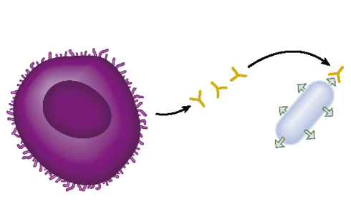
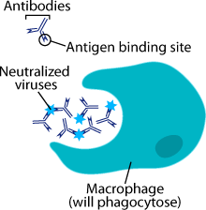
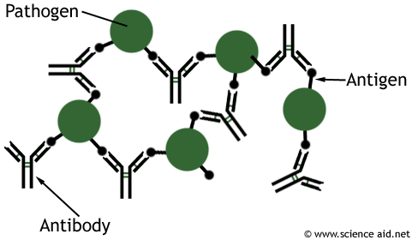
Antibodies
1.
White blood cells produce antibodies that recognise a site on the surface of the pathogen called an antigen.
Antibodies tag and disable pathogens and make them stick together.
Other white blood cells recognise the antibodies and ingest the pathogens.
2.
3.

Slide 10
Specific Immune Response
(MORE DETAILED THAN YOU NEED TO KNOW FOR YOUR EXAMS)
We are going to look at the immune response in more detail.
Before the specific pathogen is recognised, your body has a general immune response, which is very crude.
Many of your own cells are destroyed in the process, making you feel ill.
A specific immune response targets only the pathogen but it takes time to start the process.

Slide 11
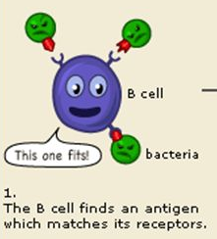
Step 1: Recognising the pathogen
White blood cells which can make antibodies (lymphocytes) only recognise one specific antigen. (think lock and key)
The body produces so many different white blood cells that most pathogens will contain an antigen that is recognised.
But it can take awhile for the special white blood cell that recognises the pathogen to be found, which is why you get sick.

Slide 12
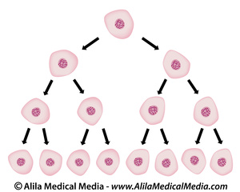
Step 2: Making more white blood cells
Once the special white blood cell recognises the pathogen, the cell divides to make more of itself. It then produces proteins that activate other white blood cells.

Slide 13
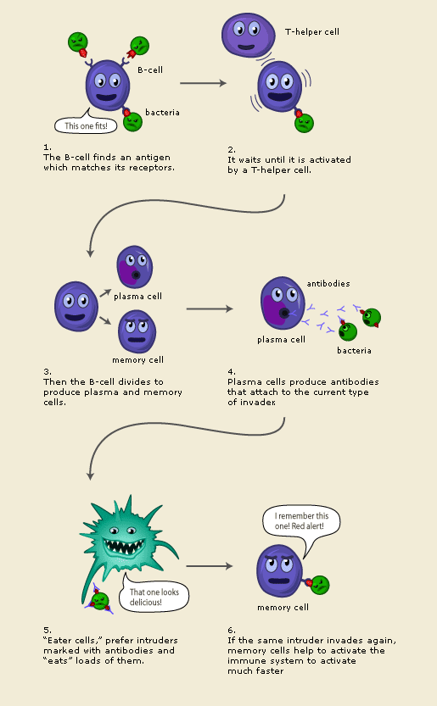
Step 3: Antibodies are produced
The white blood cells then produce antibodies that recognise a specific antigen on the surface of the pathogen.

Slide 14
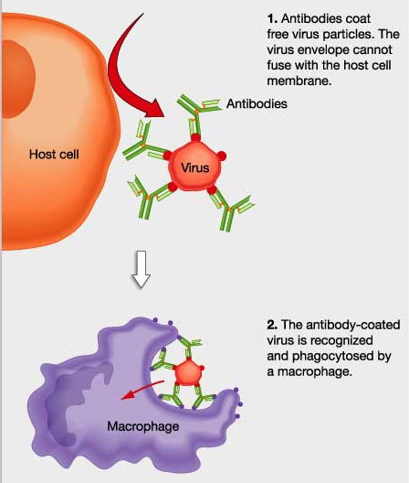
Step 4: Antibodies disable pathogens and tag them for destruction
Antibodies cover the surface of the pathogen and disable it.
It also causes the pathogens to stick together.
White blood cells (macrophages) recognise the antibodies and ingest the pathogen.
Over time, all of the pathogens are removed.

Slide 15
Step 5: Immunity
After the infection has been successfully removed some antibodies still remain in the blood for protection.
They will recognise the pathogen quickly if it returns and will get rid of the pathogen before you get sick.
Most white blood cells that were produced to fight the infection die off once their job is done.
But some white blood cells, called memory cells, remain and will activate the immune system much more quickly if the pathogen returns.

Slide 16
Vaccination
Read pg. 132 and describe what a vaccination is and how does it work.

Slide 17
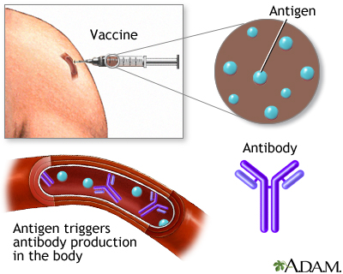
Immunisations (Vaccinations)
A vaccine containing dead or inactivated pathogen is injected into your body.
Vaccinations force your body to produce a specific immune response without you getting a dangerous infection.
Your body will then make antibodies and memory cells recognising the pathogen so that you will fight it off quickly and you won’t get ill.
You are now immune to the disease caused by that pathogen.

