Slide 1
Starter: Odd one Out
For the next few slides decide which is the “odd one out”.
For each one complete the following sentence.
The odd one out is… (you can draw it)
because it is…
all the others are…
Make sure to use the terms atom, element, molecule, compound.

Slide 5
L2 Periodic Table
Learning Objectives:
Describe what the periodic table is.
Recognise some elements and their symbols.

Slide 6
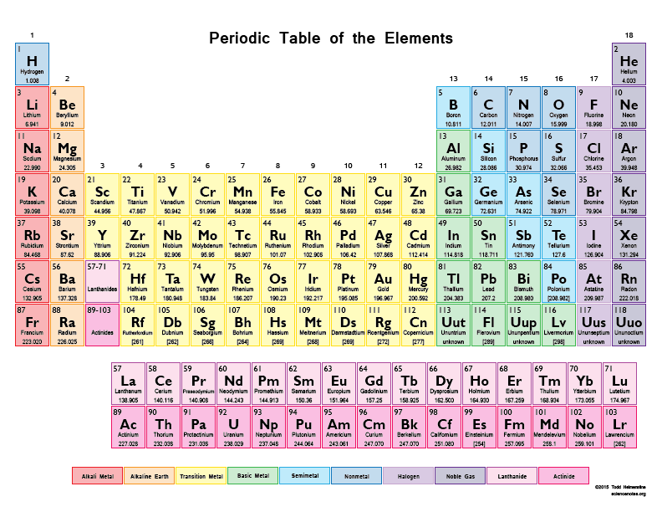
The periodic table lists all the elements.
It is arranged into different groups that have similar properties

Slide 7
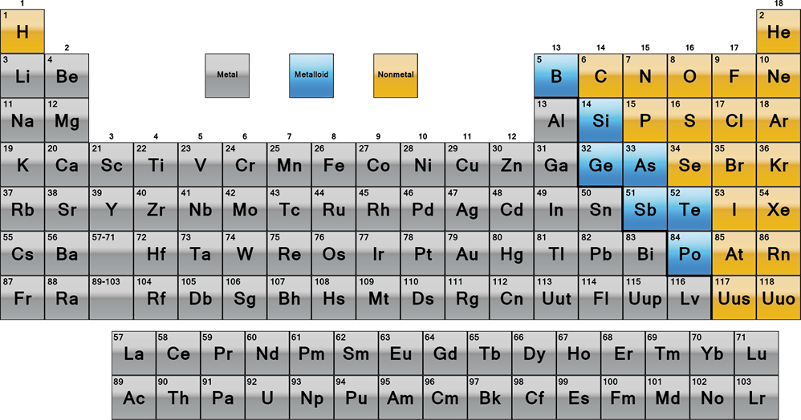
Colour in your periodic table to show where metals are located.

Slide 8
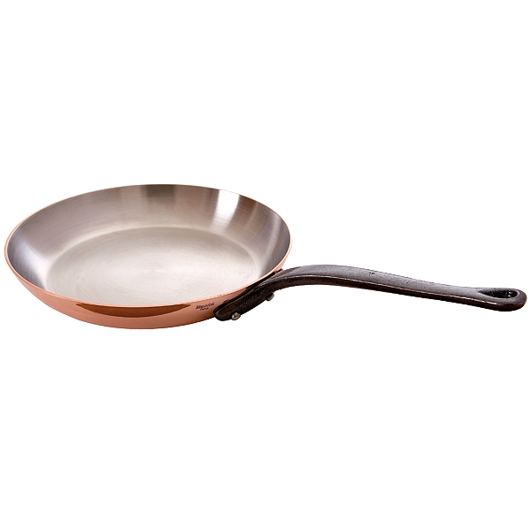
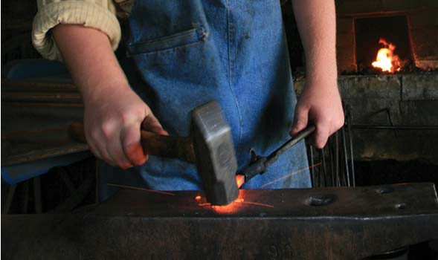
Properties of Metals
Shiny
Good conductors of heat
Good conductors of electricity
Malleable (can be hammered into shape)
Ductile (can be made into wires)
High melting and boiling points

