Slide 1
Waves Quiz
What are the two different types of waves?
How are they different?
Draw an example of each type.
Define:
Amplitude
Wavelength
Frequency

Slide 2
L2 – Light and Reflection
Learning Objectives:
Recall that light is a transverse wave.
Describe what happens to light when it meets an object.
Draw ray diagrams for reflection.
Explain why rough surfaces do not reflect images.

Slide 3
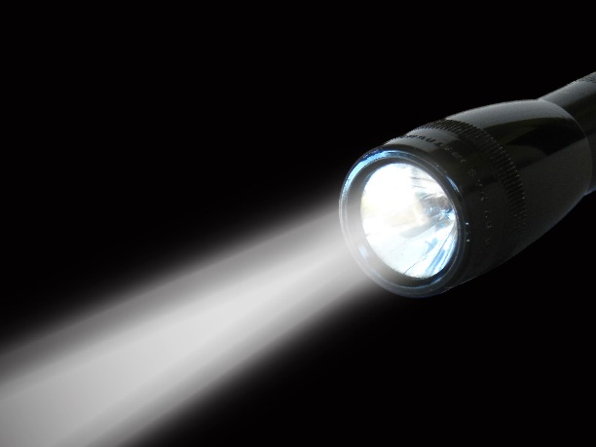
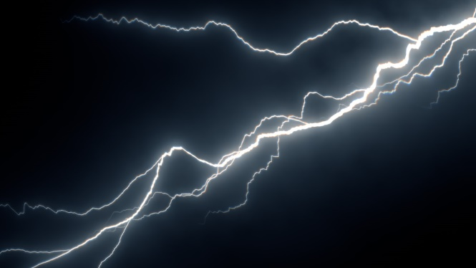
What do you know about light?

Slide 4
Light
Visible light is a type of electromagnetic wave.
Properties of light waves:
Type of energy
Very fast (about 300 million m / s, that’s 671 million mph!)
Can travel through a vacuum (empty space)
Transverse wave
Travels in straight lines

Slide 5
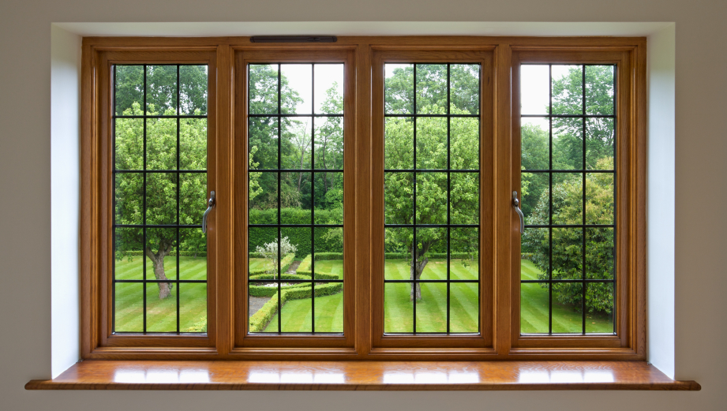
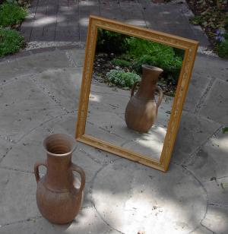
What happens when light hits an object?

Slide 6
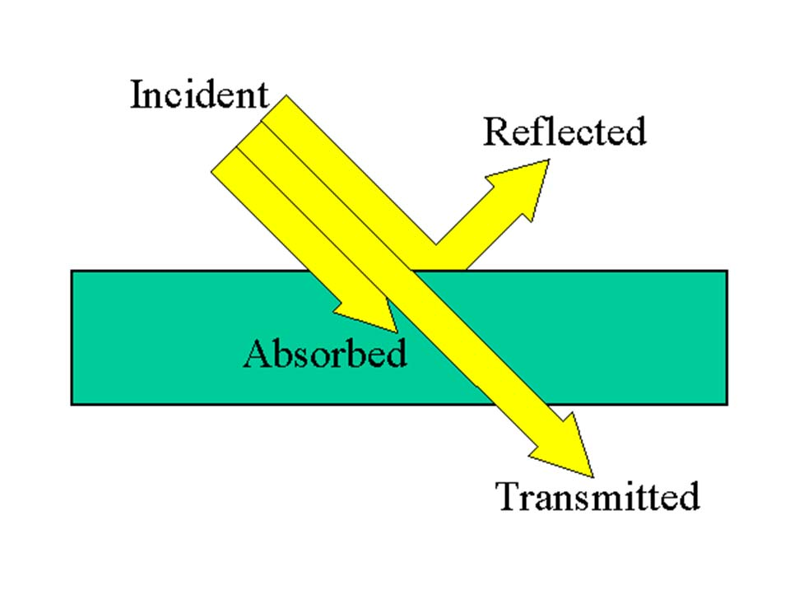
What happens when light hits an object?
Light can be…
Reflected – bounce off
Absorbed – taken in
Transmitted – passes through

Slide 7
Light sources
Luminous objects = objects that give out light
Non-luminous objects = objects that do not give off light

Slide 8
Ray Diagrams
Light travels in straight lines and can be represented by a ray diagram.
A light ray is represented by a straight line with an arrow in the middle to represent the direction the light is traveling.
We see luminous objects when light from the object enters our eyes.

Slide 9
How do we see objects that don’t give off light?
Light reflects off of objects, then enters our eye.

Slide 10
Why do shadows form?
Transparent = light is able to pass through
Opaque = light cannot pass through, it is absorbed
Shadows form when an opaque object blocks light leaving a dark area.

Slide 11
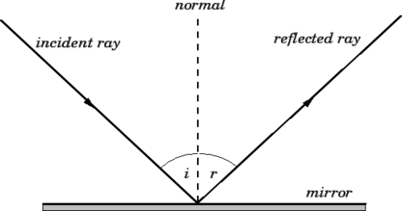
Ray Diagrams for Reflection off a Plane Mirror
Plane mirror = flat mirror
Incident ray = ray going IN to the mirror
Normal = imaginary line perpendicular (90º) to the mirror (dotted line)
Reflected ray = ray reflected off the mirror
Angle of incidence = angle between the normal and the incident ray
Angle of reflection = angle between the normal and the reflected ray

Slide 12
Practical: Reflection
We are going to investigate how the angle of incidence is related to the angle of reflection.

Slide 13
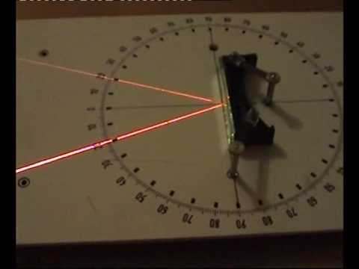
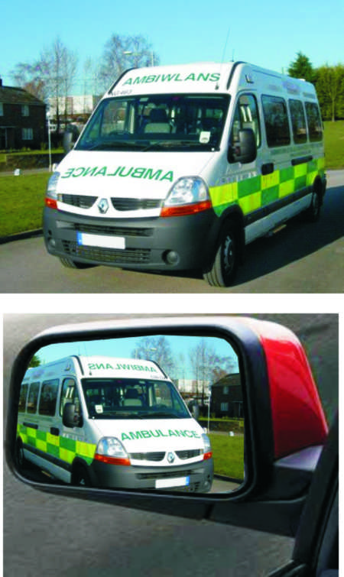
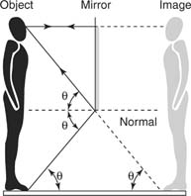
Rules for Reflection in a Plane Mirror
The angle of incidence is equal to the angle of reflection.
The image will be upright.
The image will appear the same distance to the mirror.
The image will be flipped right/left.

Slide 14
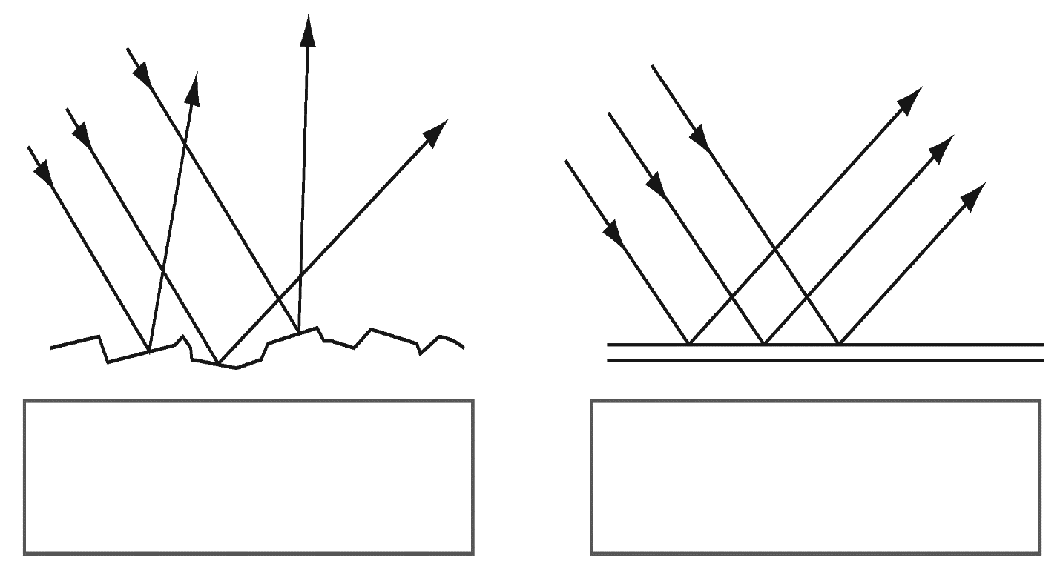
Why do rough surface not reflect an image?
Rough surfaces reflect light unevenly, so no image is formed.
Smooth surface reflect light evenly so an image is formed.

