Slide 1
L3 Refraction
Learning Objectives:
Describe refraction.
Draw ray diagrams for refraction.
Explain why light refracts.

Slide 2
Practical: Refraction (Draw the diagrams)
Experiment 1: Set the ray box and prism with the point facing up (light passes through a rectangular shape at an angle).
Experiment 2: Set the ray box and prism with the triangle flat (light passes through triangle at an angle).
Ray Box
Ray Box

Slide 3
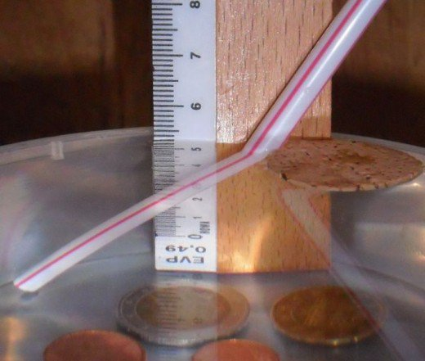
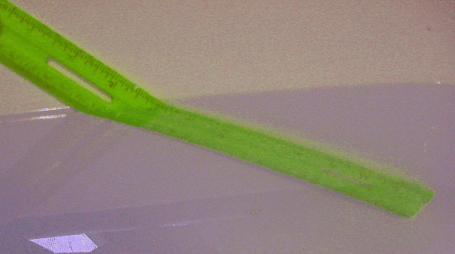
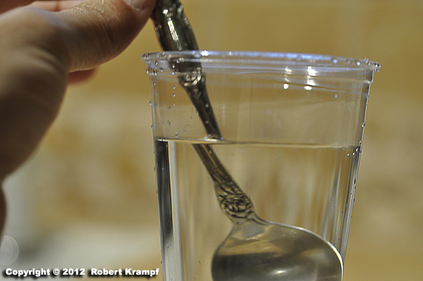
What is refraction?
Refraction = the bending of light when it passes through different mediums (materials that light can pass through).
This is why objects in water look a bit strange.

Slide 4
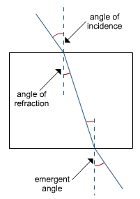
Ray Diagrams for Refraction
Normal
Incident ray
Incident ray = the ray going IN (towards) the surface
Normal = imaginary line drawn where the ray meets the surface at 90º to the surface
Angle of incidence = the angle between the normal and the incident ray
AIR
GLASS

Slide 5
Ray Diagrams for Refraction
Normal
AIR
refracted ray = the ray going OUT (away from) the surface
Angle of refraction = the angle between the normal and the refracted ray
GLASS
refracted ray

Slide 6
Ray Diagrams for Refraction
AIR
When the light leaves the glass block, it refracts a second time.
This time it is going from glass to air.
Now there is a new incident ray and refracted ray.
GLASS
Incident ray
Angle of incidence
refracted ray
Angle of refraction
Normal

Slide 7
Why does refraction happen?
Different mediums (materials) have different densities.
The more dense a medium, the slower light travels.
If light reaches an interface (where the mediums meet) at an angle, part of the light ray travels slows down first.
This causes the ray to bend towards the normal (slower side).

Slide 8
Which direction will the light bend?
Less Dense → More Dense
TOWARDS the normal
Example: Air → Glass
More Dense → Less Dense
AWAY from the normal
Example: Water → Air
Angle of incidence
Angle of refraction

Slide 9
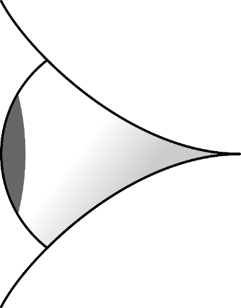
Effects of Refraction
Refraction makes objects appear in a different location then they actually are.
Image
Actual

