Slide 1
Treating Disease
Learning Objectives:
Describe how antibiotics work.
Explain why viral infections are more difficult to treat.
Analyse the development of antibiotic resistant bacteria.
Evaluate the impact of antibiotic resistant bacteria.
Link mutations in pathogens to endemics and pandemics.

Slide 2
Starter: Discovery of Penicillin
Read the story of the discovery of penicillin and answer the questions on the worksheet.

Slide 3
What medicines do we take when we are ill?
Think of as many different medicines as you can.
What do these medicines do?
How do they help you when you are ill?

Slide 4
Vocab
Write a summary paragraph including all of the following terms.
Antibiotics
Painkillers
Aspirin
Penicillin

Slide 5
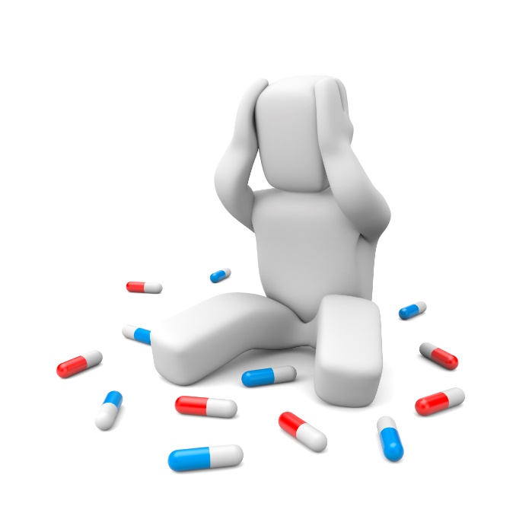
Most common medicines do not treat disease
Medicines like paracetamol (pain killers) treat the symptoms of the disease and help you to feel better when you are ill with common illnesses like cold or flu.
HOWEVER, they do NOT treat the pathogen.
Your immune system has to overcome the infection on it’s own.

Slide 6
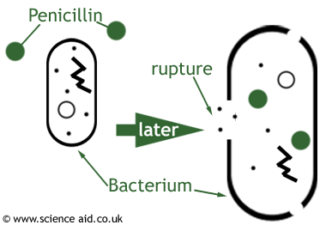
Antibiotics
Antibiotic = drug used to kill bacteria
The development of antibiotic drugs like penicillin was able to cure many bacterial infections that would have killed millions of people.
Antibiotics damage bacterial cells but do not harm human cells.
There are general antibiotics that treat many types and specific antibiotics that are used to treat specific bacterial infections.
Notes:
https://www.brainpop.com/science/diversityoflife/bacteria/

Slide 7
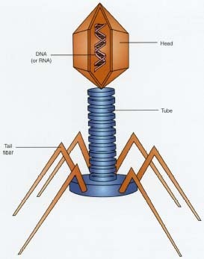
Why are viruses more difficult to treat?
Antibiotics have no effect on viruses.
Viruses reproduce inside human cells.
Since they are inside the body’s cells, it is very difficult to develop drugs that kill the virus without harming human cells.
Antivirals do exist to treat viral infections.
They disrupts the virus’ function in some way but unlike antibiotics do not kill it directly.
Notes:
https://www.brainpop.com/health/diseasesinjuriesandconditions/viruses/

Slide 8
Antibiotic Resistant Bacteria
Video: Antibiotic Resistant Bacteria
Watch the video and answer the following questions:
What property allow bacteria to adapt to new conditions?
How does antibiotic resistant bacteria develop?
What human actions caused this to happen?
How can you prevent forming and spreading antibiotic resistant bacteria?

Slide 9
What property allow bacteria to adapt to new conditions?
Reproduce quickly, many mutations in DNA
How does antibiotic resistant bacteria develop?
Antibiotics kill off weak bacteria, small percentage of bacteria contain a mutation that makes it resistant to the bacteria. With no other bacteria to compete with them the antibiotic resistance bacteria flourish.
What human actions caused this to happen?
Doctors using antibiotics for minor infections, antibiotics used on livestock, overusing antibacterial products kill weakest bacteria and allow antibiotic resistant bacteria to develop.
How can you prevent forming and spreading antibiotic resistant bacteria?
Don’t overuse antibacterial products. Doctors should not unnecessarily prescribe antibiotics. Follow doctors instructions if given antibiotics for a specific bacterial infection. Maintain good hygiene, wash hands with soap and water.

Slide 10
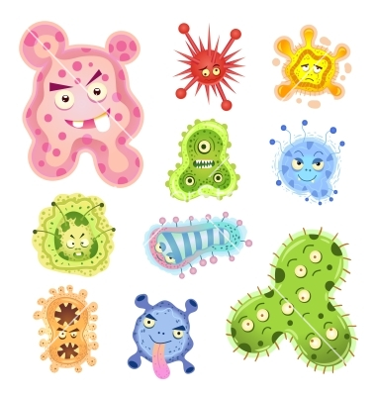
Mutation of pathogens cause new forms of diseases.
Even if you are immune to the original pathogen, you may not be immune to the mutated version.

Slide 11
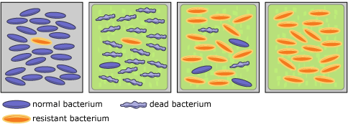
Natural selection leads to the development of antibiotic resistant bacteria

Slide 12
Development of New Drugs
Drug = a chemical substance that changes how the body functions
Drugs can be developed from a chemical in a natural substance (such as a plant) or can by synthesised (artificial made).
Examples:
Aspirin was originally derived from a chemical found in willow bark
The heart drug digitalis originates from foxgloves.
The antibiotic Penicillin originates from a type of mould.

Slide 13
Development of New Drugs
Read pg. 137-138
Outline the main steps of drug development.

Slide 14
Testing New Drugs
Scientist target a disease and develop a wide variety of drugs that could be used to treat the disease.
These need to be tested for:
Toxicity – is it poisonous?
Efficacy – does it work?
Dose – how much should be used?

Slide 15
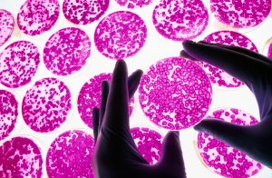
Testing New Drugs
Drugs have to pass a variety of different stages of testing
Preclinical Testing
1 – testing on cells, tissues, and organs
2 – animal testing
Clinical Trials
3 – human testing (toxicity testing)
4 – larger clinical trials (efficacy and dosage testing)

Slide 16
Clinical Trials
After animal testing demonstrates that the drug should be safe for humans, extensive clinical trials test the toxicity, efficacy, and dose in that order.
Step 1 – small group of healthy volunteers are given very low doses of the drug to test for side effects (toxicity testing)
Step 2 – then it is tested on patients with the disease to see if it treats the disease (efficacy testing)
Step 3 – if it seems safe and effective larger clinical trials are used to determine the optimal dose of the drug to use

Slide 17
Carrying Out Clinical Trials: Double Blind Trials
In order to make it a fair test some patients are given a placebo to rule out the psychological effect of taking a new drug.
Placebo = a substance that has no therapeutic effect, used as a control in testing new drugs
The placebo may contain no drugs at all or the treatment that the patient was already receiving. Patient given the placebo are considered the control group, the group used as a comparison.
It is called a double blind trial because both the doctors and the patients DO NOT know who is given the placebo and who is given the new drug. Only the scientists carrying out the study know.

