Slide 1
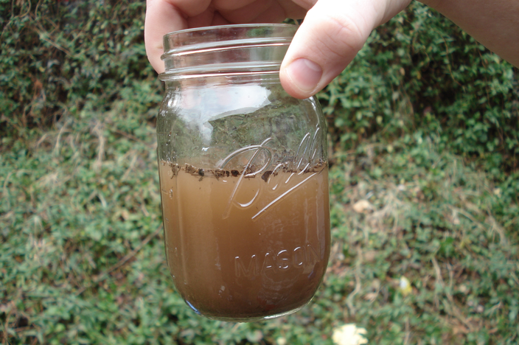
Starter
How could you get pure water from this?

Slide 2
L5: Mixtures
Learning Objectives:
Describe what a mixture is.
Explain how to separate mixtures by filtration and evaporation.
Explain how to separate mixtures by distillation.

Slide 3
Mixtures
Mixture = combination of different particles that are not chemically joined (can be made of atoms, molecules, or compounds)
Pure Element
Pure Compound
Mixture

Slide 4
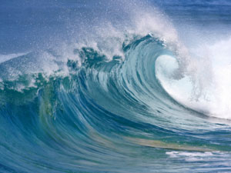
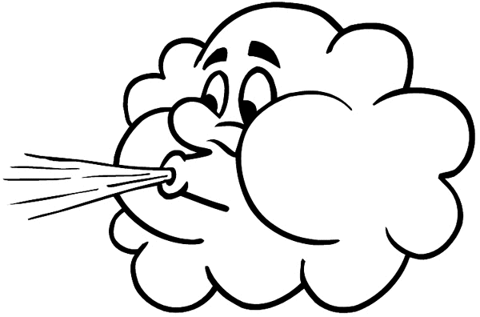
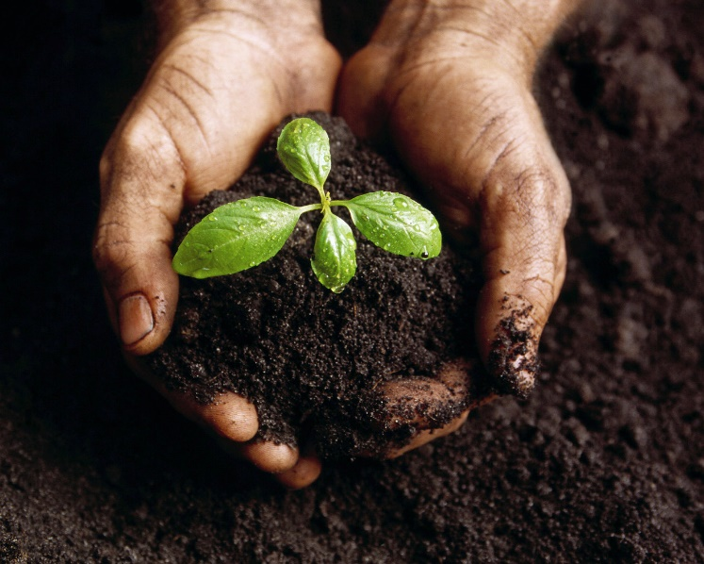
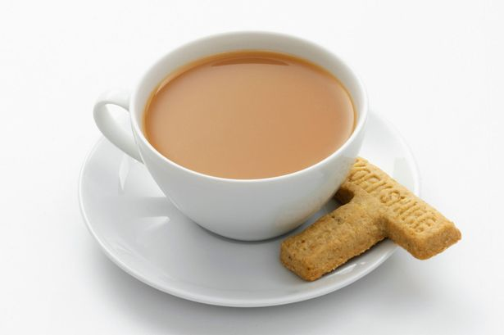
Examples of Mixtures
Seawater
Tea
Air
Soil

Slide 5
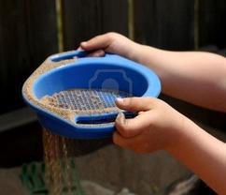
Mixtures Can be Separated
Since mixtures are not chemically joined they can be separated by physical means.

Slide 6
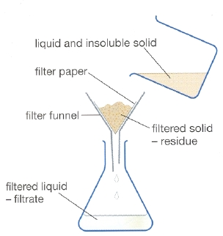
Separating Insoluble Solid from a Solution
Filtration separates insoluble solids from liquids.
Insoluble = does not dissolve
Soluble = able to dissolve
Filter paper has tiny holes that allow liquid particles and dissolved solids through. Insoluble solids are too big to fit through the holes.

Slide 7
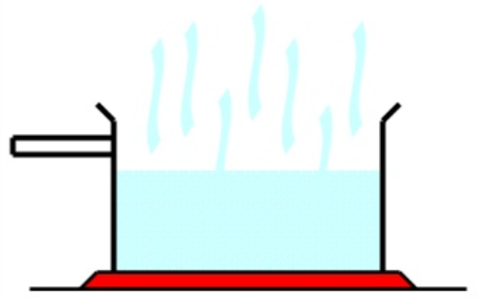
Separating Soluble Solids from a Liquid
Evaporation can be used to separate soluble solids from a liquid.
Different substances will evaporate or boil at different temperatures.
Heat the mixture to the boiling point of the liquid.
The liquid will evaporate and leave the solid behind.

Slide 8
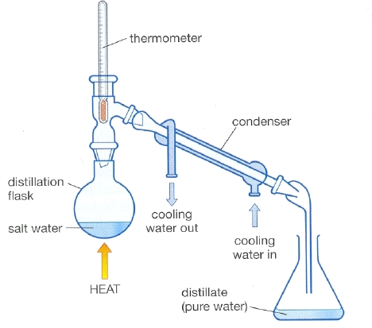
Separating a Liquid from a Solution:
Distillation

Slide 9
Separating a Liquid from a Solution
Distillation = method of separating a mixture based on the different boiling points of the different substances
Heat the mixture to the boiling point of one substance (but not hot enough to boil the second).
Thermometer used to monitor the temperature.
The liquid turns to a gas, rises, and passes into the condenser.
The condenser cools the hot gas.
The gas then condenses (turns back to liquid) and is collected.

