Slide 1
L6 – Hearing and the Ear
Learning Objectives:
Recall the parts of the ear and the human hearing range.
Recall that decibels (dB) are used to measure loudness.
Describe the functions of the parts of the ear.
Explain how different parts of the ear can become damaged.

Slide 2
How does the ear work?
1) Sound waves are “funnelled” into the ear by the earflap
6) The electrical signals are then sent to the brain along the auditory nerve
2) Sound waves travel through the ear canal
5) These vibrations are turned into electrical signals in the cochlea
3) These vibrations make the ear drum vibrate
4) These vibrations make the ear bones vibrate

Slide 3
The human ear can hear frequencies that range from 20 Hz to 20,000 Hz.

Slide 4
How loud does a sound have to be before we can hear it? What happens if it is too loud?

Slide 5
How loud does a sound have to be before we can hear it? What happens if it is too loud?
The loudness of a sound is measured in decibels (dB).
The quietest sound we can hear is 0 dB. This is called the threshold of hearing.
Sound starts to become painful at 134 dB.
The eardrum breaks at 185 dB.

Slide 6
How loud does a sound have to be before we can hear it? What happens if it is too loud?
The loudness of a sound is measured in decibels (dB).
The quietest sound we can hear is 0 dB. This is called the threshold of hearing.
Sound starts to become painful at 134 dB.
The eardrum breaks at 185 dB.

Slide 7
How loud does a sound have to be before we can hear it? What happens if it is too loud?
The loudness of a sound is measured in decibels (dB).
The quietest sound we can hear is 0 dB. This is called the threshold of hearing.
Sound starts to become painful at 134 dB.
The eardrum breaks at 185 dB.

Slide 8
How loud does a sound have to be before we can hear it? What happens if it is too loud?
The loudness of a sound is measured in decibels (dB).
The quietest sound we can hear is 0 dB. This is called the threshold of hearing.
Sound starts to become painful at 134 dB.
The eardrum breaks at 185 dB.

Slide 9
How loud does a sound have to be before we can hear it? What happens if it is too loud?
The loudness of a sound is measured in decibels (dB).
The quietest sound we can hear is 0 dB. This is called the threshold of hearing.
Sound starts to become painful at 134 dB.
The eardrum breaks at 185 dB.

Slide 10
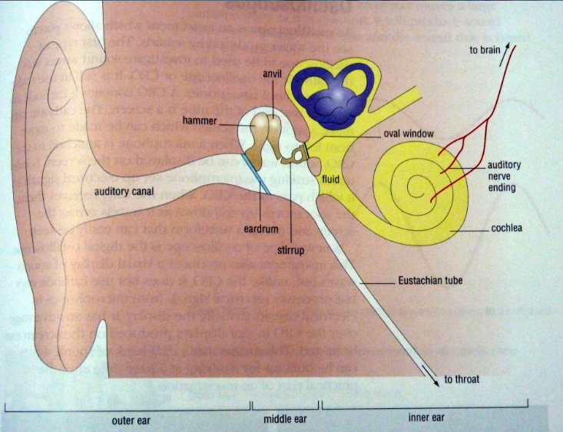
Damage to the Ear
Human ear has 3 parts:
Outer Ear
Middle Ear
Inner Ear
Outer Ear
The earflap and the ear canal
Purpose: to collect and direct the sound waves to the middle ear.
Sound waves go directly or get reflected into the auditory canal.
Problem: Ear wax in outer ear can stop sound waves from reaching the middle ear.
Duration: Temporary
Solution: Remove ear wax

Slide 11
Damage to the Ear
Middle Ear
Eardrum and Earbones
Purpose: to change energy of sound waves into vibrations.
Sound waves reach the eardrum and makes it vibrate.
The vibrations cause the hammer, anvil and stirrup (the three ear bones) to vibrate.
Problem: High energy waves from loud sounds can tear a hole in the eardrum!
Duration: usually temporary
Solution: Most ruptured eardrums will heal on their own but severe cases may need surgery to repair the rupture.

Slide 12
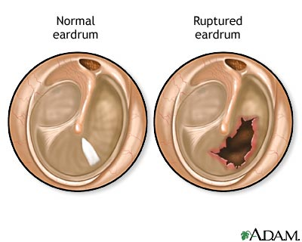
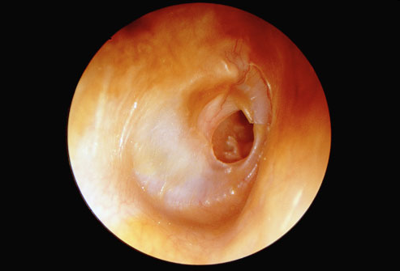
Ruptured Ear Drum

Slide 13
Inner Ear
Cochlea and Auditory nerve
Purpose: to change the vibrations into nerve impulses and send them to the brain.
Vibrations from ear bones travel through a liquid and to the cochlea.
Cochlea is lined with 20,000 tiny hair-like nerve cells.
Each nerve cell has different length and detects a different frequency of sound.
Problem: The tiny “hairs” are damaged by loud or constant noise.
Duration: Damage is Permanent! Cochlear cilia do not grow back!
Solution: Avoid extremely loud and long exposure to loud sounds
Hearing aids and cochlear implants can be used.

Slide 14
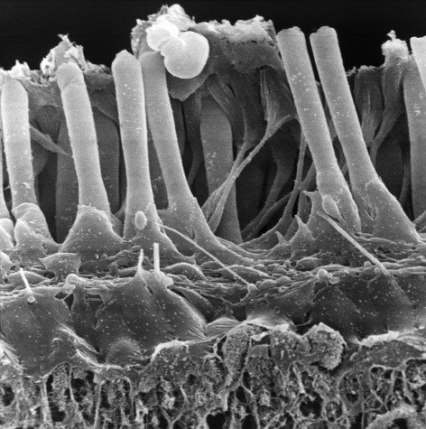
Tiny hairs – cilia – hang down into the liquid. Vibrations travelling through the liquid push the hairs.
Nerve cells on the hairs detect this movement.
They send signals to the brain.
You hear the sound.

Slide 15
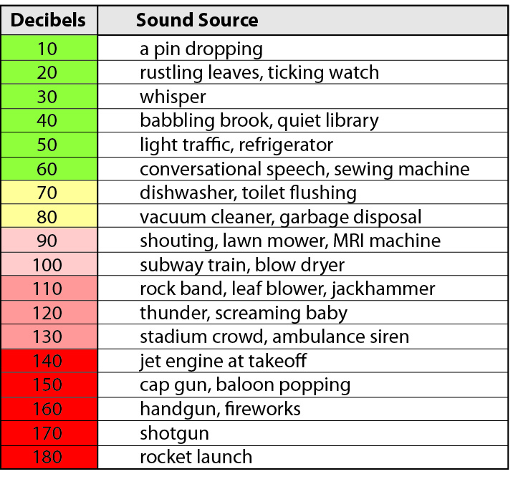
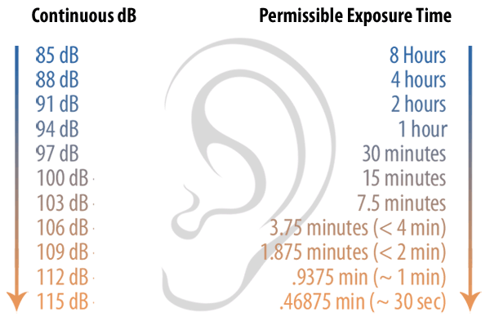
Sounds louder than 80 decibels are considered potentially dangerous.
Headphones as maximum volume are usually around 100 dB.

