Slide 1
Starter: Quick Quiz
What two substances do your cells need to get energy?
How does your body get these two substances?
How does your body deliver these substances to all of your cells?
What is the name of the chemical reaction that gives cells energy?

Slide 2
What two substances do your cells need to get energy?
Glucose and Oxygen
How does your body get these two substances?
Glucose from digestion, Oxygen from breathing
How does your body deliver these substances to all of your cells?
The circulatory system. The heart pumps blood around the body delivering glucose and oxygen to all cells.
4. What is the name of the chemical reaction that gives cells energy?
Respiration

Slide 3
L7: Gas Exchange
Learning Objectives:
Recall that gas exchange involves oxygen coming in and carbon dioxide going out.
Draw a flow chart to show the movement of gases in gas exchange.
Describe how the features of alveoli make them good at gas exchange.
Explain how gas exchange happens by diffusion.

Slide 4
From Breathing
From Digestion

Slide 5
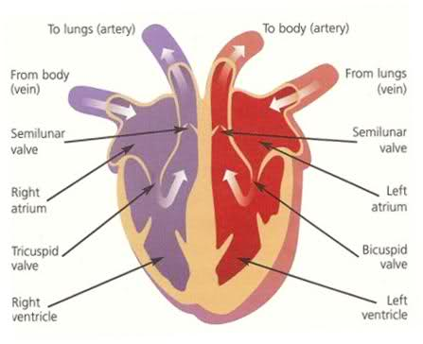
Review: Flow of blood through the heart
Video: Heart

Slide 6
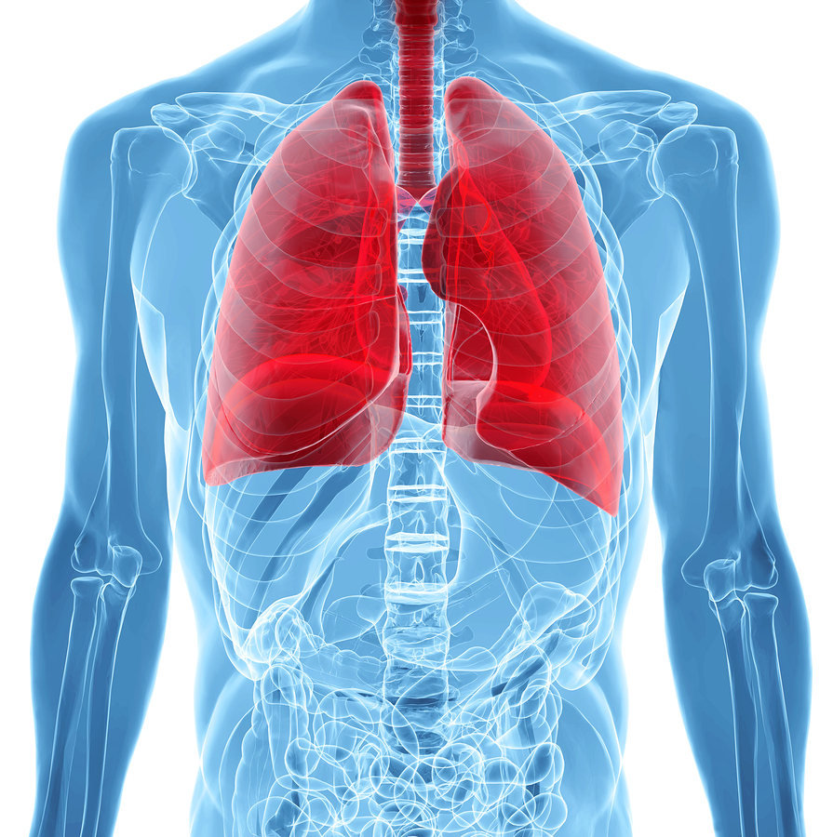
Video: Respiratory System

Slide 7
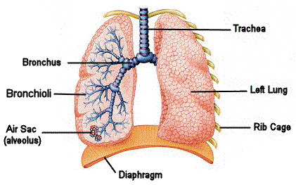
Respiratory System
The respiratory system is in charge of breathing.
(NOT RESPIRATION!)
It takes in oxygen and removes carbon dioxide.

Slide 8
move down and in
contracts and moves down
relaxes and moves back up

Slide 9
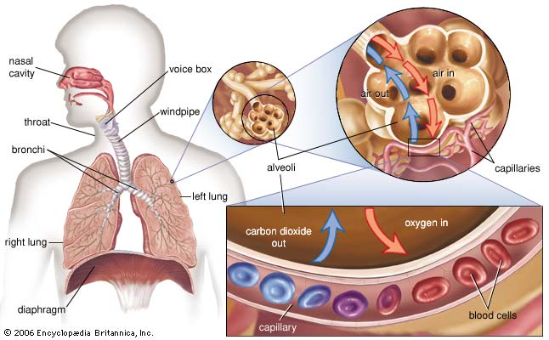
Lungs Contain Air Sacs with Alveoli

Slide 10
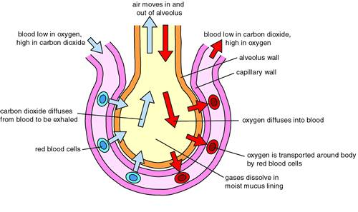

Slide 11
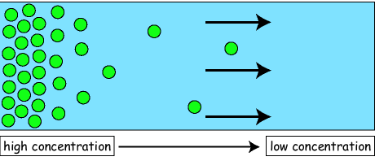
Gas Exchange
In the lungs, oxygen enters the bloodstream and carbon dioxide exits the blood stream.
This happens by diffusion, particles naturally move from high to low concentration.

Slide 12
Inhaled Air vs Exhaled Air
Gas | % in Inhaled Air | % in Exhaled Air
Nitrogen | 78% | 78%
Oxygen | 21% | 17%
Carbon Dioxide | 0.03% | 4%

