Slide 1
Anagrams

Slide 2
Atoms, Elements, Compounds, and Mixtures Quiz
Draw and name an example of each of the following:
Atom
Element
Compound
Mixture
Explain briefly what each of them are (definition) in your own words.

Slide 3
Chemical Naming
Lesson Objectives:
• Know what a chemical formula shows
• Know the roots of common elements used in naming compounds
• Know how to name simple molecules including metal + non-metal, metal + non-metal + oxygen and non-metal + non-metal

Slide 4
Starter
Try to draw a particle model of the following compound.
H₂O
What information do the parts of the chemical formula give you?

Slide 5
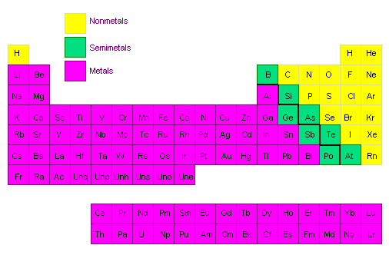

Slide 6
Naming Simple Molecules Metal + Non-Metal
First word: Write out the full name of the first element (metal) of the chemical formula.
Second word: Write out the root of the second element (non-metal) and add –ide to the end.
Numbers do NOT matter!
Example: MgO = magnesium oxide
CaF₂ = calcium fluoride

Slide 7
Can you figure out the roots?
Element
Hydrogen
Sulphur
Chlorine
Nitrogen
Phosphorous
Root
Hydr-
Sulph-
Chlor-
Nitr-
Phosph-

Slide 8
Name that Compound!
Chemical Formula
NaCl
CuO
KBr
CaCl₂
ZnS
Name
Sodium Chloride
Copper Oxide
Potassium Bromide
Calcium Chloride
Zinc Sulphide

Slide 9
Naming Simple Molecules Metal + Non-Metal + Oxygen
First word: Write out the full name of the first element (metal) of the chemical formula.
Second word: Write out the root of the second element (non-metal) and add –ate to the end.
Do not worry about number of oxygens here!
Example: MgSO₄ = magnesium sulphate
ZnNO₃ = zinc nitrate

Slide 10
Naming Simple Molecules Metal + Non-Metal + Oxygen
Use this method if one oxygen is removed from a substance ending in –ate.
First word: Write out the full name of the first element (metal) of the chemical formula.
Second word: Write out the root of the second element (non-metal) and add –ite to the end.
These have one fewer oxygens than –ate endings
Example: MgSO₃ = magnesium sulphite
ZnNO₂ = zinc nitrite

Slide 11
Naming Simple Molecules Non-Metal + Non-Metal
1. First word: Prefix (unless its 1) + Write out the full name of the first element of the chemical formula.
2. Second word:
a. Look at the number of atoms and write the correct prefix.
b. Write out the root of the second element and add –ide to the end.
Example: CO₂ = carbon dioxide

Slide 12
Can you figure out the prefix?
Number
One
Two
Three
Four
Five
Six
Seven
Eight
Nine
Ten
Prefix
Mono-
Di-
Tri-
Tetra-
Penta-
Hex-
Hept-
Oct-
Non-
Dec-

Slide 13
Name that Compound!
Chemical Formula
NO
SO₂
CO
CCl₄
Name
Nitrogen Monoxide
Sulphur Dioxide
Carbon Monoxide
Carbon Tetrachloride

Slide 14
Name that Compound!
Chemical Formula
MgCO₃
ZnSO₄
ZnSO₃
Na₂SO₄
LiNO₃
Ca₃(PO₄)₂
Name
Magnesium Carbonate
Zinc Sulphate
Zinc Sulphite
Sodium Sulphate
Lithium Nitrate
Calcium Phosphate

Slide 15
Common Non-Metal + Oxygen Endings
Sulphate
Nitrate
Phosphate
Carbonate
-SO₄
-NO₃
-PO₄
-CO₃

Slide 16
Name the following compounds
LiCl
CaF₂
KBr
BaO
MgCO₃
ZnSO₄
ZnSO₃
WCl₃
AlPO₄
NaNO₃
Lithium Chloride
Calcium Fluoride
Potassium Bromide
Barium Oxide
Magnesium Carbonate
Zinc Sulphate
Zinc Sulphite
Tungsten Chloride
Aluminium Phosphate
Sodium Nitrate
Notes:
Students should try to name these on their own to check their understanding

Slide 17
Name the following compounds
CO
SF₆
SO₂
SiCl₄
P₄O₁₀
NH₃
PBr₅
PCl₃
SiO₂
XeF₆
Carbon Monoxide
Sulphur Hexafluoride
Sulphur Dioxide
Silicon Tetrachloride
Tetraphosphorus Decaoxide
Nitrogen Trihyride
Phosphorous Pentabromide
Phosphorous Trichloride
Silicon Dioxide
Xenon Hexafluoride
Notes:
Students should try to name these on their own to check their understanding

Slide 18
What is the formula?
Silicon tetrafluoride
Nitrogen dioxide
Disulphur dichloride
Arsenic trihydride
Radon difluoride

Slide 19
Task
Naming compounds card sort

