Slide 1
Specific heat capacity

Slide 2
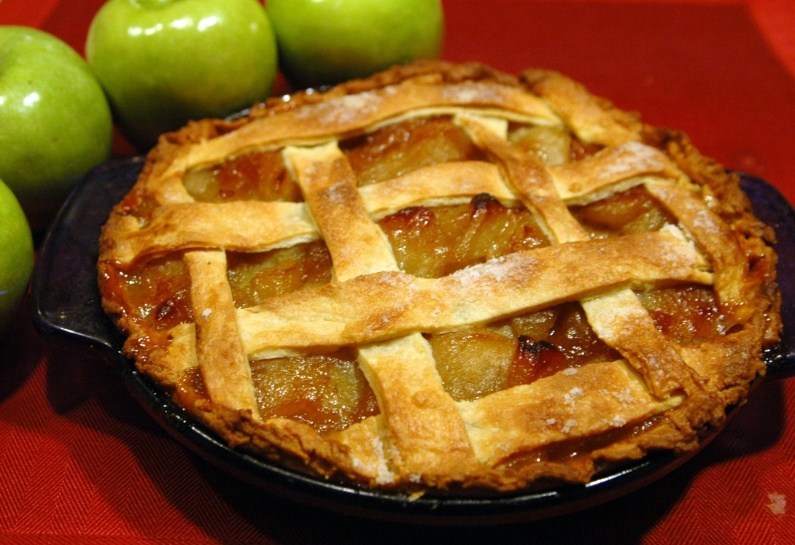
The filling in this hot pie feels hotter than the pastry. Why?

Slide 3
By the end of this lesson you should :
Understand that different materials need different amounts of
heat energy to raise their temperature by the same amounts
Be able to understand what specific heat capacity is
To be able to use the equation with the correct units
Understand how night storage heaters work

Slide 4
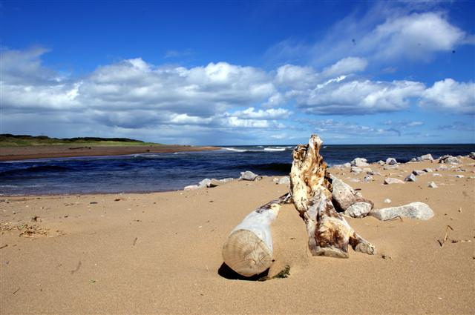
Specific heat capacity
At the end of a sunny day at the beach, what do you notice about the temperature of the sand compared to the water?
The sand has become quite hot. The water has stayed cool.
Notes:
Image credit © Derek E-Hay 2011 https://flic.kr/p/9P5sWu

Slide 5



same amount of energy transferred
small temperature rise
large temperature rise
water
sand
Transferring the same amount of energy by heating into some materials gives a bigger temperature rise than in other materials.

Slide 6


How do we measure heat capacity?
To compare the heat capacity of materials, we need to measure:
The amount of energy in joules
needed to change the temperature by one degree Celsius.
1°C rise

Slide 7
Specific heat capacity (c) of a substance is…
.. the amount of energy (joules)
needed to change the temperature of
one kilogram of the substance by
1 °C.
1 kg
How many joules ?
1°C rise

Slide 8

What is specific heat capacity?
The specific heat capacity of a material is the amount of energy required to raise 1 kg of the material by 1 °C.
It can be used to work out how much energy is needed to raise the temperature of a material by a certain amount:
Change in thermal energy
specific heat
capacity
temperature
change
=
mass
×
×
Energy is measured in joules (J).
Mass is measured in kilograms (kg).
Temperature change is measured in °C.
Specific heat capacity is measured in J/kg°C.
Notes:
Boardworks GCSE Science: Physics
Specific Heat Capacity
Spring 2011

Slide 9
This equation will be given to you on your equation sheet
∆E = m c∆θ

Slide 10
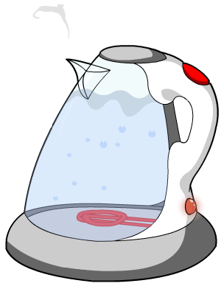
Specific heat capacity example
How much energy is needed to increase the temperature of 600 g of water by 80 °C in a kettle?
Note: mass = 600 g = 0.6 kg and the specific heat capacity
of water is 4,200 J/kg°C.
energy
=
mass
×
specific heat
capacity
×
temperature
change
energy = 0.6 kg × 4,200 J/kg°C × 80 °C
= 201,600 J
Notes:
Spring 2011

Slide 11


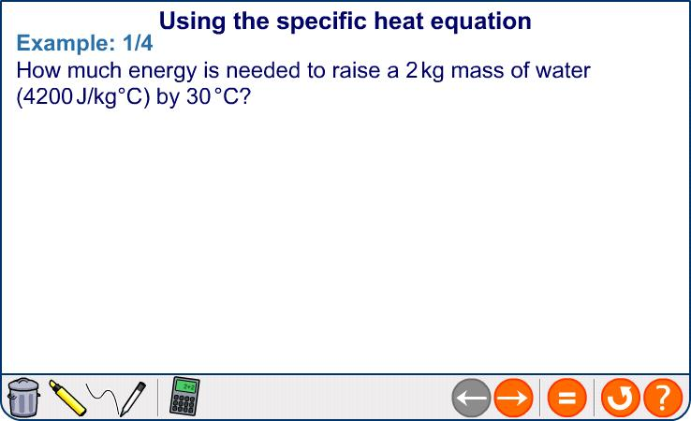
The specific heat capacity equation
Notes:
This content is higher tier for AQA GCSE Science.
Teacher notes
This slide could be used to emphasize the need to show work in the calculation and demonstrate the most suitable layout.
Boardworks GCSE Science: Physics
Specific Heat Capacity
Spring 2011

Slide 12
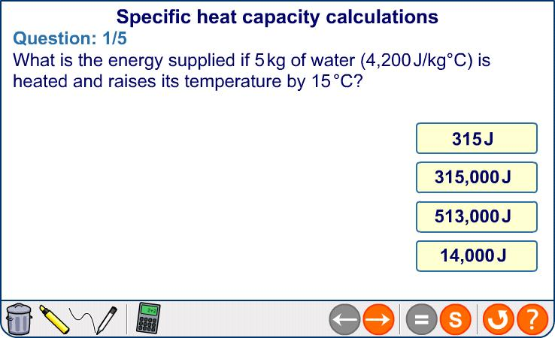
Specific heat capacity calculations
Notes:
Teacher notes
For this set of practice questions, students could be asked to find the answer before it is revealed on the slide. Students should be encouraged to lay out their work as on the previous slide.
Boardworks GCSE Science: Physics
Specific Heat Capacity
Spring 2011

Slide 13

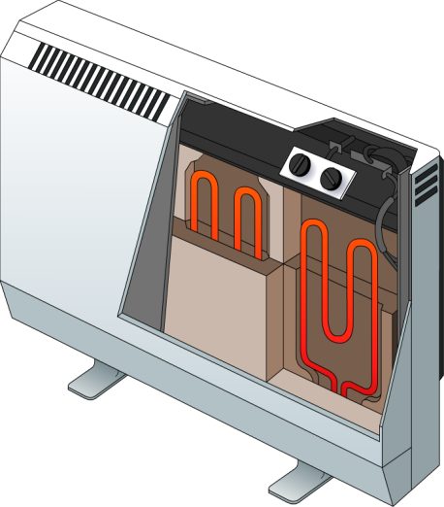
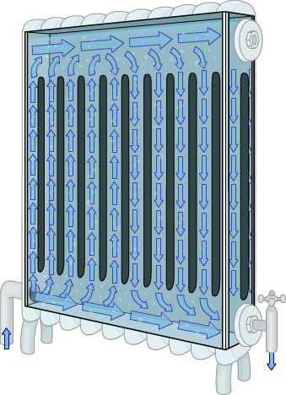
Choosing suitable materials
Different materials have different specific heat capacity values. A high value means that the material can store a large amount of heat energy for a minimal temperature change.
For example, concrete is used in night storage heaters. Concrete has an SHC of 880 J/kg°C. This is high compared with other suitable materials such as granite (SHC = 790 J/kg°C).
Radiators use closed liquid systems. Water is used because it has an extremely high SHC of 4200 J/kg°C. This is much higher than oil, for example, with a typical SHC of 1800 J/kg°C.
Notes:
This slide is accompanied by the worksheet Specific Heat Capacity.
Spring 2011

Slide 14
By the end of this lesson you should :
Understand that different materials need different amounts of
heat energy to raise their temperature by the same amounts
Be able to understand what specific heat capacity is
To be able to use the equation with the correct units
Understand how night storage heaters work

Slide 15
Now can you explain why the inside of the pie, which
has a high water content, feels hotter than the pastry!

