Slide 1
Summary of alpha etc

Slide 2
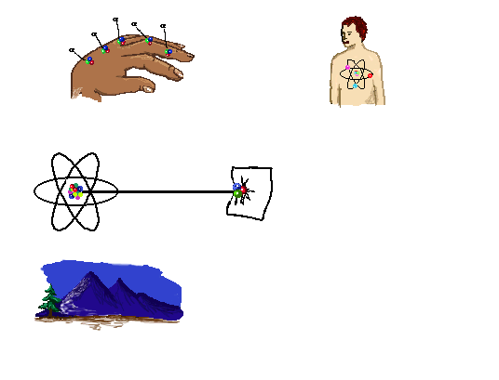
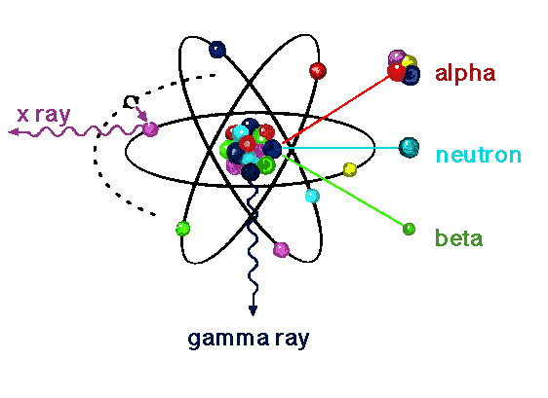
Alpha Decay
⁴He Nucleus
Ejected from Nucleus
Your skin will stop it
internal hazard
stopped by paper
found in soil, radon and other radioactive materials
Notes:
Alpha decay
An alpha particle is comprised of two neutrons and two protons. It is a highly charged type of radiation.
Since it is so large, it interacts readily with any type of matter. An inch or two of air is very effective in shielding alpha radiation and because of this, in order to detect radioactive material that emits alpha radiation, the detector must be close to the radiation. If we can measure the energy of the alpha radiation, we can translate that discrete energy to a specific radioactive material thus allowing us to identify that particular radioactive material.
Shielding: Alpha particles can be shielded, (stopped) by layer of skin or thin paper. However, Alpha particles are an internal hazard.

Slide 3
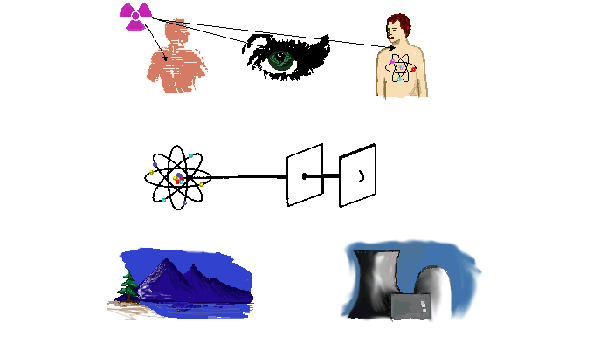
Beta Decay
Either too many neutrons or too many protons
skin, eye and internal hazard
stopped by plastic/thin sheet of aluminium
Naturally occurring in food, air and water
Notes:
Beta radiation is typically due to the fact that the nucleus has too many neutrons or protons. The energy of the beta radiation emitted is radionuclide specific. Beta particles have a range of energy up to a specific value known as the end point. Keep in mind that beta particles are emitted having about 1/3 of their maximum energy. For example C-14 has an end point maximum energy of 156 keV, but most C-14 beta particles are emitted with approximately
Mention the shielding, plastic, secondary shielding for Bremssthalung.

Slide 4
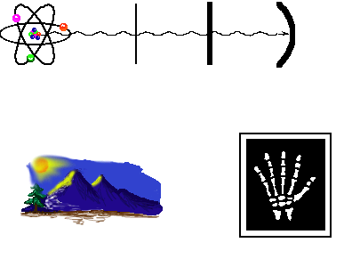
Gamma / X-ray Decay
Emission of a photon
Often occurs after α or β when nucleus is in an excited state
stopped by lead
naturally present in soil and cosmic radiation
medical uses
Notes:
Gamma radiation is pure energy, similar to light waves. In that it is pure energy, it does not have any mass.
X-rays are produced in the electron cloud, while gamma rays are emitted from the nucleus of an atom.
Since discrete energies are emitted for each gamma emitting radionuclide, we can measure the energy and identify the radionuclide.
Shielding: Lead

