Slide 1
Term 1 Revision Quiz Chemistry

Slide 2
What is an atom?
The smallest particle of an element that can take part in a chemical reaction.

Slide 3
What is an element?
One type of atom. Substance with all the same type of atom.

Slide 4
What is a molecule?
Two or more atoms (of any kind) chemical joined.

Slide 5
What is a compound?
Two or more atoms OF DIFFERENT ELEMENTS chemically joined.

Slide 6
What is a mixture?
Two or more substances NOT chemically joined.

Slide 7
Draw the particle diagram for a molecule of an element.

Slide 8
Draw the particle diagram for a mixture of atoms of two elements.

Slide 9
Draw the particle diagram for a pure sample of a compound.

Slide 10
Draw the particle model for a mixture of molecules.

Slide 11
What is the periodic table?
A table containing information about all the elements.

Slide 12
Which side of the periodic table are metals located on?
Left side

Slide 13
What are the main properties of metals?
Shiny
Conduct heat
Conduct electricity
Malleable/Flexible
Ductile

Slide 14
What information does the chemical formula tell you?
The number of atoms of each element in a molecule.

Slide 15
What elements are in the a molecule of H₂SO₄?
Hydrogen
Sulfur
Oxygen

Slide 16
How many atoms are in the a molecule of H₂SO₄?
7

Slide 17
What is a chemical reaction?
A change where a new substance is formed.

Slide 18
What is a reactant?
Starting materials in a chemical reaction, substances that reacts with another.

Slide 19
What is a product?
New substance that is made in a chemical reaction.

Slide 20
What is a word equation?
Equation representing a chemical reaction and tells you the reactants and products.

Slide 21
Give an example of a physical change.
Freezing, melting, evaporating, boiling…

Slide 22
Give an example of a chemical change.
Rusting, combustion, neutralisation…

Slide 23
What are the three mixture separation techniques we learned?
Filtration
Evaporation
Distillation

Slide 24
Describe how filtration works.
Filter paper has tiny holes that prevents solids from passing through.

Slide 25
Describe how evaporation works.
Substances have different boiling points.
Heat a mixture to the boiling point of one substance which will evaporate off and leave behind the second substance.

Slide 26
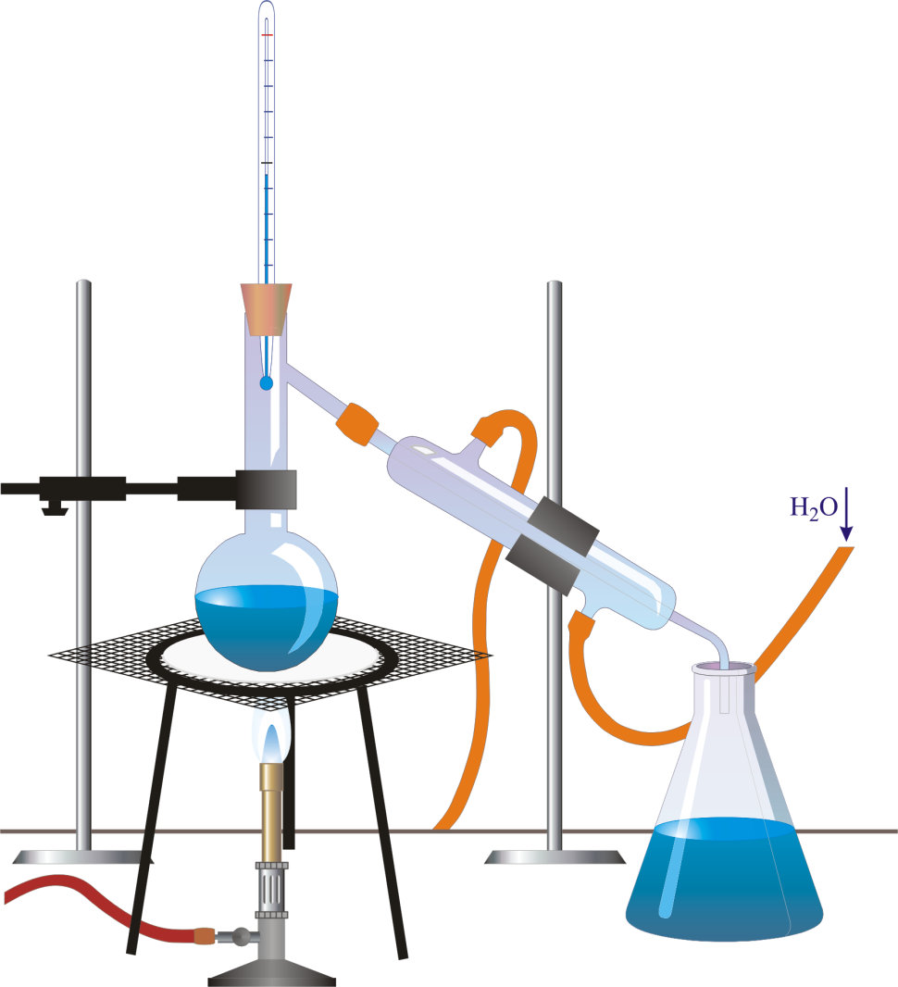
Name the piece of equipment used for distillation.
thermometer

Slide 27
Name the piece of equipment used for distillation.
Bunsen burner

Slide 28
Name the piece of equipment used for distillation.
condenser

