Slide 1
Properties of solids, liquids and gases

Slide 2
By the end of the lesson you should know
The names of the states of matter
That matter is made of particles
How the particles are arranged in solids liquids
and gases
The names of the changes of state

Slide 3

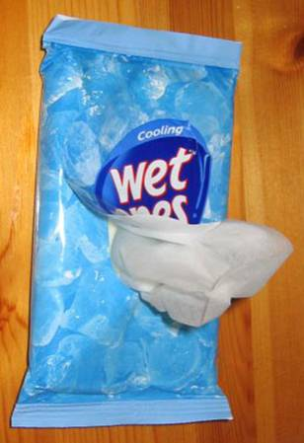
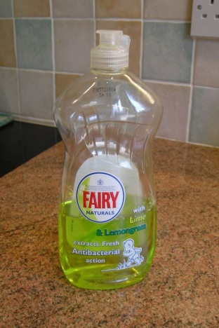
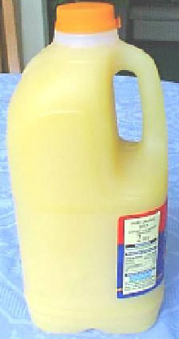

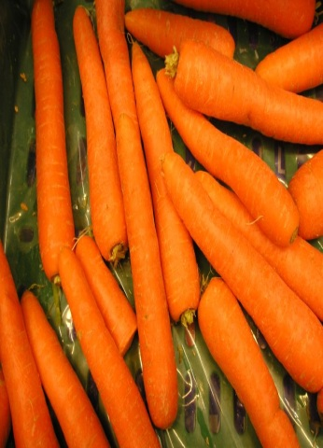

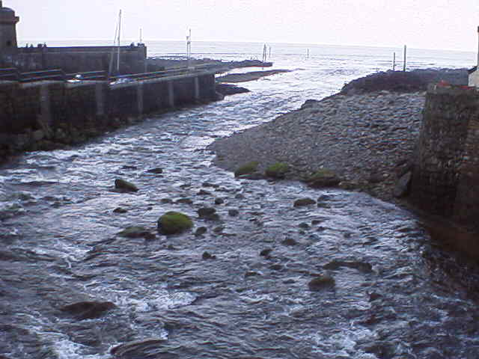

Three states of matter
At room temperature most substances exist in one of three physical states.
solid
liquid
gas

Slide 4

Solid, liquid or gas?

Slide 5
By the end of the lesson you should know
The names of the states of matter
That matter is made of particles
How the particles are arranged in solids liquids
and gases
The names of the changes of state

Slide 6
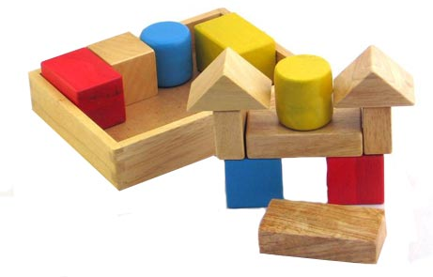
Keep their shape
Have a fixed volume
SOLIDS
Cannot be squashed
(incompressible)
Some are very heavy
for their size (dense)

Slide 7
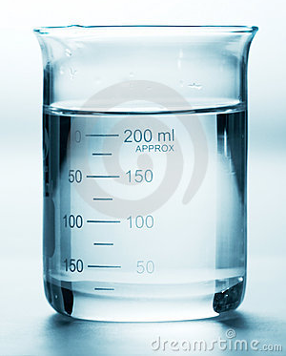
Take the shape of the container
but do not fill it
Have a fixed volume
liquids
Can flow so can
be poured
Cannot be squashed
(incompressible)

Slide 8
Fill the container
No fixed volume
G
GASES
Can flow
Can be squashed
(compressible)
Not very dense

Slide 9
The Particle Model –sometimes called the kinetic theory
1. All matter is made of particles
2. They can have different sizes
3. They can move around by themselves
4. The particles attract one another
5.The hotter the substance the faster the particles move

Slide 10
http://www.harcourtschool.com/activity/states_of_matter/

Slide 11
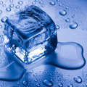
States of matter
Task Draw a diagram to show what happens to the particles in a solid when they are heated and the solid changes to a liquid, then a gas.
Solid
Liquid
Gas

Slide 12
Solid, Liquid or Gas?

Slide 13

The particles do not touch each other
Solid, Liquid or Gas?
Gas!

Slide 14

The particles are tightly packed together in a regular pattern
Solid, Liquid or Gas?
Solid!

Slide 15
The particles can only vibrate slightly
Solid, Liquid or Gas?
Solid!

Slide 16

The particles are loosely attracted to each other in a random arrangement
Solid, Liquid or Gas?
Liquid!

Slide 17
The particles move fast in random directions
Solid, Liquid or Gas?
Gas!

Slide 18
The particles can flow
Solid, Liquid or Gas?
Liquid!
and
Gas!

Slide 19
The particles are strongly attracted to each other
Solid, Liquid or Gas?
Solid!

Slide 20
The material keeps its shape
Solid, Liquid or Gas?
Solid!

Slide 21
The material takes the shape of the container
Solid, Liquid or Gas?
Liquid!

Slide 22
The material cannot be compressed
Solid, Liquid or Gas?
Liquid!
and
Solid!

Slide 23
The material spreads out in no particular shape
Solid, Liquid or Gas?
Gas!

Slide 24
By the end of the lesson you should know
The names of the states of matter
That matter is made of particles
How the particles are arranged in solids liquids
and gases
The names of the changes of state

Slide 25


A state of matter can change.
sublimating
melting
evaporating
SOLID
LIQUID
GAS
Freezing, solidifying
condensing

Slide 26
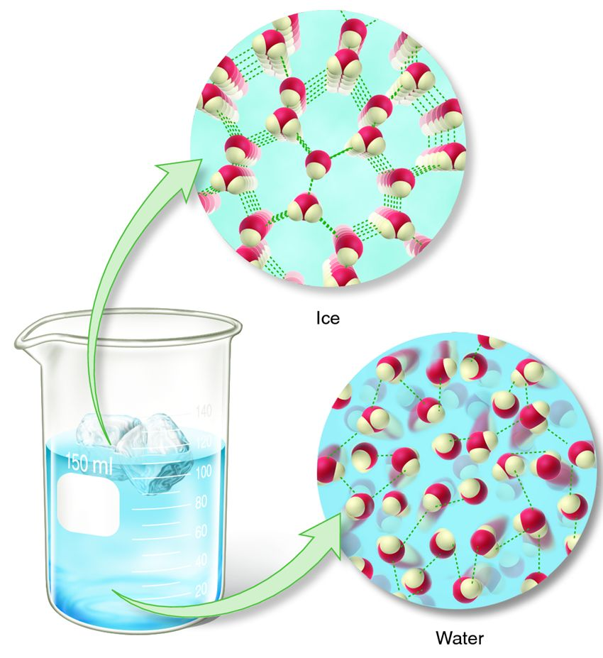
Ice floats on water because
it is less dense than water
This is because the molecules of water are held in fixed positions further apart because of special forces called hydrogen bonds.

