Slide 1

The Earth
Days and Years

Slide 2
Learning Objectives:
Recall that the Earth gets heat and light from the Sun.
Recall that the Earth spins on its axis AND orbits around the Sun.
Describe how the motion of the Earth cause days, years and seasons.
Explain why we need to have a “leap year” every 4 years.

Slide 3
The Earth is tilted on an axis
North pole
South pole

Slide 4
The Earth is divided up into the northern hemisphere and the southern hemisphere:
Northern hemisphere
Southern hemisphere
Equator

Slide 5
DAY
The Earth spins on its axis every ___ (__ hours)
24

Slide 6
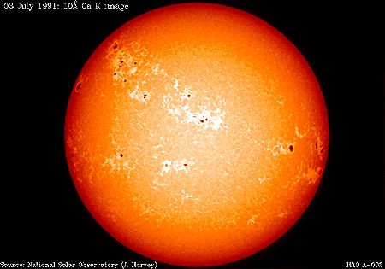
While the Earth is spinning the side that faces the sun is in ________
DAYTIME

Slide 7

At any time, half of the Earth faces the sun and therefore receives light.
This part is in day.
This part is in night.
The other half faces away from the Sun, and so receives very little light.

Slide 8
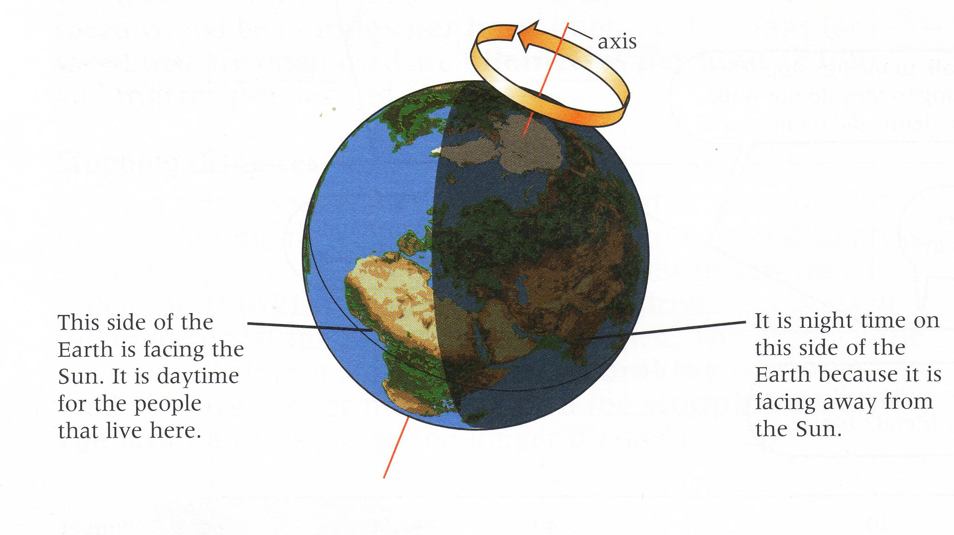
Day and night

Slide 9

This side of the Earth is facing the Sun.
It is daytime for the people that live here.
This side of the Earth is facing away from the Sun.
It is night time for people that live here.

Slide 10
Because of this spin the sun rises in the ______ and sets in the ______
Which direction is East in this example?
EAST
WEST

Slide 11
http://www.bbc.co.uk/learningzone/clips/how-does-the-earths-rotation-create-day-and-night/2173.html

Slide 12
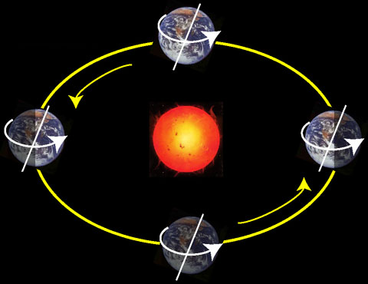
The Earth orbits the…
Sun
The sun is a…
Star

Slide 13
The Earth orbits the sun every…
…year (365 ¹/₄ days)

Slide 14
The Earth is kept in orbit by the force of…
Gravity
…and by the fact that is is moving at a high velocity

Slide 15

As the Earth orbits the Sun, when its axis tips towards the Sun, the weather gets warmer. When it tips away, the weather gets colder, causing the Earth’s seasons.

Slide 16
In the northern hemisphere:
spring here
winter here
autumn here
summer here
summer here
autumn here
winter here
In the southern hemisphere:
spring here

Slide 17
http://www.bbc.co.uk/learningzone/clips/the-earths-orbit-around-the-sun/1592.html

Slide 18
http://www.bbc.co.uk/learningzone/clips/day-and-night-in-the-worlds-most-northerly-city/2429.html

Slide 19
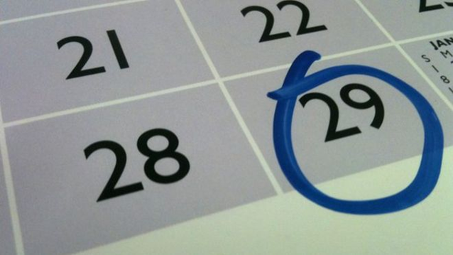
Leap Year
Every four years we have a “leap year” which has an extra day, February 29th.
Why do we need to have leap years?

Slide 20
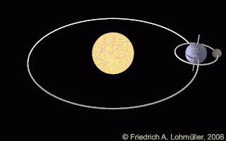
Leap Years
It takes the Earth 365 and ¼ days to orbit the sun.
We can’t have ¼ of a day on the calendar.
Instead, every 4 years we have 1 extra day.

Slide 21
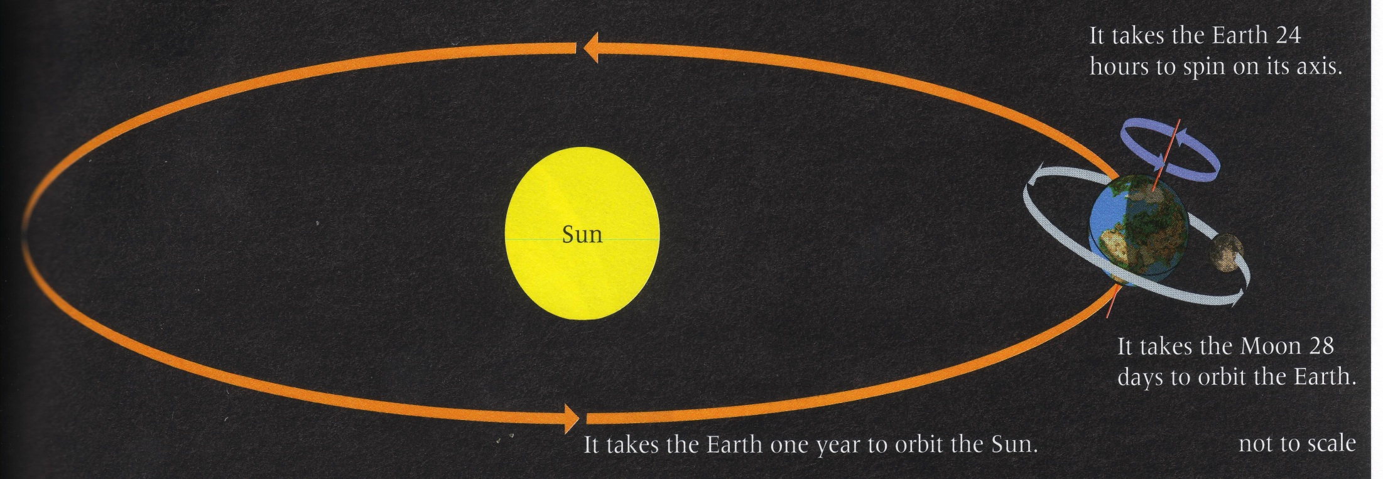
The Earth orbits the Sun

Slide 22
Gravity also keeps the moon in orbit around the Earth. The moon orbits the Earth every…
…28 days
This makes the moon a satellite (object that orbits the Earth).

Slide 23
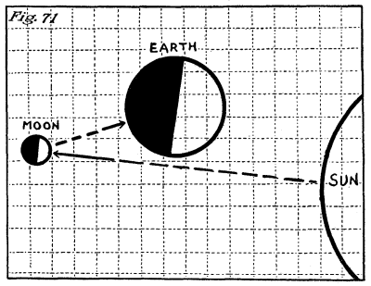
The Sun is luminous (gives out light), that’s why we see it.
The moon is NOT luminous.
Why can we see the moon?
Light from the sun reflects off of the moon onto the Earth.

Slide 24
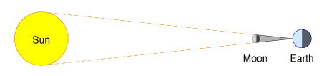
Solar Eclipse
An eclipse is when the moon blocks out light from the Sun on one place on Earth.

Slide 25
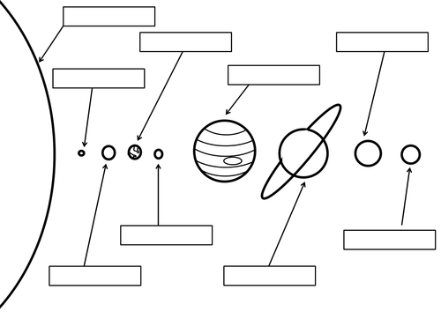

Slide 26
