Slide 1
Starter
How much do you know about the Earth?
Video: Earth

Slide 2
The Atmosphere and the Water Cycle
Learning Objectives:
Recall that the Earth’s atmosphere is a layer of gases surrounding the Earth.
Identify the main gases of the atmosphere.
Describe the main functions of the atmosphere to supporting life on Earth.
Describe the water cycle.

Slide 3
the Atmosphere
Atmosphere = the envelope of gases surrounding the Earth or another planet.

Slide 4
Gases in the Atmosphere
Gas | Percentage
Nitrogen | 78%
Oxygen | 21%
Argon | 0.9%
Carbon Dioxide | 0.04%
Other | Trace
Notes:
Students can make predictions. Would not be expected to know this previously.
Then reveal the table (animations).

Slide 5
Where does this come from?

Slide 6
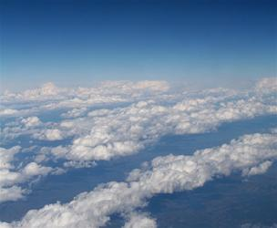
Why is the atmosphere important?
Discuss a few reasons why you think the atmosphere is important for life on Earth.

Slide 7
Functions of the Atmosphere
Protects us from harmful radiation from the sun (UV, gamma, x-rays).
Acts like a blanket to trap in heat and keeps us warm.
Provides oxygen for respiration. Provides carbon dioxide for photosynthesis (plants).
Gives us weather and is an important part of the water cycle.
Protects us from meteorites.
Notes:
Also can mention:
Allows us to talk
Allows flight

Slide 8
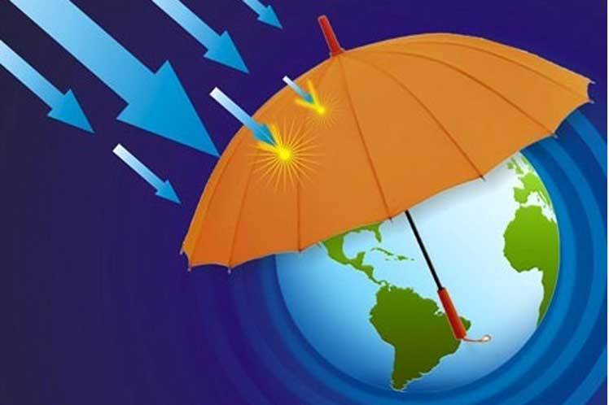
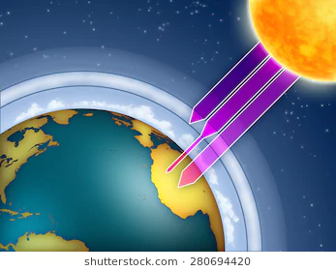
Functions of the Atmosphere
Protects us from harmful radiation from the sun (UV, gamma, x-rays). (ozone layer)
Notes:
Also can mention:
Allows us to talk
Allows flight

Slide 9
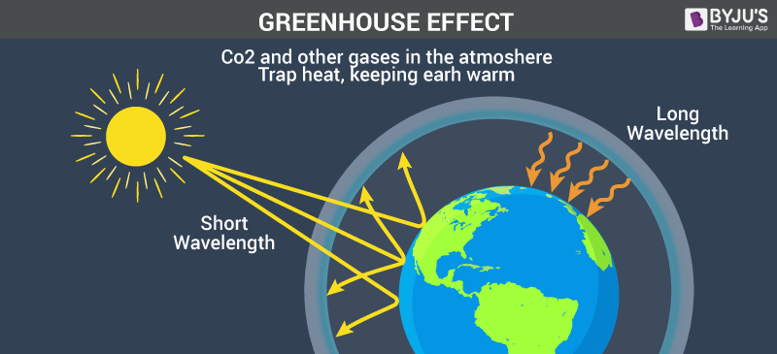
Functions of the Atmosphere
2. Acts like a blanket to trap in heat and keeps us warm.
Notes:
Also can mention:
Allows us to talk
Allows flight

Slide 10
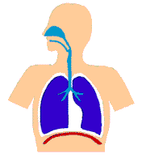
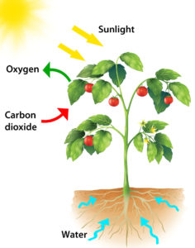
Functions of the Atmosphere
3. Provides oxygen for respiration. Provides carbon dioxide for photosynthesis (plants).
Notes:
Also can mention:
Allows us to talk
Allows flight

Slide 11
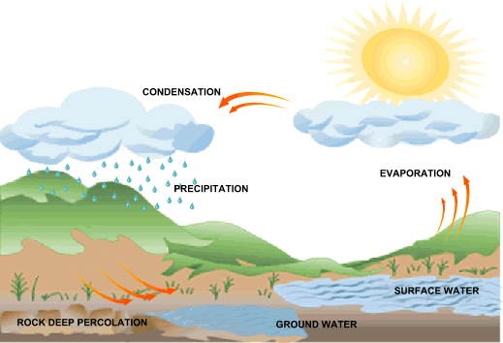
Functions of the Atmosphere
4. Gives us weather and is an important part of the water cycle.
Notes:
Also can mention:
Allows us to talk
Allows flight

Slide 12
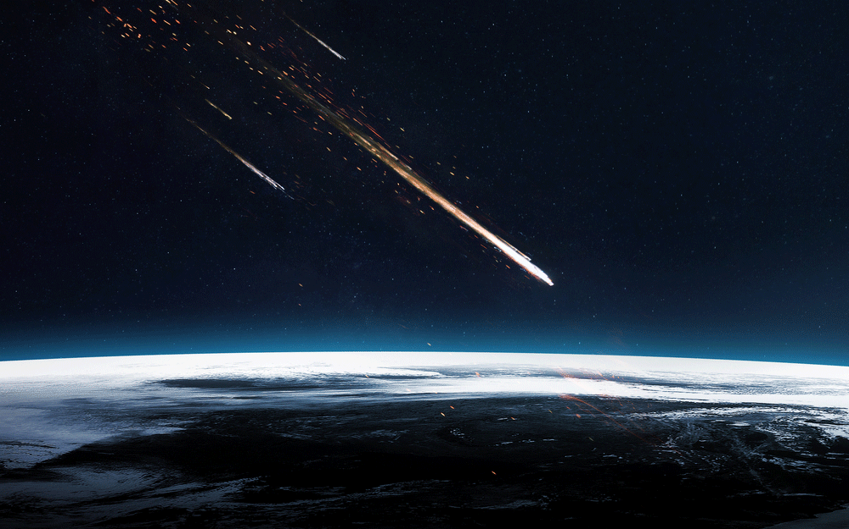
Functions of the Atmosphere
5. Protects us from meteorites.
Notes:
Also can mention:
Allows us to talk
Allows flight

Slide 13
The Water Cycle
Video: Water Cycle
Watch the video and complete the worksheet on the water cycle.

Slide 14
SUN
WIND
PRECIPITATION
CONDENSATION
EVAPORATION
RIVERS AND STREAMS
RUNOFF
INFILTRATION
OCEAN
GROUNDWATER

