Slide 1
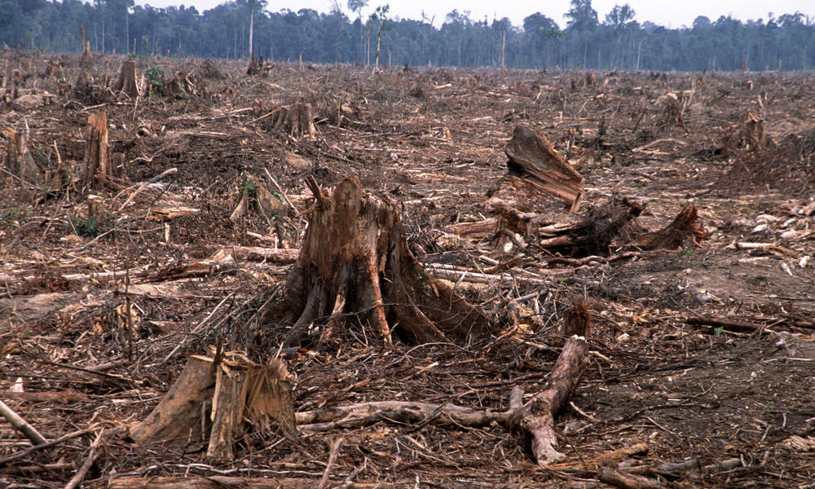
What impact will this have on the Earth?
Notes:
Picture Deforestation – What impact will this have on the Earth? Discussion: deforestation and how it affects the Earth and atmosphere, should lead to how trees are good for the environment because they produce oxygen through photosynthesis. Lead discussion to how there will be more carbon dioxide in the atmosphere if there are less trees.

Slide 2
The Carbon Cycle
Learning Objectives:
All:
Describe the different ways carbon is stored.
Most:
Describe the processes that cause carbon to move through the carbon cycle including…
  Photosynthesis
  Decomposition
  Respiration
  Combustion
Some:
Explain how human activity can affect the carbon cycle

Slide 3
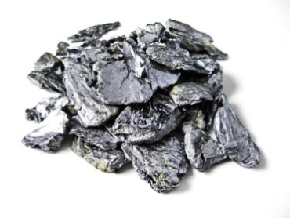
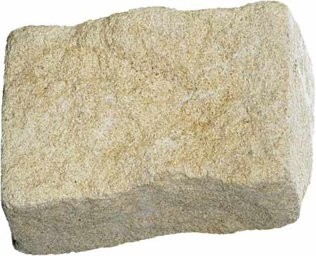
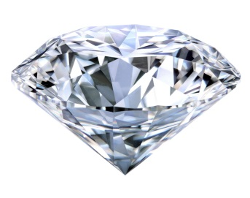
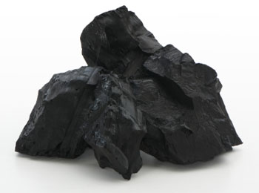
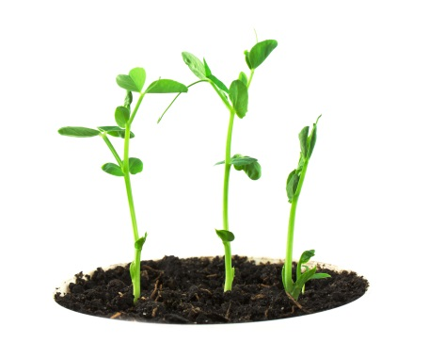
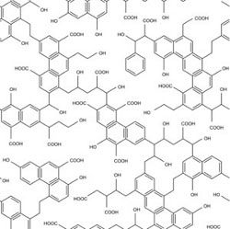
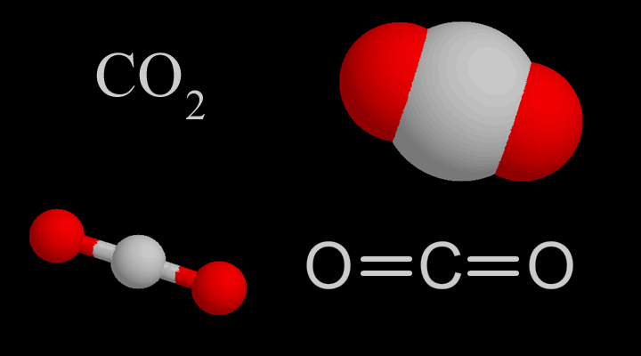
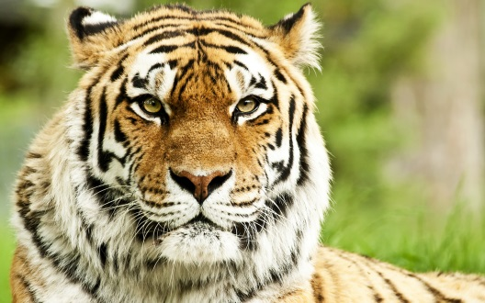
In what forms is carbon found?
Solid
Carbon
ROCKS
Calcium Carbonate
Living Things
Organic Compounds
Atmosphere
Carbon
Dioxide

Slide 4
Key Terms
Element = made of only one type of atom (C)
Compound = two or more elements chemically joined together (CO₂)
Organic Compound = carbon containing compounds found in living things
Inorganic Compound = compounds NOT found in living things (usually in rocks, example: calcium carbonate)

Slide 5
Carbon Cycle
Read the information and highlight the following information in two different colours:
Where is carbon stored?
What processes cause carbon to move through the carbon cycle?

Slide 6
Where is carbon stored?

Slide 7
Where is carbon stored?
In pencil, place the following stores in order from highest to lowest.
Rocks
Ocean
Soil
Plants and Animals
Atmosphere
Notes:
Animations will reorder into correct order: rocks (most), ocean, soil, atmosphere, plants and animals (least)

Slide 8
Rocks = 99.93% of stored carbon

Slide 9
Carbon Stores
Rocks
  Fossil Fuels
Ocean
Soil
Atmosphere
Plants and Animals
Which are
LONG TERM stores and which are SHORT TERM stores?
Notes:
Rocks and Deep Ocean = long term stores
Plants and Animals, Soil, Shallow Ocean, Atmosphere = short term store
Fossil Fuels = WAS long term store but is not being burned at a fast rate, goes into the atmosphere

Slide 10
Out of the Carbon Stores that are NOT Rocks
~93 %
~3 %
~2 %
~2 %
Ocean
Soil
Atmosphere
Living Things
Notes:
Percentage stored

Slide 11



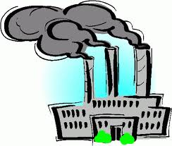
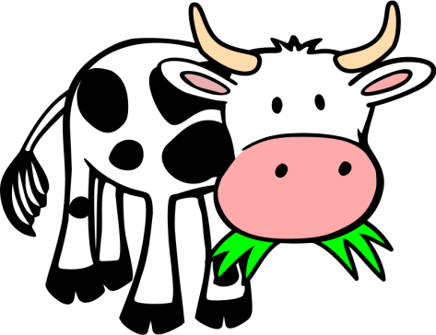



Notes:
Short Term Carbon Cycle
Carbon Stores: Ocean, Soil, Atmosphere, Plants and Animals
Processes: Dissolving into the Oceans, Decay (plants and animals into soil), Photosynthesis, Respiration (plants and animals), Feeding (plants → animals)

Slide 12
Carbon Cycle Processes
Photosynthesis
Respiration
Feeding
Decomposition (Decay)
Combustion
Dissolving
Use your fact sheet to explain the following processes and how they fit into the carbon cycle.

Slide 13
Atmosphere
Photo-
synthesis
Com-
bustion
Respiration
Dissolving
Fossil Fuels
Living Systems
Feeding
Decay
Decay
Soil
Uptake
Ocean
Notes:
Short Term Carbon Cycle
Carbon Stores: Ocean, Soil, Atmosphere, Plants and Animals
Processes: Dissolving into the Oceans, Decay (plants and animals into soil), Photosynthesis, Respiration (plants and animals), Feeding (plants → animals)

