Slide 1
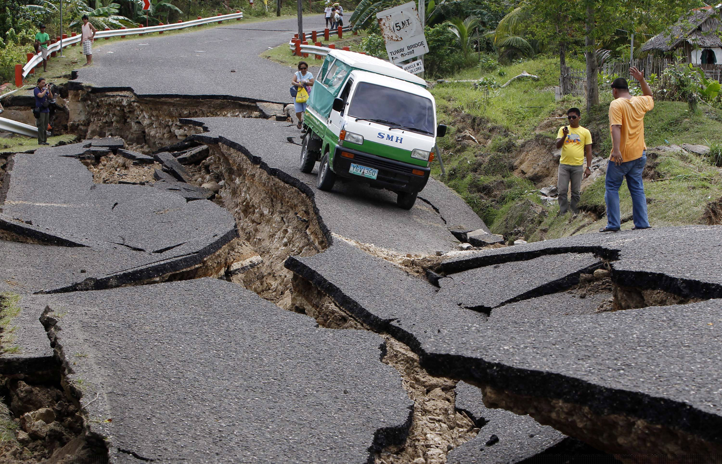
What causes this?
Notes:
Discussion about earthquakes

Slide 2
Structure of the Earth
Learning Objectives:
All:
Describe the structure of the Earth.
Most:
Describe the theory of plate tectonics.
Some:
Explain how volcanoes, earthquakes, and mountain ranges occur.

Slide 3
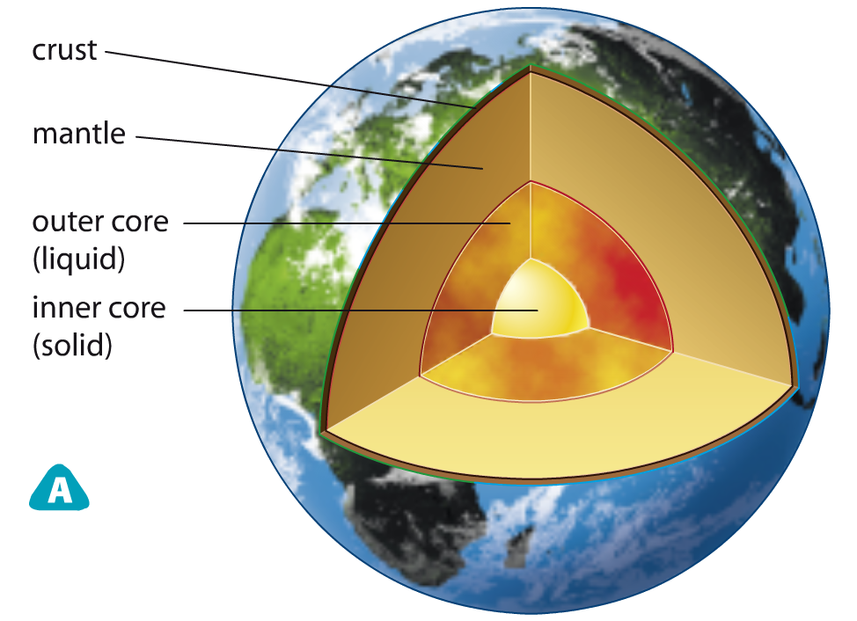
Is it possible to drill to the other side of the Earth?
If you drill deep into the Earth, what would you find?
Notes:
Crust is rocky. Mantle is mostly solid but some parts are made of molten rock (magma). Mantle acts as a very viscous liquid in geologic time. Outer core is liquid but the inner core is a solid ball, mostly made of iron.

Slide 4
Key Terms
Describe the following in your own words:
Crust
Mantle
Outer core
Inner core
Notes:
Pg. 108 Exploring Science 8
Crust – solid rock at the surface of the Earth
Mantle – part of the Earth below the crust, mostly solid but molten rock in places
Outer core – liquid portion of the core in the centre of the Earth
Inner core – solid core of the Earth, mostly made of iron

Slide 5
Key Terms
Crust – solid rock at the surface of the Earth
Mantle – part of the Earth below the crust, mostly molten rock
Outer core – liquid portion of the core in the centre of the Earth
Inner core – solid core of the Earth, mostly made of iron
Notes:
Pg. 108 Exploring Science 8
Crust – solid rock at the surface of the Earth
Mantle – part of the Earth below the crust, mostly solid but molten rock in places
Outer core – liquid portion of the core in the centre of the Earth
Inner core – solid core of the Earth, mostly made of iron

Slide 6
Check for Understanding
I can:
Describe the structure of the Earth.
Describe the theory of plate tectonics.
Explain how volcanoes, earthquakes, and mountain ranges occur.

Slide 7
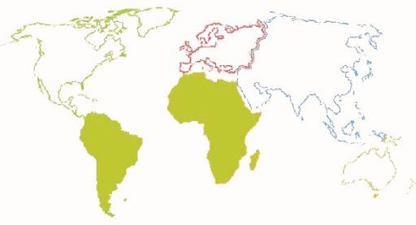
What do you notice if you look at the coastlines of these continents?

Slide 8
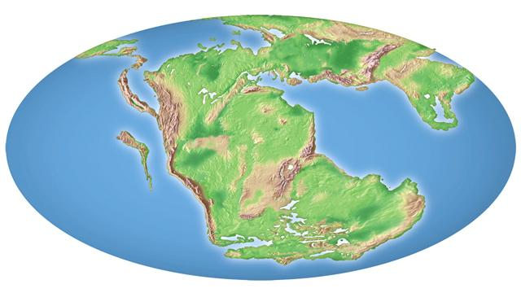
Welcome to Pangaea
Pangaea is the ancient landmass comprising all the continents combined together.
Notes:
Pangaea is the ancient landmass comprising all the continents combined together which began to break up around 200 million years ago
https://www.youtube.com/watch?v=uLahVJNnoZ4&t=280s

Slide 9
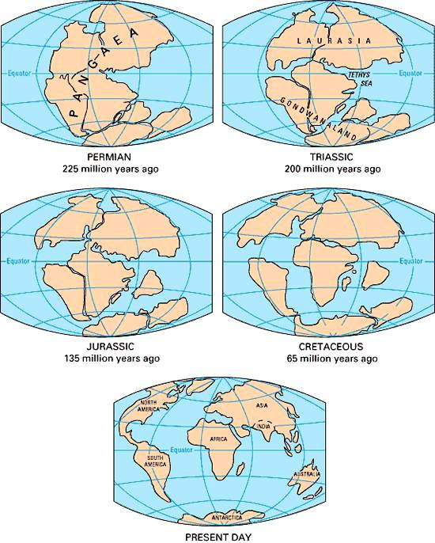
Continental Drift
Parts of the crust move around slowly and the continents shift with them. This is called continental drift.
Notes:
Pangaea split up and continents moved apart – continental drift

Slide 10
Theory of Plate Tectonics
Tectonic plates are sections of the crust that float on top of the mantle.
SOLID
LIQUID
Notes:
*mantle is mostly solid but behaves like a very viscous liquid in geologic time

Slide 11
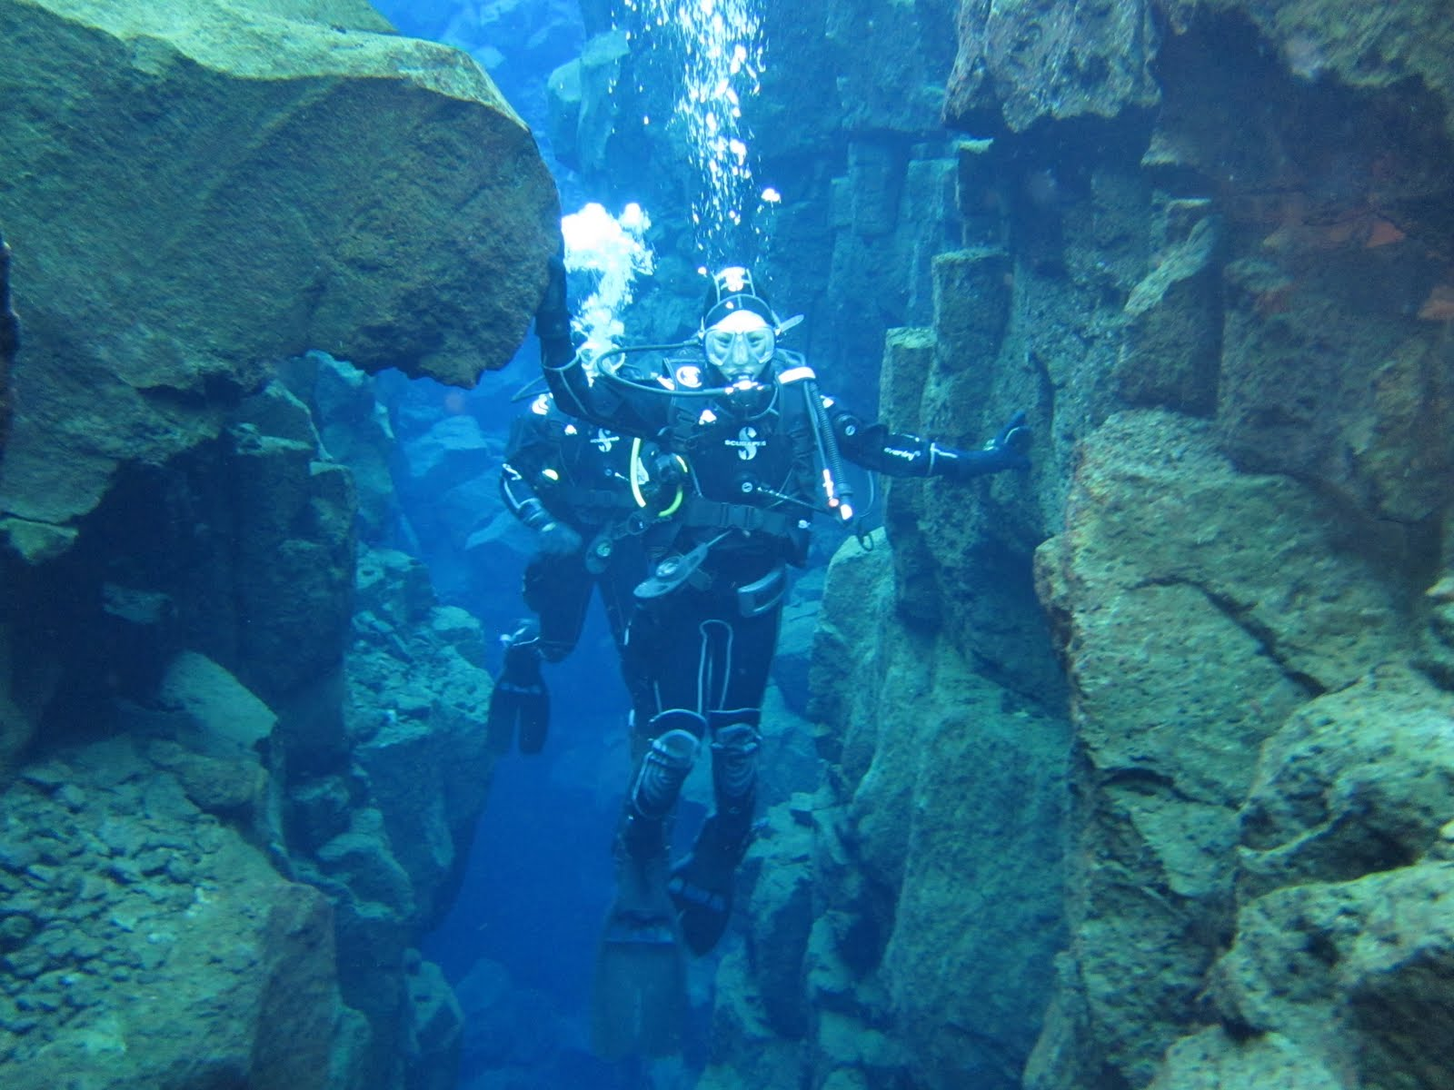
Modern Plates
In between the North American and Eurasian plates
There are currently 8 major plates.
African
Antarctic
Eurasian
North American
South American
Pacific
Indian
Australian
Notes:
Picture: Mrs. Gao touching both the North American plate and the Eurasian plate while diving in Silfra in Iceland (Silfra is a rift that is part of the divergent tectonic boundary between the North American and Eurasian plates, http://en.wikipedia.org/wiki/Silfra). The meeting of the two plates is why Iceland is so volcanic!

Slide 12
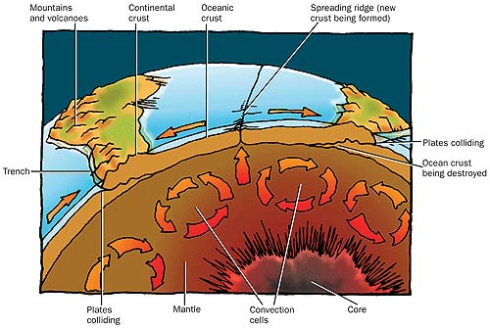
What causes the plates to move?
Convection currents push the plates around.
This is caused from uneven heating of the mantle.
Notes:
Demo: corks floating in beaker of water, heat, see them move from convection currents
Extension: Describe and Explain are convection currents?

Slide 13
Check for Understanding
I can:
Describe the structure of the Earth.
Describe the theory of plate tectonics.
Explain how volcanoes, earthquakes, and mountain ranges occur.

Slide 14
What happens when the plates meet?
Demo: We going to represent plates with rolled paper.
What can happen when the plates meet?

Slide 15
When plates crash together one can get pushed under the other.
Magma pushes up and forces the plates to move apart.
When plates crash together they can push up mountains.

Slide 16
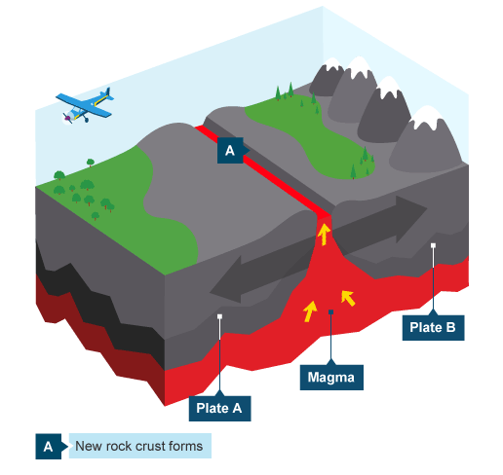
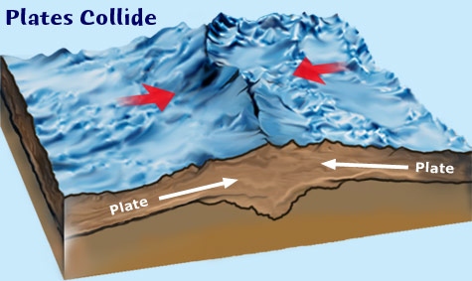
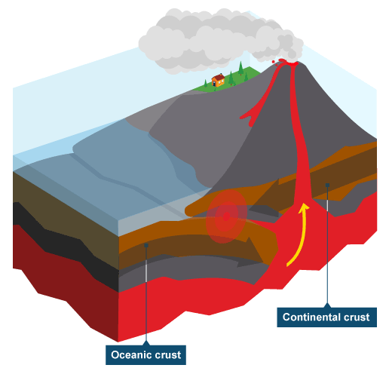
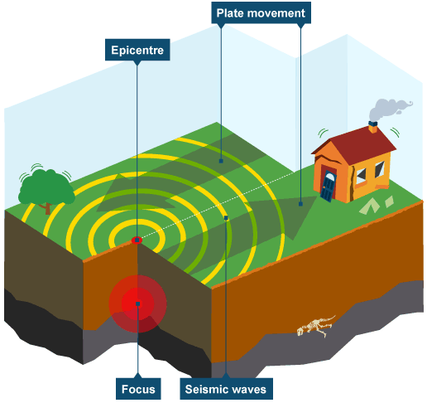
Plate Boundaries

Slide 17
Divergent Plate Boundary
Plates moving apart create new crust.
Magma fills in the gap, cools, and forms new crust.
Notes:
Divergent plate boundary

Slide 18
Convergent Plate Boundary
Plates can collide and push up mountain ranges.
Notes:
Convergent plate boundary

Slide 19
Convergent Plate Boundary - Subduction
One plate can get pushed under the other.
This can form mountains as well.
This can also force magma up and cause volcanoes.
Notes:
Convergent Plate Boundary - Subduction zone

Slide 20
Transform Plate Boundary
Plate can also slide past each other.
Pressure can build up and release with a jerk.
This is what causes earthquakes.
Demo
Notes:
Demo: pulling block across sandpaper with force meter – force applied does not move block right away, then as the force increases the block moves with a jerk. This mirrors what happens with earthquakes, plates apply force → pressure builds → pressure is released as an earthquake as the crust moves with a big jerk.

Slide 21
Check for Understanding
I can:
Describe the structure of the Earth.
Describe the theory of plate tectonics.
Explain how volcanoes, earthquakes, and mountain ranges occur.

Slide 22
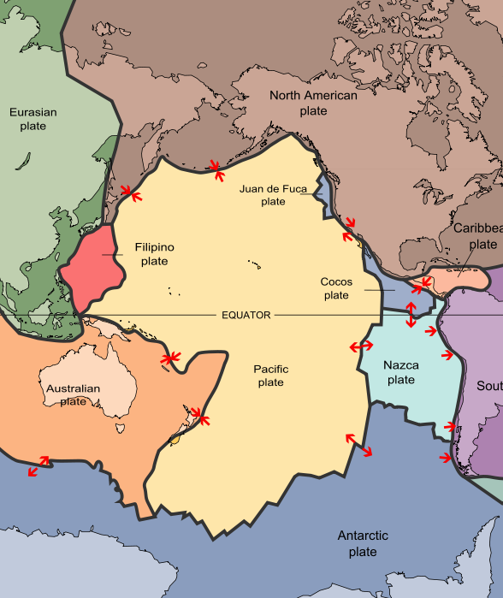
Ring of Fire
Plenary
Writing Task:
“Why is the Ring of Fire known for being an area with a large number of earthquakes and volcanic eruptions?” (3 marks)

Slide 23
Core Task (Part 2)
You are a journalist from EARTH magazine.
Your task is to write an article about the structure of the EARTH.
Your article should include:
The structure of the Earth
The theory of plate tectonics
Explaining mountain ranges, volcanoes, and earthquakes
Focus on an example in the world (ie. mountain range, volcanic area)
Notes:
Some possibilities for the focus on section: mariana trench, iceland, hawaii, andes mountains, rocky mountains, ring of fire

