Slide 1
Variation
Learning Objectives:
Recall examples of inherited and environmental variations.
Describe the difference between inherited and environmental variation.
Explain what causes variation.
Draw graphs of categoric variables and continuous variables.

Slide 2
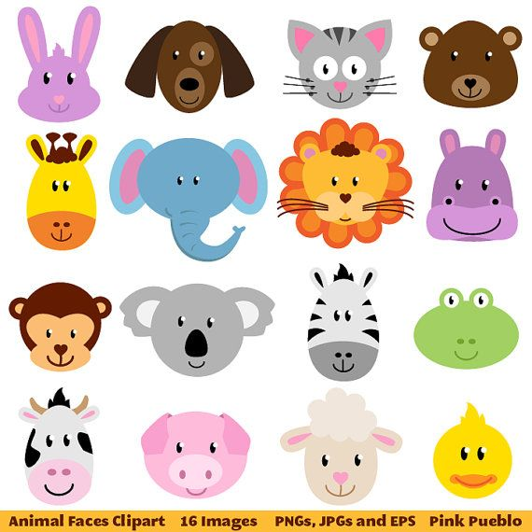
What is variation?
Variation = the differences between organisms
These can be differences between organism of different species.
Or differences between organisms of the same species.

Slide 3
Where does variation come from?
There are two main types of variation:
Inherited
Environmental
Inherited variation = variation caused by the features you get from your parents through your genes (DNA)
Environmental variation = variation caused by things in your surroundings (environment)

Slide 4
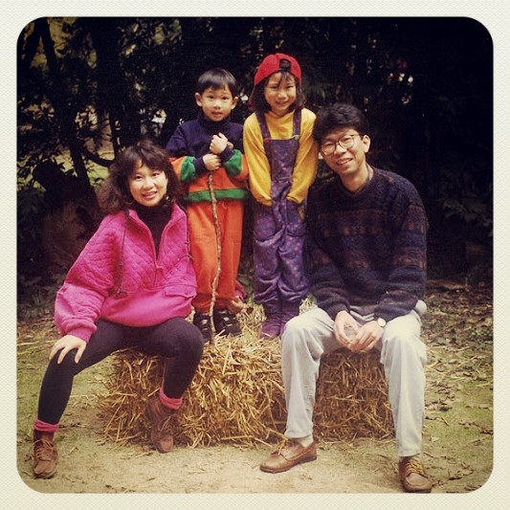
Inherited Variation
How can you tell that people in this family are related?
Why do relatives share similar features?

Slide 5
Children look like their parents because they get their genes from their parents.
Gene = a section of DNA that controls one particular feature
You get half of your genes from your mom and half from your dad.
That is why you look like a combination of both and not exactly like either one.

Slide 6
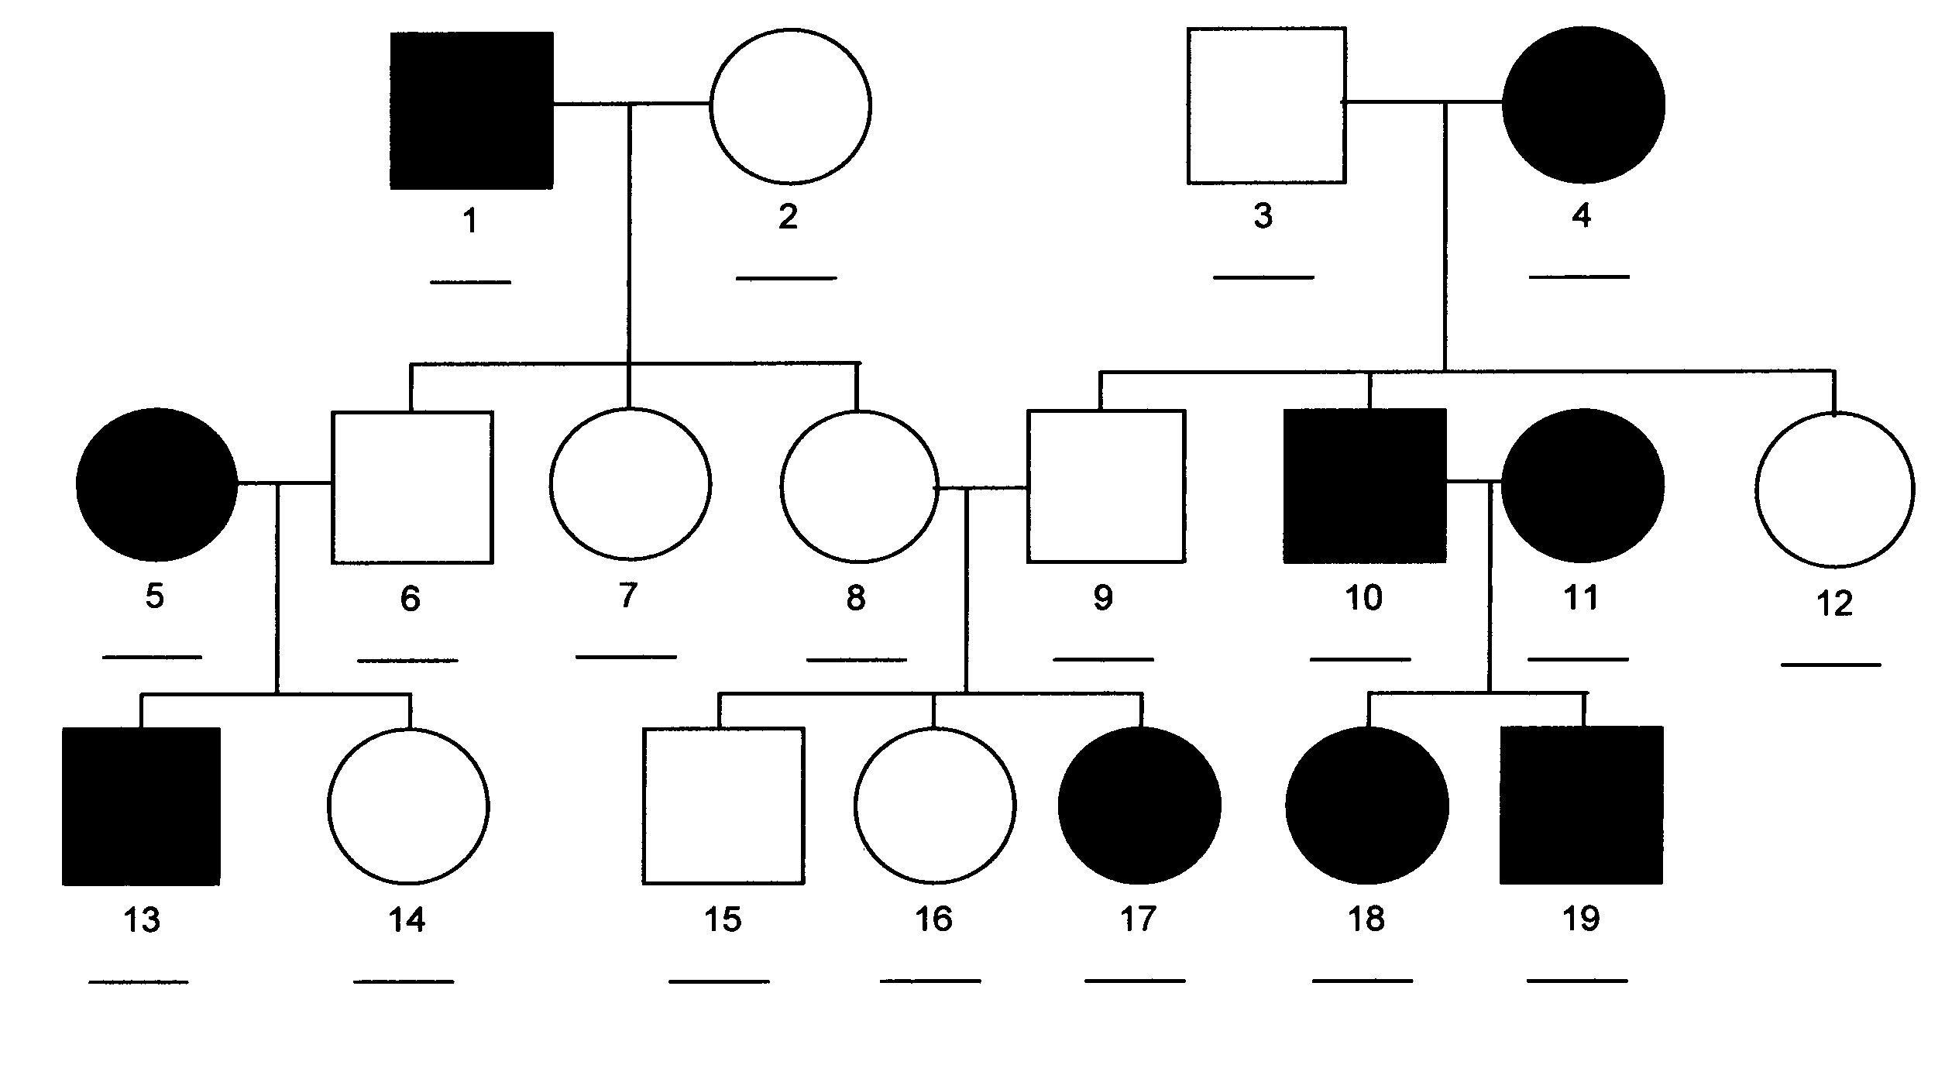
Pedigree Charts
Genetic disease = some diseases are inherited.
Doctors can look at pedigree charts to see what the chances are of a child inheriting a genetic disease.

Slide 7
How to read a pedigree chart
Key
Male – Normal
Male – Disease
Female – Normal
Female – Disease

Slide 8
Environmental Variation
Variation can also be caused by the environment.
Can you think of how the environment might causes variation?
This is why identical twins don’t look EXACTLY the same even though they have the same genes.

Slide 9
What kind of variable is variation?
There are two main types of variables used to decide what kind of graph to use:
Categoric
Continuous
Categoric variable = categories using words
Continuous variable = measurements using numbers

Slide 10
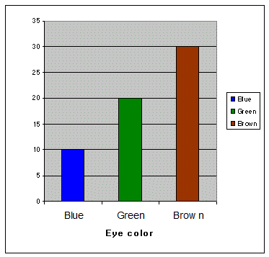
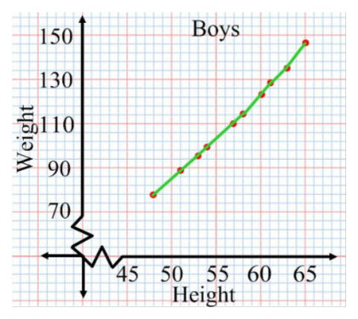
What graph would use for categoric variables?
What graph would you use for continuous variables?

Slide 11
Categoric or Continuous?
Activity 1
As a class, we will record the numbers of students in the class that:
Attached earlobes
Detached earlobes
Can roll their tongue
Cannot roll their tongue
Clasped hands right over left
Clasped hands left over right
Draw a graph of the results.
Are these variables caregoric or continuous?

Slide 12
Categoric or Continuous?
Height (cm) | Arm Span (cm)
Activity 2:
Measure your height and arm span and record the information on the board.
Draw a graph of the class data.
Are these variables categoric or continuous?

