Slide 1
From Cells to Systems
Learning Objectives:
Review the signs of life.
Describe how organisms are organised from cells, tissues, organs, and organ systems.
Name some human organs and organ systems.
Name some plant organs.

Slide 2
Task
Use the textbook to fill in the packet on “Cells, Tissues, Organs, and Organ Systems”.
Use these pages: 20, 34-35, 8-9, 7, back to 8-9.
Do as many as you can, if you don’t know it skip it and move on.
We will go over it afterwards.

Slide 3
How do we know if something is alive?
The Seven Signs of Life
M
R
S
G
R
E
N

Slide 4
How is the body organized?
Living things are made up of organized systems.
Each specific cell is grouped with cells similar in structure and function to form a tissue.
cells
tissue

Slide 5
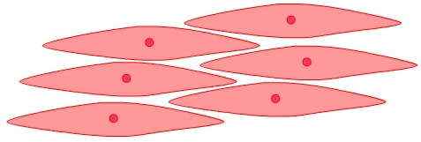
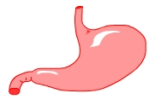

How is the body organized?
cell
tissue
organ
Cells are the
basic units of life.
Groups of cells
work together
to form tissues.
Groups of tissues work together to form organs.

Slide 6
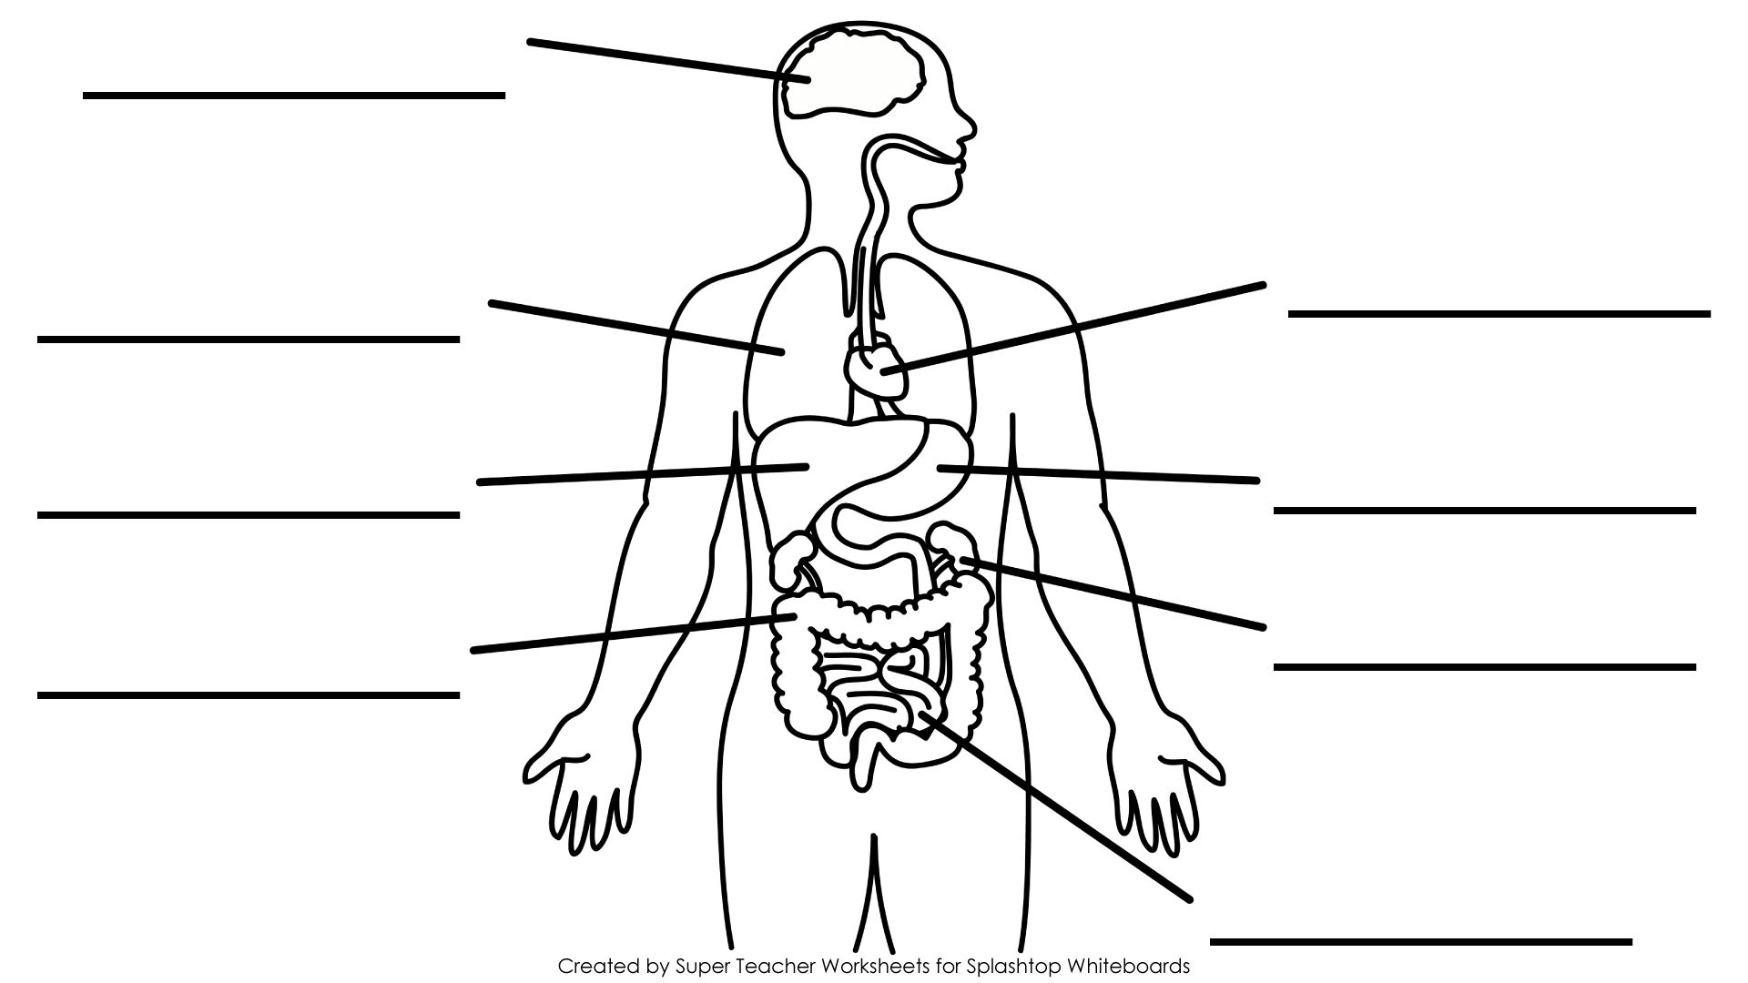
Main Human Organs
BRAIN
LUNG
HEART
LIVER
STOMACH
KIDNEY
LARGE
INTESTINE
SMALL
INTESTINE

Slide 7
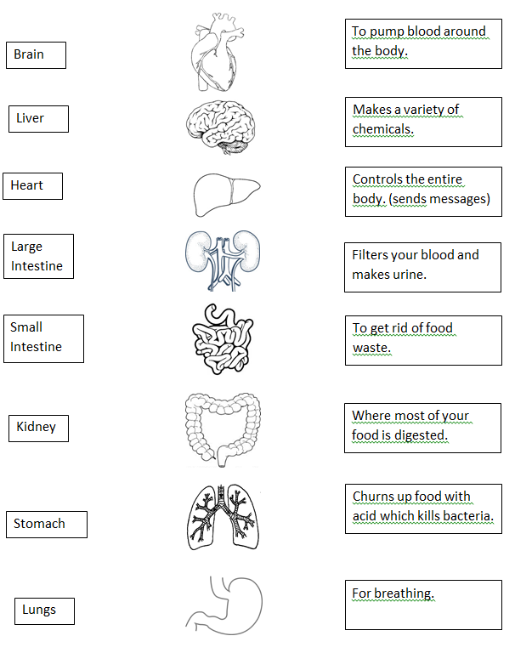

Slide 8
WARNING!
IF YOU ARE SQUEEMISH!

Slide 9
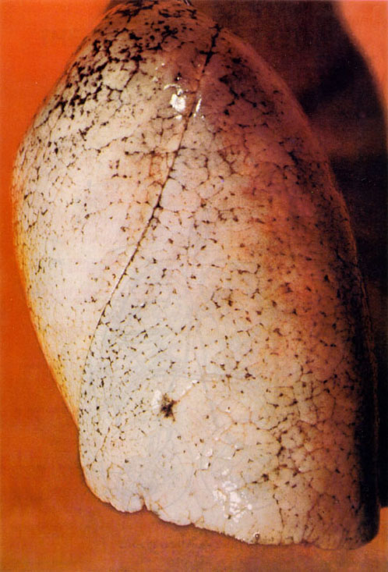
Notes:
lung

Slide 10
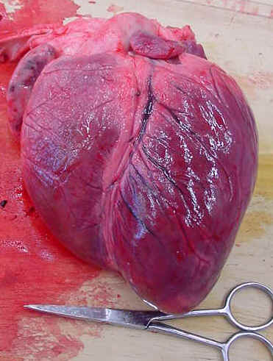
Notes:
heart

Slide 11
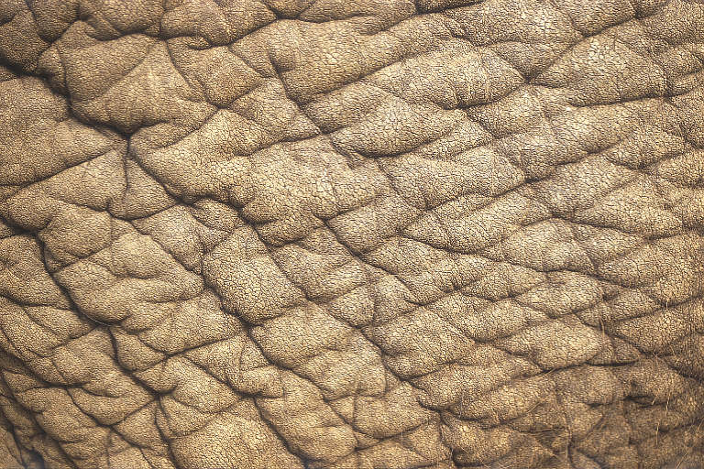
Notes:
skin

Slide 12
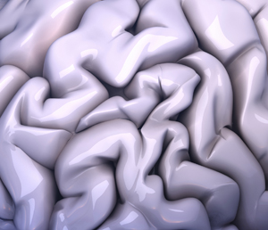
Notes:
brain

Slide 13
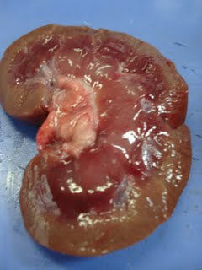
Notes:
kidney

Slide 14
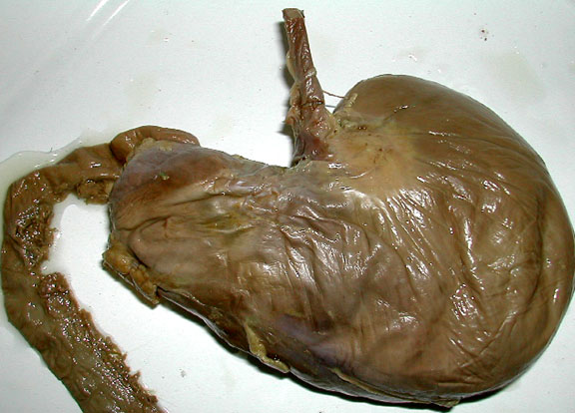
Notes:
stomach

Slide 15
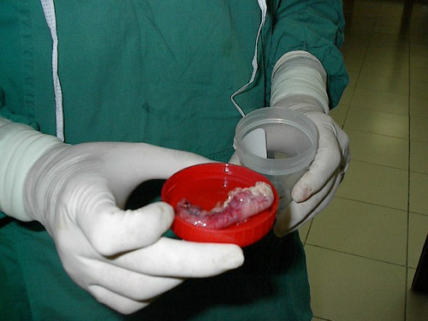
Notes:
appendix

Slide 16
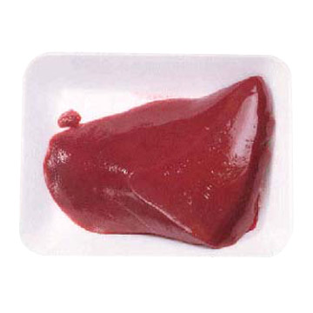
Notes:
Liver from a calf

Slide 17
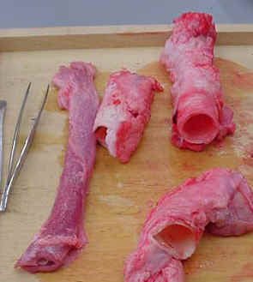
Notes:
trachea

Slide 18
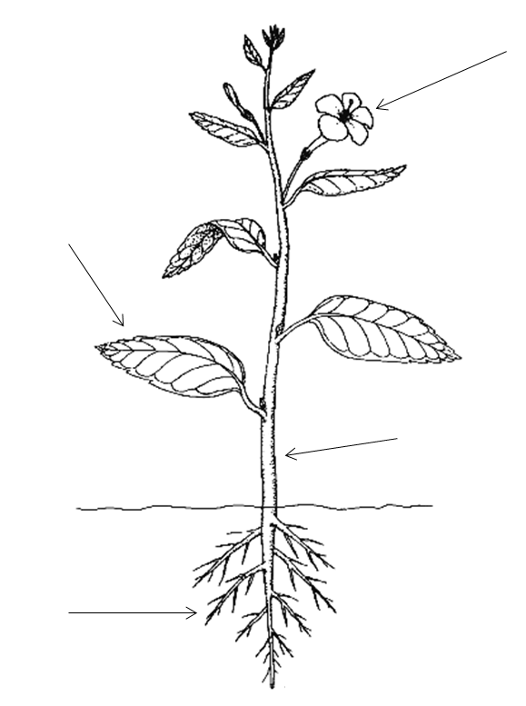
Plants also have organs!
Flower
- for reproduction
Leaves
- for photosynthesis
Stem
- to transport water and nutrients
Root
- Absorb water

Slide 19
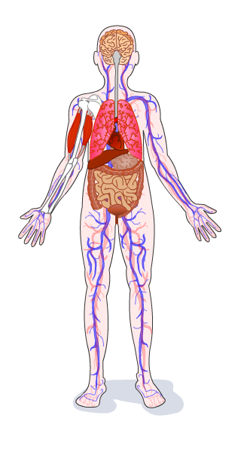
Organ Systems
Groups of organs form systems.
Organs that work together to do one specific job are called an organ system.

Slide 20
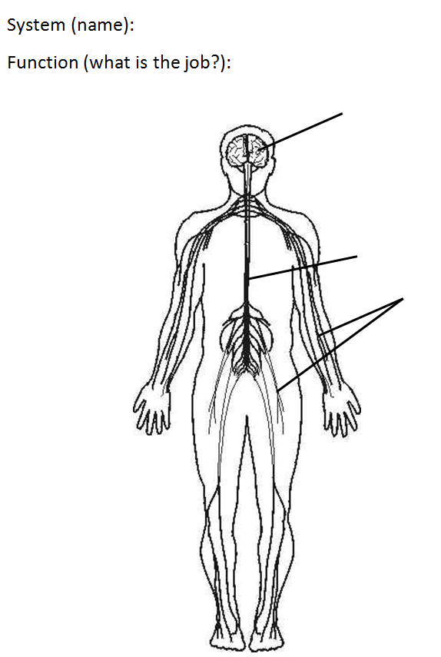
Nervous System
Helps the parts of the body communicate (sends messages)
Brain
Spinal Cord
Nerves

Slide 21
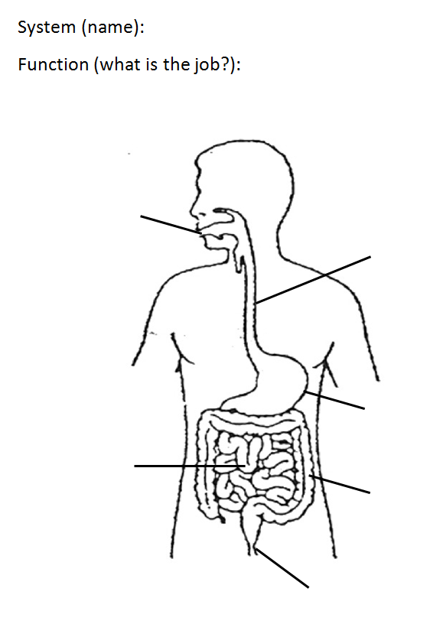
Digestive System
Breaks down food we eat
Mouth
Oesophagus (Gullet)
Stomach
Small Intestine
Large Intestine (Colon)
Rectum

Slide 22
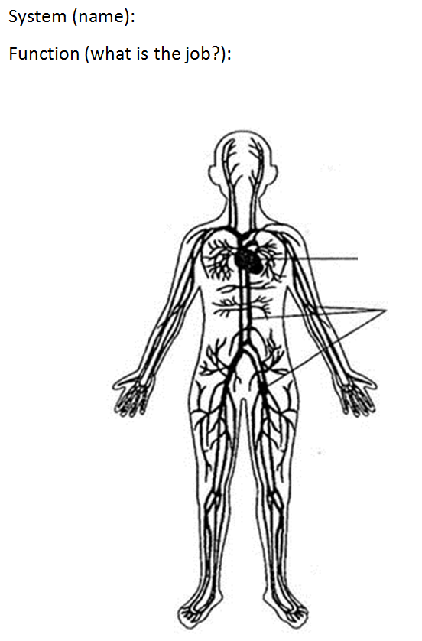
Circulatory System
Transports substances all over the body (through the blood)
Heart
Blood Vessels

Slide 23
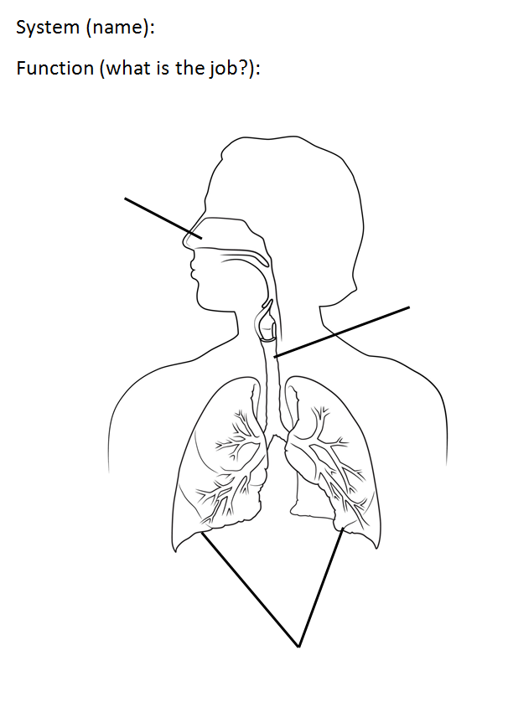
Respiratory System
Breathing (bringing in oxygen and removing carbon dioxide)
Nose (nasal cavity)
Trachea (Windpipe)
Lungs

Slide 24
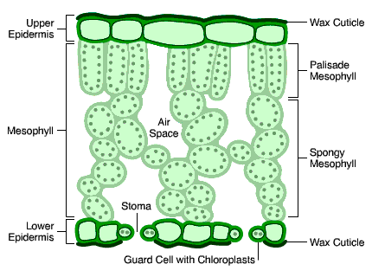
Cells, tissues, organs and systems
Basically, all living things are made up of cells…
A group of CELLS makes up a TISSUE
A group of TISSUES makes up an ORGAN
A group of ORGANS makes up a SYSTEM
A group of SYSTEMS make up an ORGANISM

Slide 25

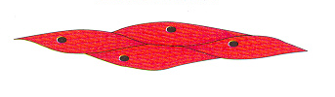
Another example
Here’s another example in humans:
Muscle cells
Muscle tissue
Organ
System
Organism

