Slide 1
Classification
Learning Objectives
Recall that organisms are sorted into different groups.
Classify animals into vertebrates and invertebrates.
Describe the features of the different vertebrate groups.
Use classification keys to classify organisms.

Slide 2
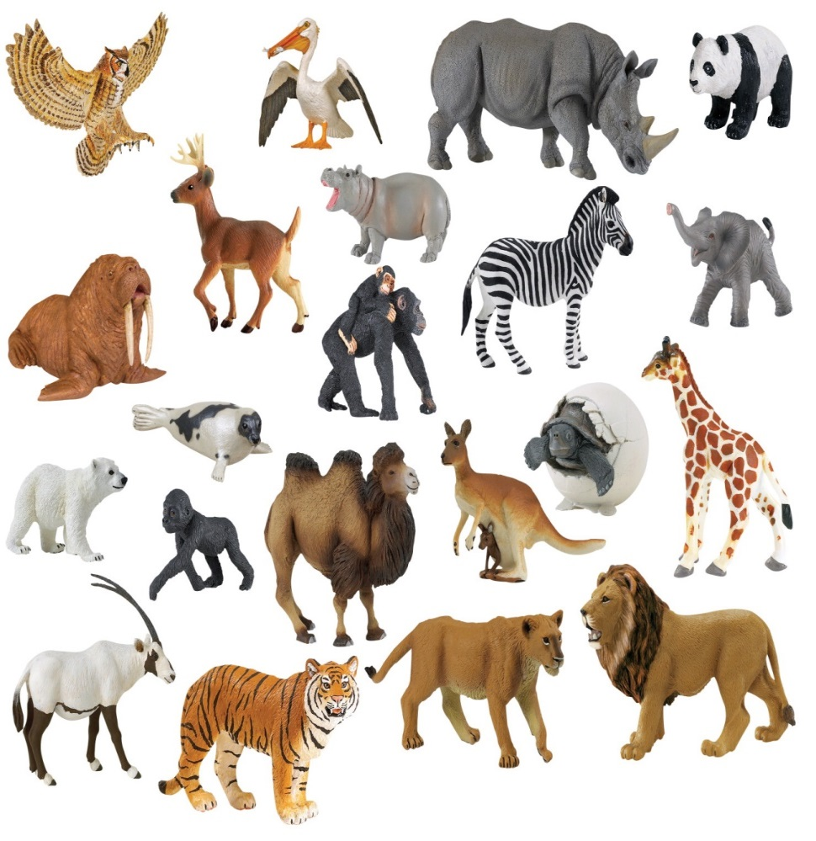
What is classification?
Classification = sorting into groups
Scientists can use variation to sort organisms into different groups.
WHY?
This makes them easier to study.
How would you sort these animals?

Slide 3
What are the main animal classifications?
Vertebrates = have a backbone
Invertebrates = do NOT have a backbone

Slide 4
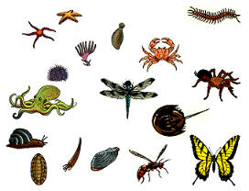
Invertebrates
Insects
Spiders
Crustaceans (such as crabs)
Mollusks (such as the octopus)
Worms

Slide 5
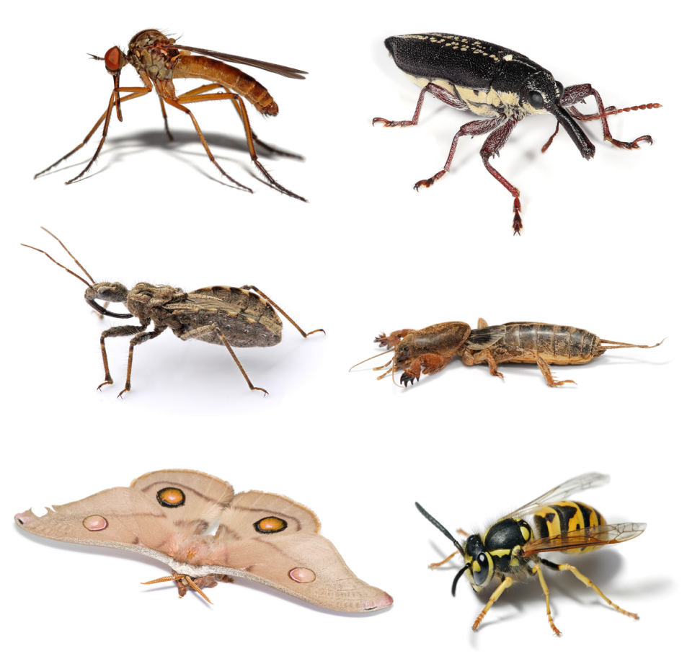
Insects
Have an exoskeleton (outer skeleton)
Have six legs

Slide 6
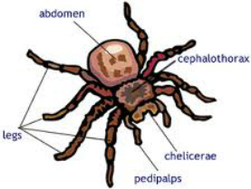
Spiders (Arachnids)
Have an exoskeleton.
Have eight legs.

Slide 7
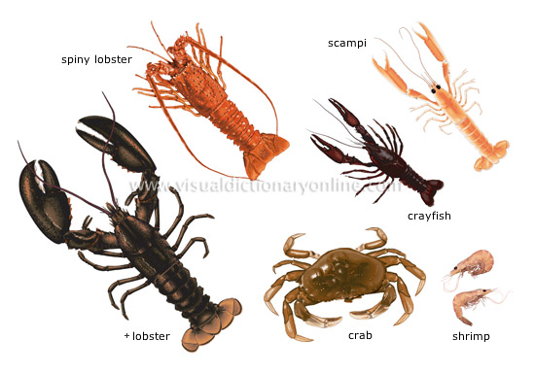
Crustaceans
Have a hard exoskeleton shell.
Gills to breath underwater.

Slide 8
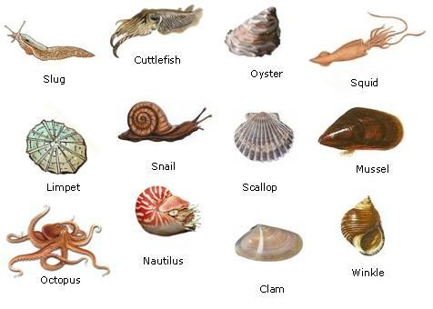
Molluscs
Have a soft body.

Slide 9
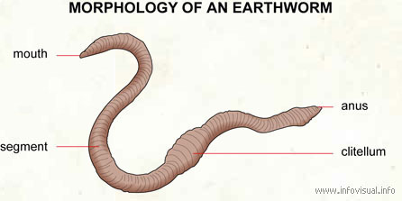
Worms
Long segmented body.

Slide 10
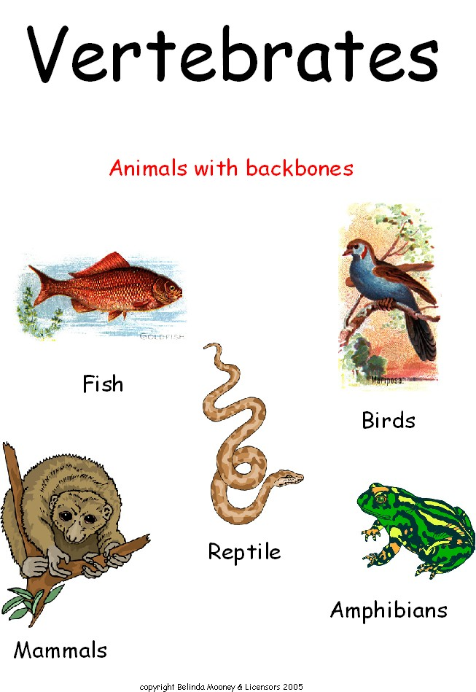
Vertebrates
There are five main vertebrate groups:
Mammals
Birds
Fish
Reptiles
Amphibians

Slide 11
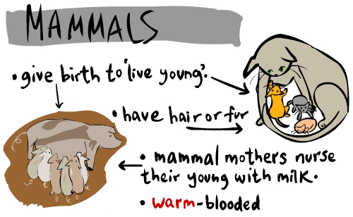

Slide 12
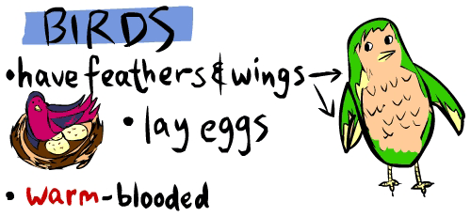

Slide 13
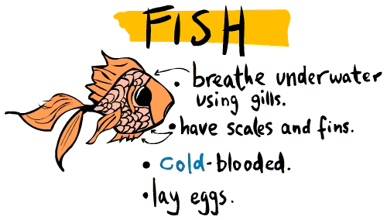

Slide 14
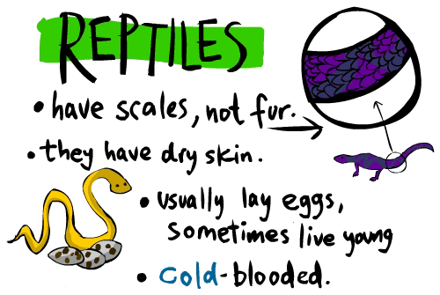

Slide 15
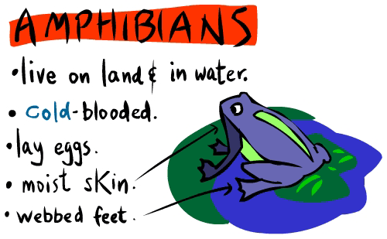

Slide 16
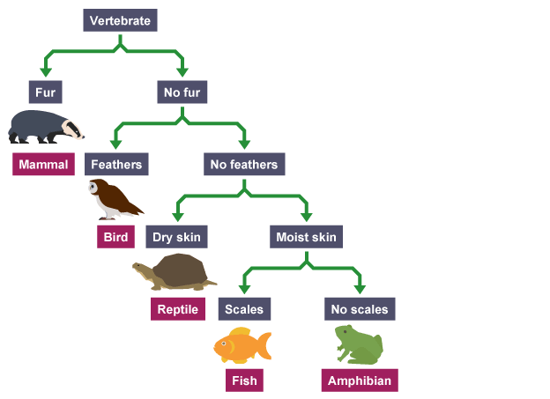
Classification Keys
Classification keys can be used to help scientists to identify species, especially ones that are very similar.

Slide 17
How to use a classification key

Slide 18
Peacock Flounder
Spotted goat fish
Glassy sweeper
Squirrel fish
Spotted eagle ray
Band tail puffer
Spotted moray eel
Glass eye snapper
Trumpet fish

