Slide 1
Changes in Habitats
Learning Objectives:
Name some daily changes in a habitat.
Name some seasonal changes in a habitat.
Describe how organisms are adapted to these changes.

Slide 2
Are habitats always the same?
What daily changes are there?
What seasonal changes are there?
How do animals adapt to these daily and seasonal changes?

Slide 3


Slide 4
Adaptations to Daily Changes
Changes
Amount of Light - Light during the day, dark at night
Temperature - Warmer during the day, colder at night
Adaptations
Nocturnal animals
Sleep during the day
Big eyes to see in low light
Good hearing or smell
Thick fur to keep warm
Diurnal animals
Sleep at night
Take shelter at night

Slide 5
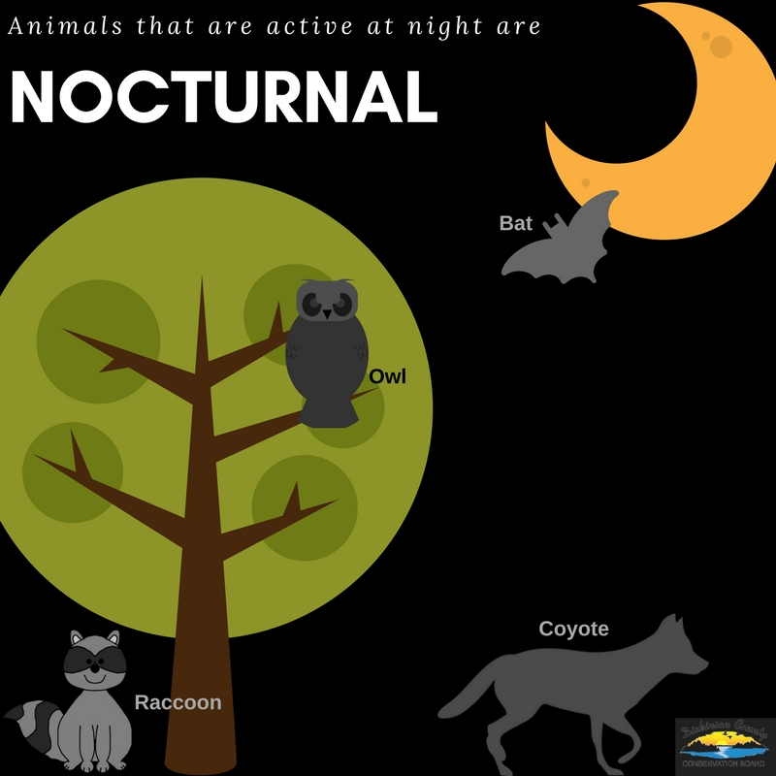

Slide 6


Slide 7
Adaptations to Seasonal Changes
Changes
Temperature - (cold season, warm season)
Rain (rainy seasons, dry seasons)
Length of day
Brightness of light
Adaptations
Hibernation (sleep during winter)
Migration (move to different areas during cold season)
Body Covering - Changes in fur/feathers to better insulate or camouflage

Slide 8
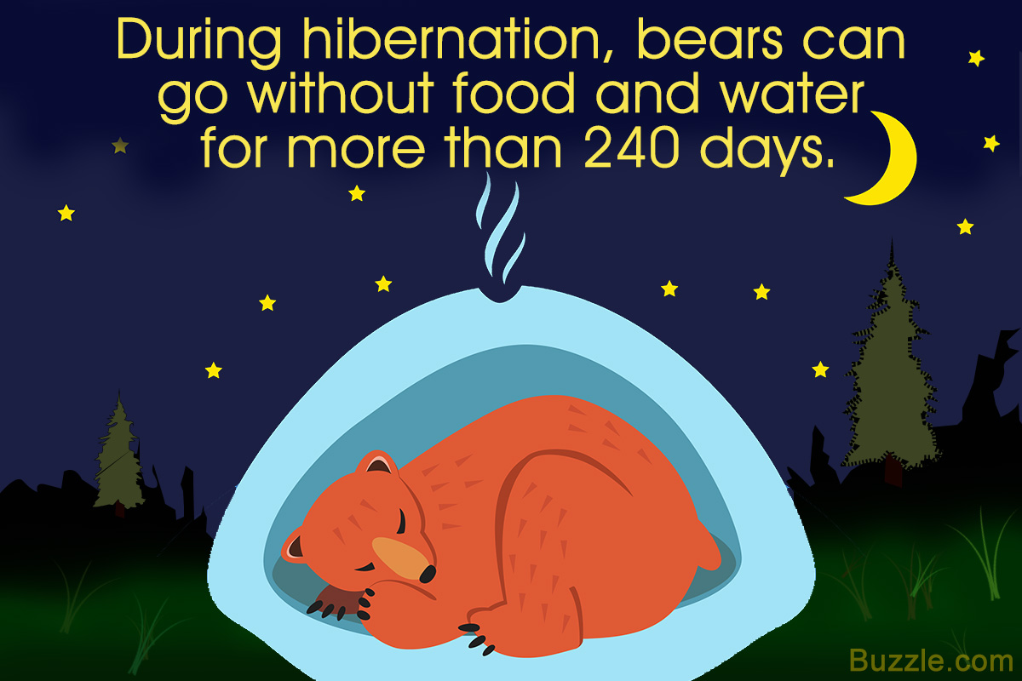

Slide 9
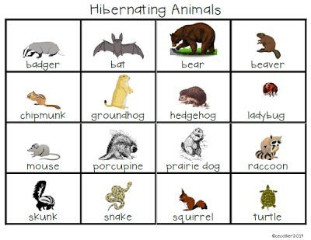

Slide 10
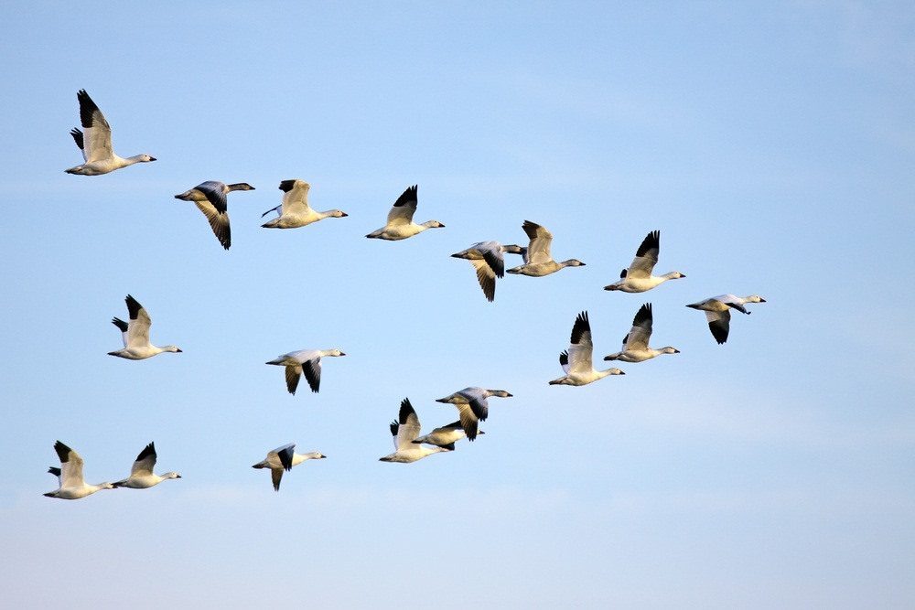

Slide 11
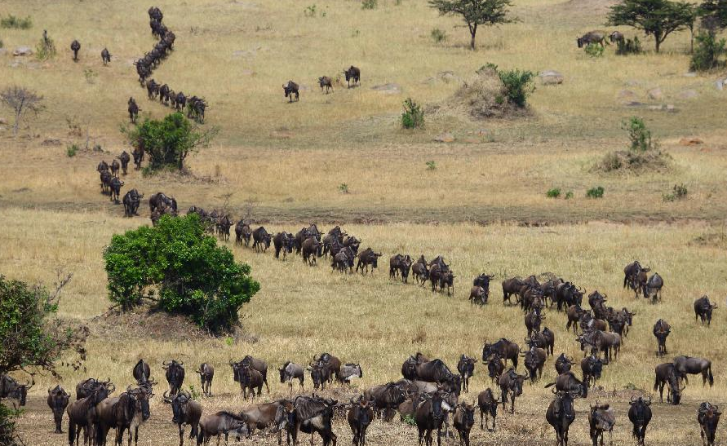

Slide 12
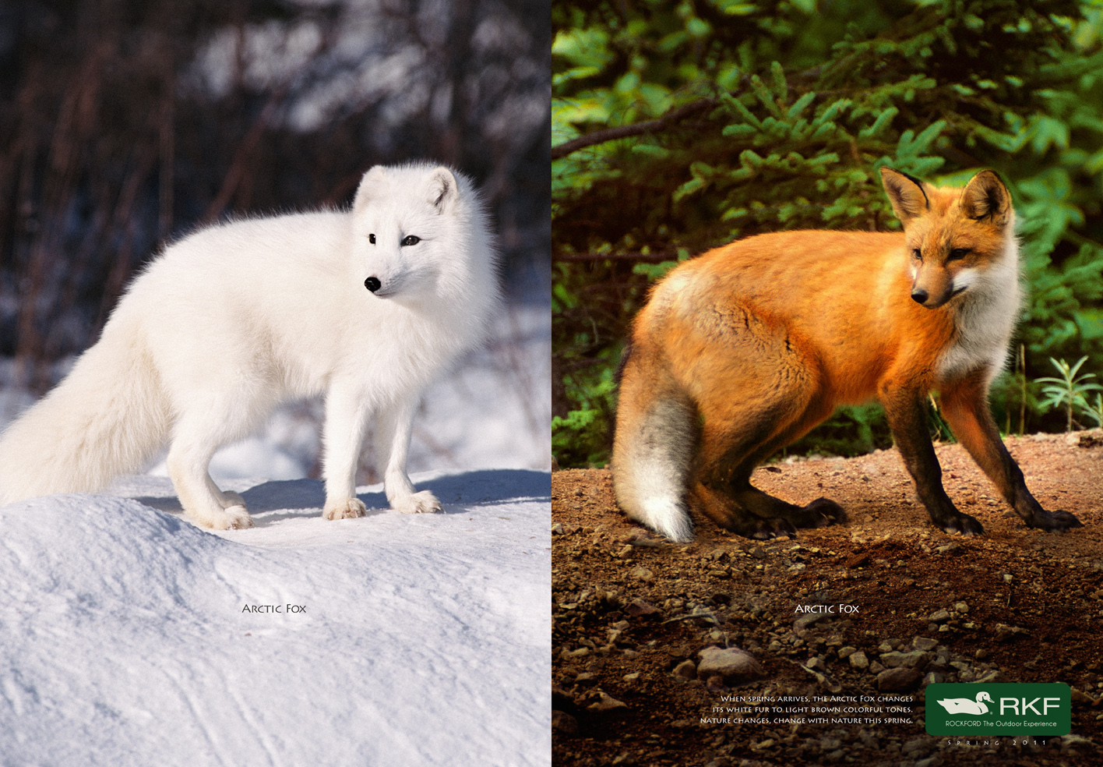

Slide 13
