Slide 1
Starter: Review
What is the scientific name for burning?
What three things do fires need for this chemical reaction?
What is a fuel?
What types of energy are released when something burns?
What gases are produced when something burns?
Name three ways to put out a fire and explain why it works

Slide 2
Starter: Review
What is the scientific name for burning?
combustion
What three things do fires need for this chemical reaction?
fuel, oxygen, and heat
What is a fuel?
a substance that releases energy when burnt
What types of energy are released when something burns?
heat and light
What gases are produced when something burns?
carbon dioxide and water vapour

Slide 3
Starter: Review
6. Name three ways to put out a fire and explain why it works
put water on a wood fire – cools the fire and removes heat
use a fire blanket – prevents oxygen from getting to the fire
use a carbon dioxide fire extinguisher – removes the heat and oxygen
7. Fuel + Oxygen → Carbon Dioxide + Water

Slide 4
Energy L1: Introduction to Energy
Learning Objectives:
Recall the different forms of energy.
Understand the law of conservation of energy.
Describe energy transfers.

Slide 5
Energy
Energy is needed for many things to happen.
Can you think of things that need energy to happen?

Slide 6
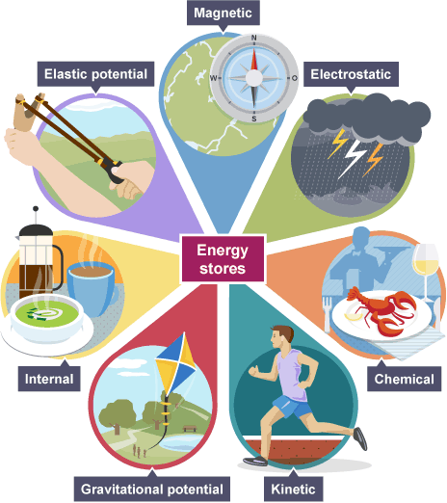
Energy Stores
Thermal (heat)
Chemical
Elastic or Strain
Kinetic (movement)
Gravitational Potential
Magnetic
Heat

Slide 7
What do we measure energy in?
Length is measured in …….
Metres
Time is measured in …….
Seconds
Temperature is measured in …….
Degrees Celsius

Slide 8
What do we measure energy in?
Energy is measured in…
Joules (J)

Slide 9
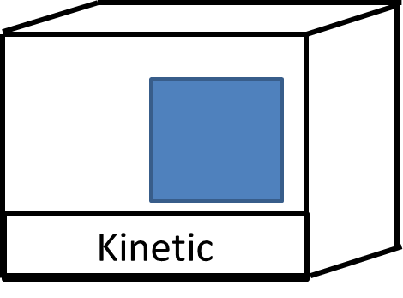
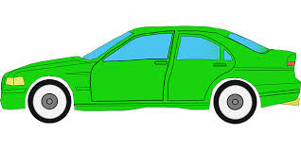
Kinetic (Movement) Energy Store
An object which is moving, will have kinetic energy in its store

Slide 10
Gravitational Energy Store
Objects that are high up, such as an aeroplane will have gravitational energy in its store. The higher the plane goes………
Gravitational

Slide 11
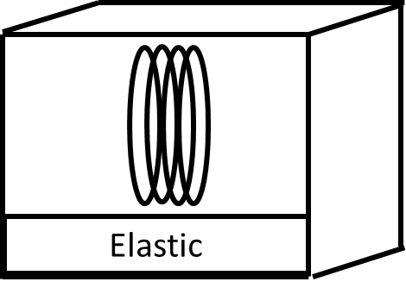
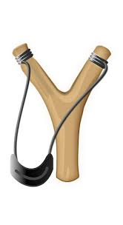
Elastic Energy Store
Objects that are stretched or squeezed have elastic energy in their store

Slide 12
Thermal Energy Store
Objects that are warm or hot have thermal energy in their store. The hotter the object……
Thermal

Slide 13
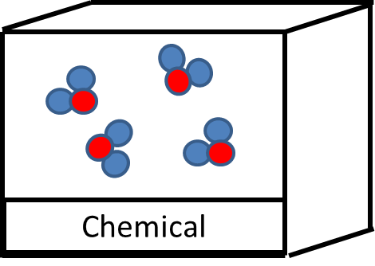
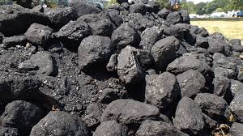
Chemical Energy Store
Objects that have chemicals that can react (like fuels) have chemical energy in their store

Slide 14
Magnetic Energy Store
Magnetic energy is stored when you hold a magnetic material (or another magnet) close to a magnet.

Slide 15
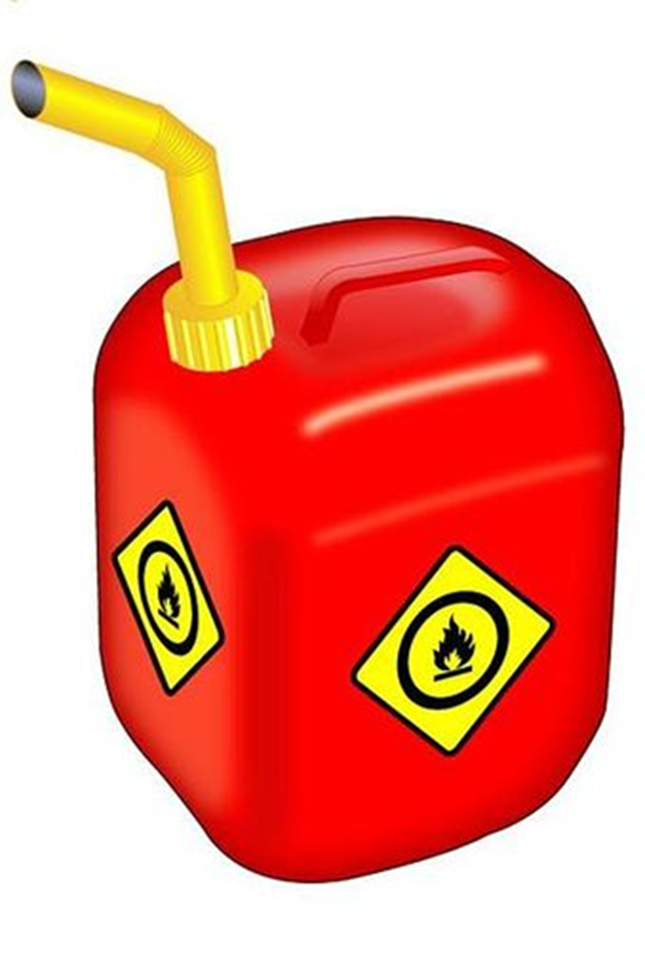
Energy store examples
This can of petrol has chemical energy in
its store

Slide 16
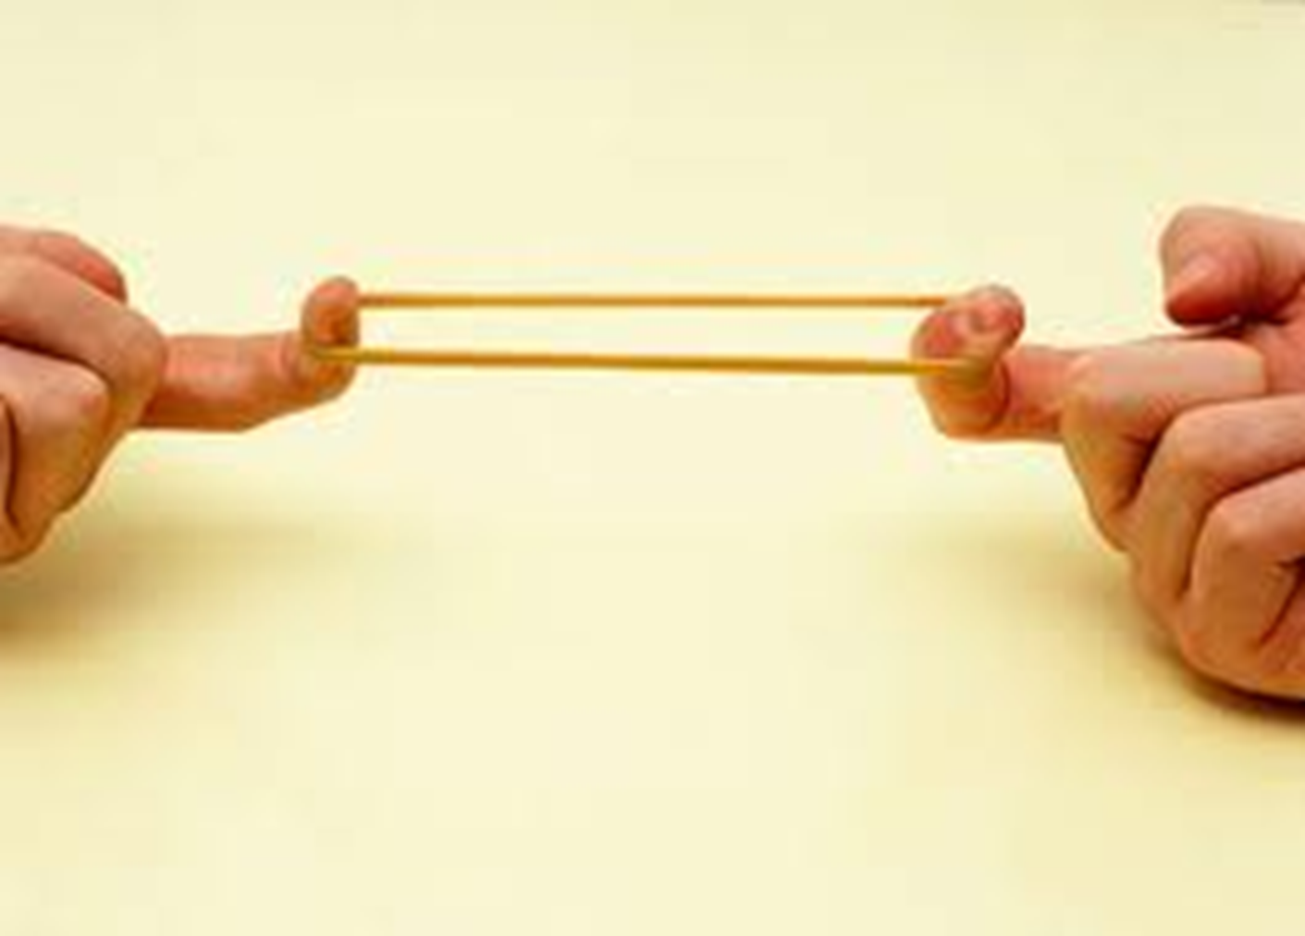
This elastic band has elastic energy in its store

Slide 17
This bird flying high has gravitational energy in its store

Slide 18
What energy is in the energy store of these objects?

Slide 19
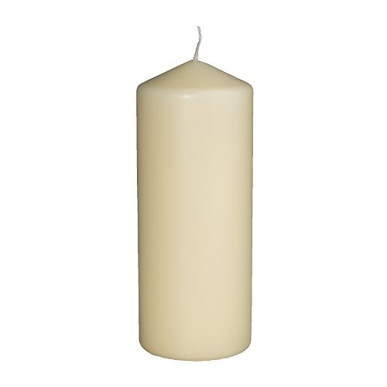

Slide 20
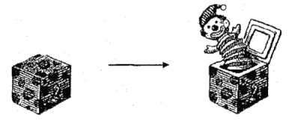

Slide 22
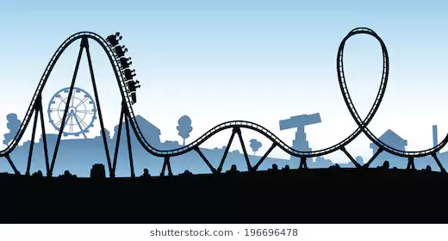

Slide 23
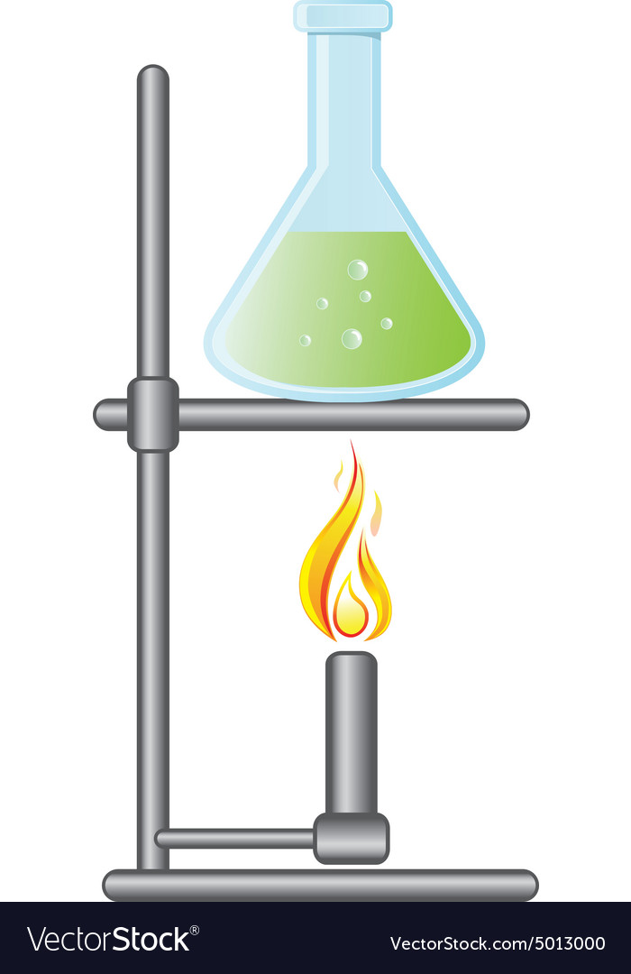

Slide 24
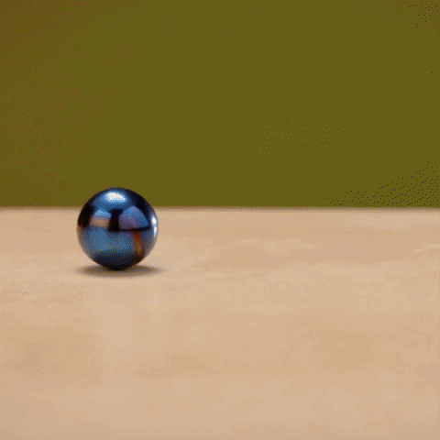

Slide 25
Energy Transfers
Energy doesn’t stay in one store forever.
Energy is being constantly transferred from one energy store to another but……..
Energy cannot be created or destroyed!

Slide 26
Energy Transfers
Name the energy store BEFORE and AFTER the transfer.
Example: Combustion
Before – CHEMICAL
After – THERMAL (HEAT)
Chemical → Thermal

Slide 27
Energy Transfers
Name the energy store BEFORE and AFTER the transfer.
Before –
After –
……………….. → ………………….

Slide 28
Energy Transfers
Name the energy store BEFORE and AFTER the transfer.
Before –
After –
……………….. → ………………….

Slide 29
Energy Transfers
Name the energy store BEFORE and AFTER the transfer.
Before – Gravitational
After – Kinetic
Gravitational → Kinetic

Slide 30
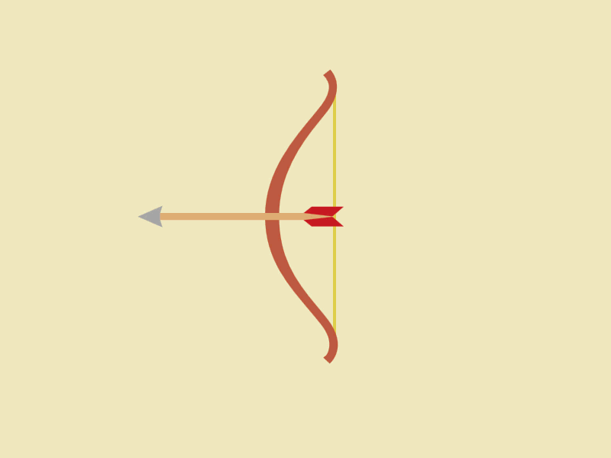
Energy Transfers
Name the energy store BEFORE and AFTER the transfer.
Before –
After –
……………….. → ………………….

Slide 31
Energy Transfers
Name the energy store BEFORE and AFTER the transfer.
Before – Elastic
After – Kinetic
Elastic → Kinetic

Slide 32
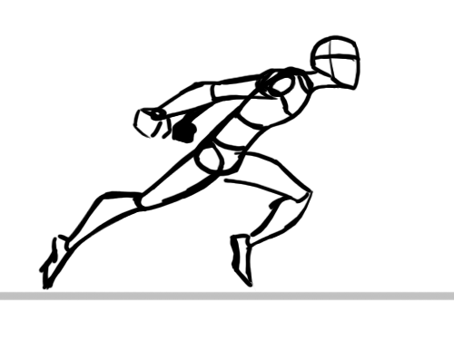
Energy Transfers
Name the energy store BEFORE and AFTER the transfer.
Before –
After –
……………….. → ………………….

Slide 33
Energy Transfers
Name the energy store BEFORE and AFTER the transfer.
Before – Chemical
After – Kinetic
Chemical → Kinetic

Slide 34
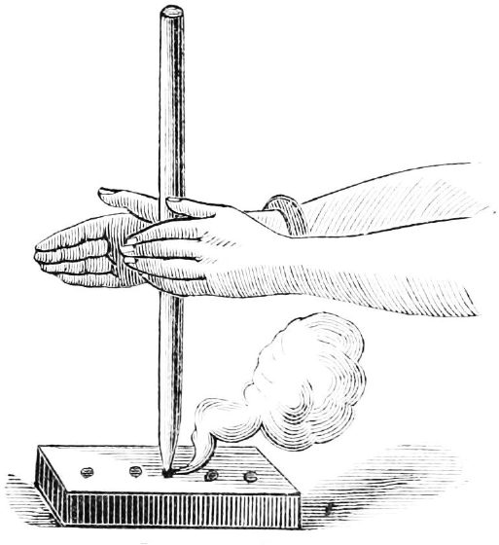
Energy Transfers
Name the energy store BEFORE and AFTER the transfer.
Before –
After –
……………→ ……………….

Slide 35
Energy Transfers
Name the energy store BEFORE and AFTER the transfer.
Before – Kinetic
After – Thermal
Kinetic → Thermal

Slide 36
How is the energy transferred from one store to another?

Slide 37
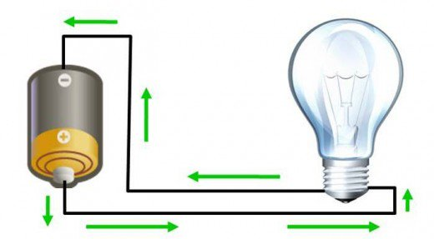
Electrically
The chemical energy store of the cell is transferred electrically to
the thermal energy store of the bulb (the bulb gets hot)

Slide 38
Mechanically
Whenever a force is involved moving something,
energy is transferred mechanically.
The man’s chemical energy store is being transferred
Mechanically to the kinetic energy store of the box

Slide 39
By waves (sound, light, infrared)
The thermal energy in the filament’s energy
store is transferred to the surroundings as
light waves. The thermal energy store of the
Surroundings is also increasing

Slide 40
By heating
Energy is transferred from the hot coffee to the cooler surroundings
The thermal energy store of the surroundings is increasing but the
thermal energy store of the surroundings is spread out.

