Slide 1
Microscopes
Learning Objectives:
Define the term “microscopic”.
Know how to prepare a slide.
Know how to use a microscope.

Slide 2
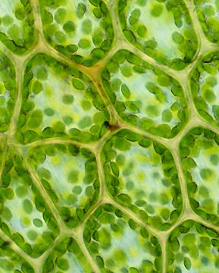
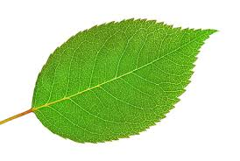
Cells are Microscopic
Microscopic – too small to see with the naked eye

Slide 3
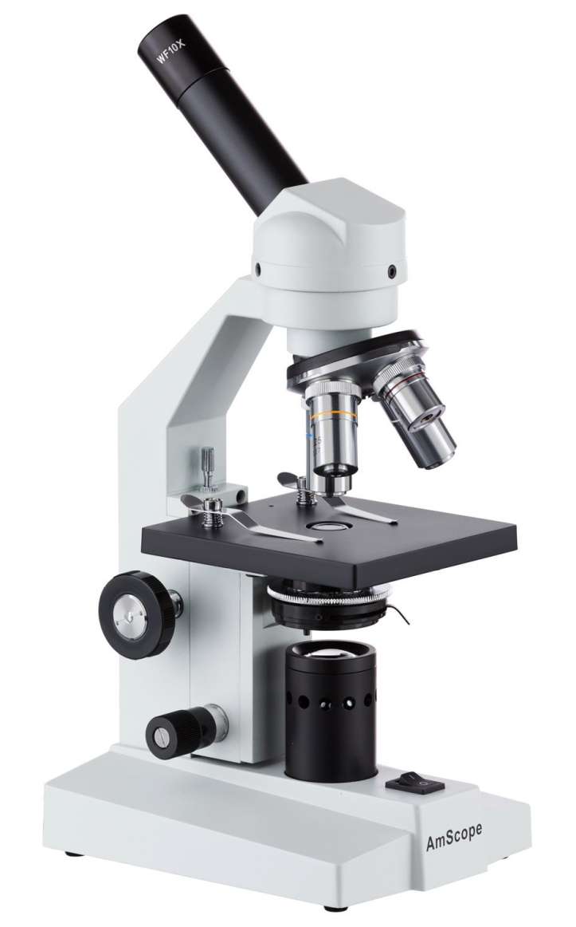
Microscopes
Microscope – equipment used to magnify microscopic things
Magnify – makes something appear larger

Slide 4
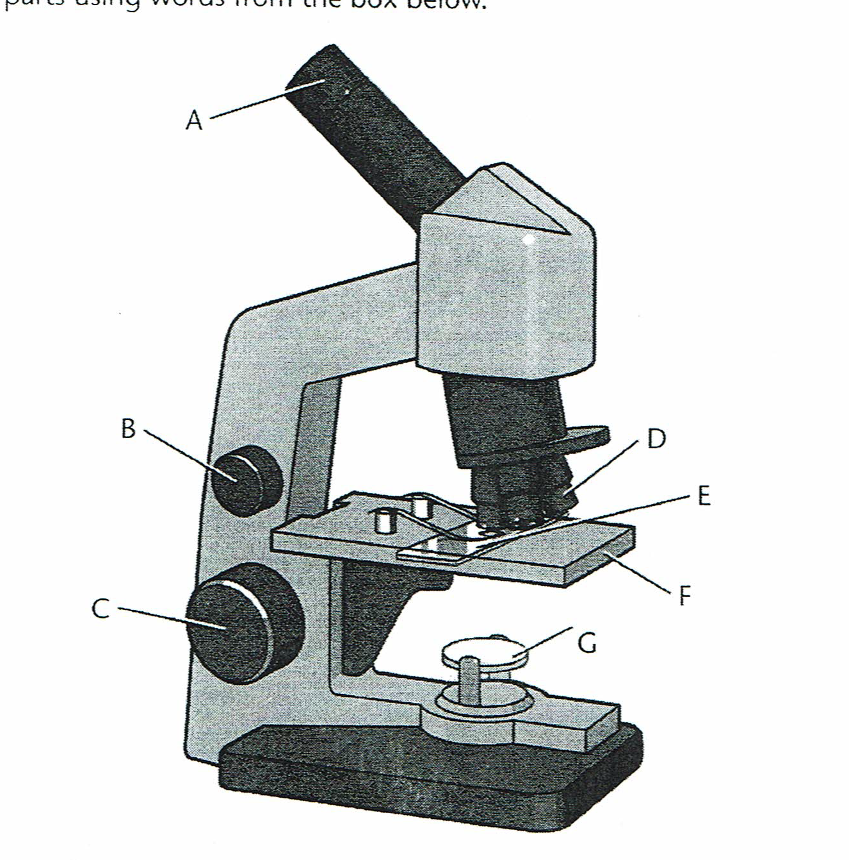
Eyepiece Lens
Objective Lens
Fine Focusing Wheel
Slide
Coarse Focusing Wheel
Stage
Light Source

Slide 5
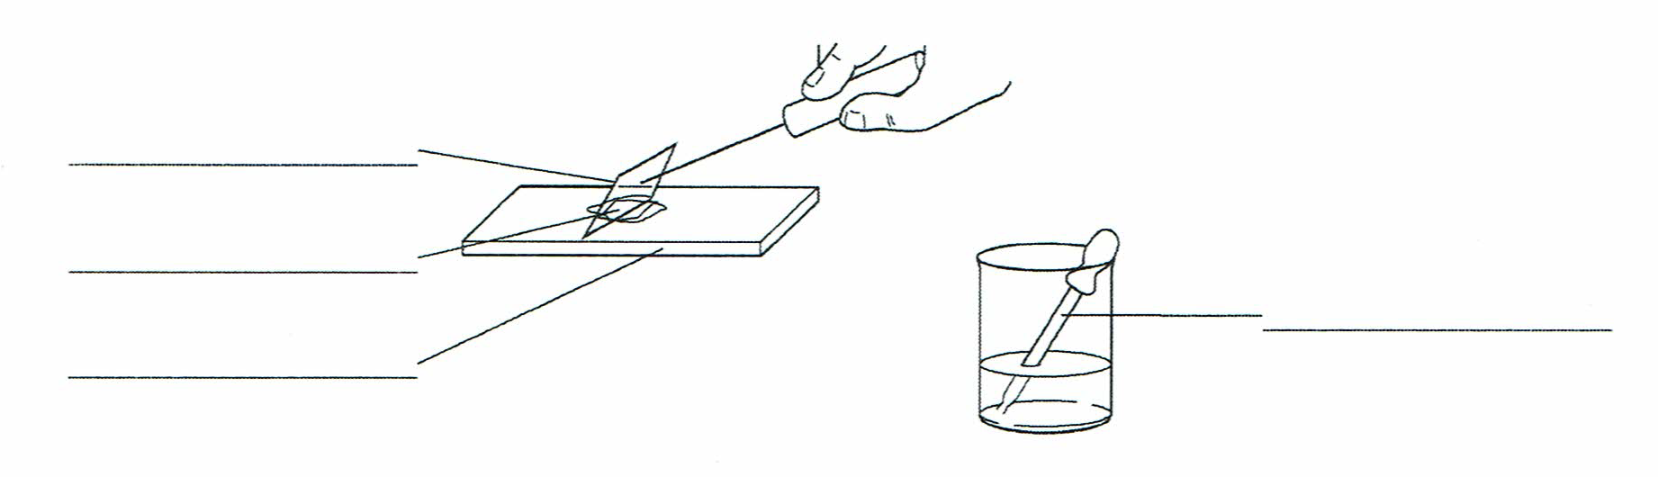
Preparing a Slide
Slide – piece of glass holding the specimen you are looking at
Coverslip
Specimen
Pipette
Slide

Slide 6
d Gently tap out any air bubbles.

Slide 7
Using a Microscope
Place the slide on the stage and clip in.
Turn the shortest lens into place.
Turn on the light.
Look through the eyepiece lens.
Use the coarse focusing wheel to focus the image to get a clearer picture. BE CAREFUL NOT TO SMASH THE LENS INTO THE SLIDE!!!
Use the fine focusing wheel to better focus.

Slide 8
Writing Task
How do we study cells?
Use the following key words in a paragraph.
  Cells
  Microscopic
  Microscope
  Magnify

