Slide 1
Habitats and Adaptations
Learning Objectives:
Different habitats have different features.
Different habitats support different organisms.
Organisms have different adaptations allowing them to survive in a particular habitat.

Slide 2
Habitats
Habitat = where an organism lives
Environmental factors = non-living things that affect the conditions of the habitat
Examples: amount of sunlight, amount of rain, temperature, humidity

Slide 3
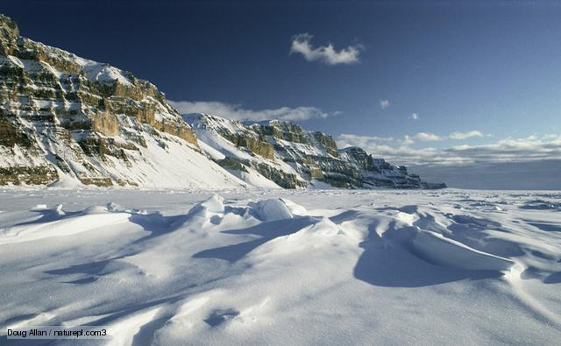
A
B
Desert
Savanna/Grasslands
D
C
Rainforest
Polar/Arctic

Slide 4
https://www.bbc.com/education/topics/zxhhvcw/resources/1

Slide 5
Adaptations
Organisms are adapted to live in certain habitats.
Adaptation = a feature or behaviour that helps an organism to survive
What are the environmental features of different habitats?
What adaptations might help organisms to live in different habitats?

Slide 6
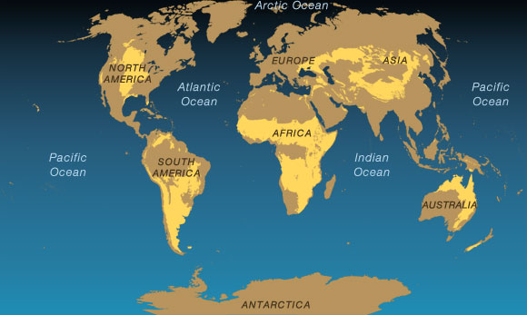
Where are the savannahs of the world?

Slide 7
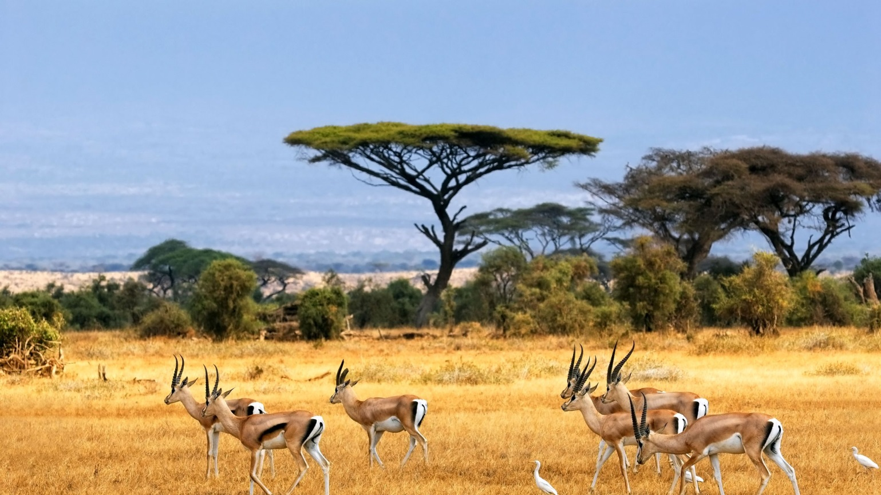
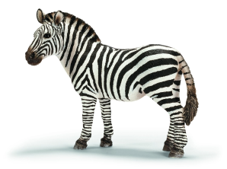
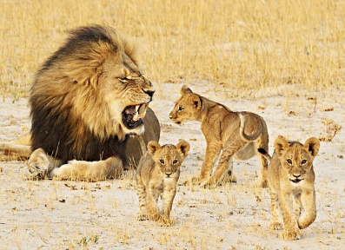
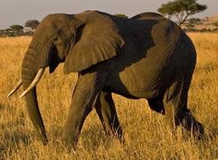
Savanna
Tropical grasslands
Warm temperatures
Long dry season (winter)
Short wet season (summer)

Slide 8
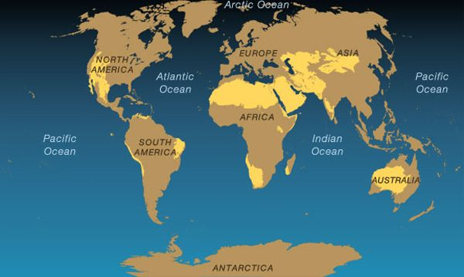
Where are the main deserts of the world?

Slide 9
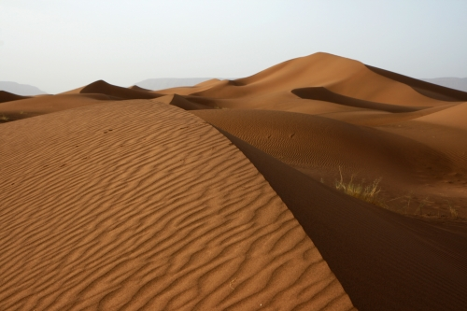
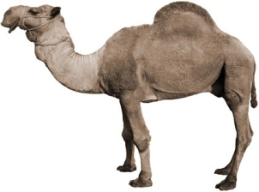
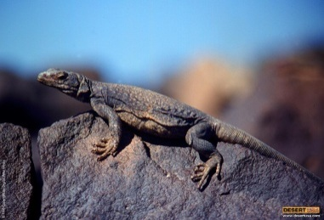
DESERT
Covered in sand or rock
Hot during the day
Cold at night
Very dry

Slide 10
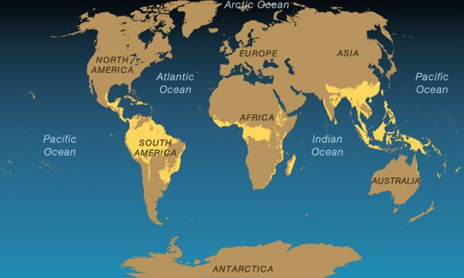
Where are the world’s rainforests?

Slide 11
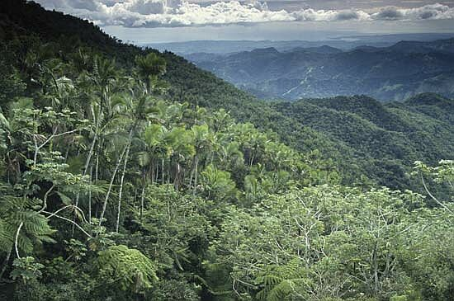
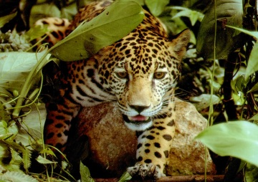
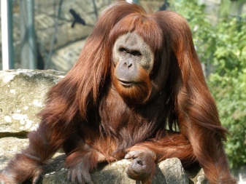
RAINFOREST
Hot all year round
Very wet/humid
Lots of sunlight at the top
Very dark on the forest floor

Slide 12

arctic
Antarctic

Slide 13
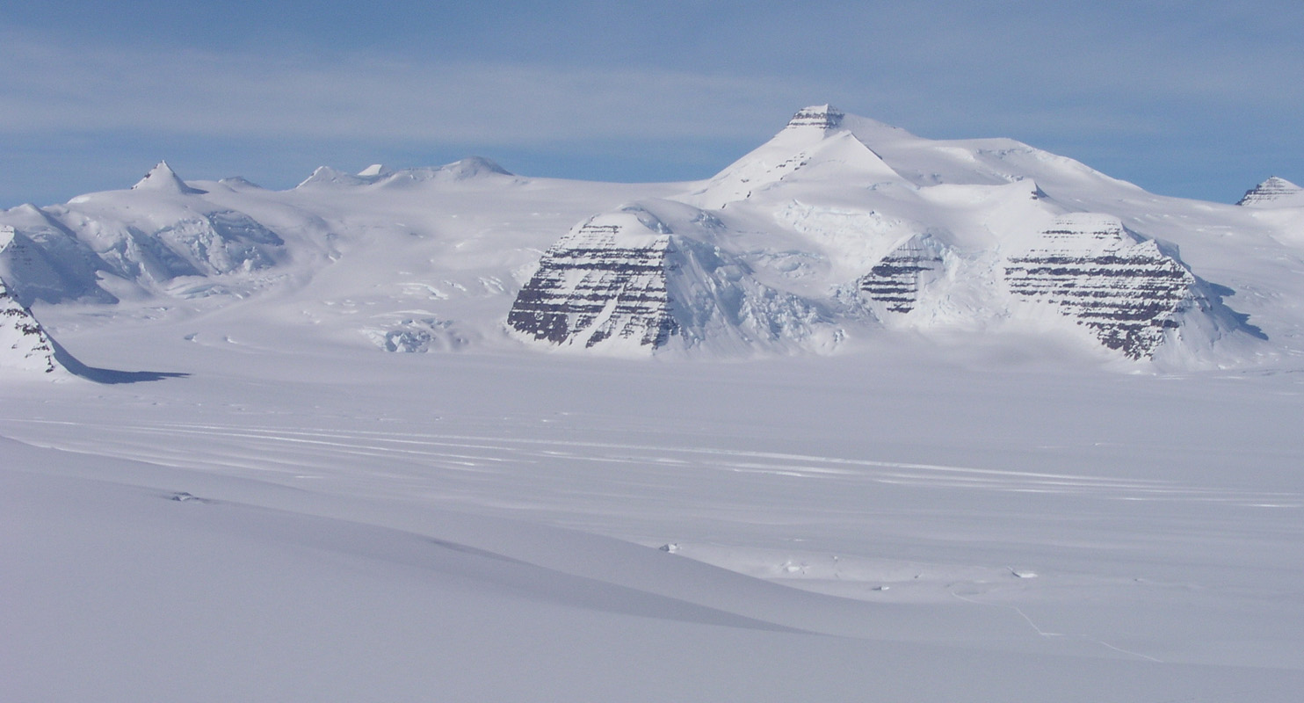
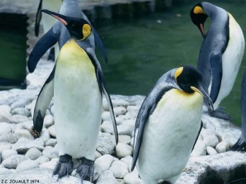
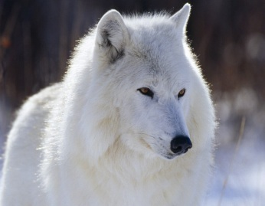
ARCTIC
Covered in snow and ice
Very cold temperatures
Lots of light in the summer
Very dark in the winter

Slide 14
Are habitats always the same?
What daily changes are there?
What seasonal changes are there?
How do animals adapt to these daily and seasonal changes?

Slide 15
Adaptations to Daily Changes
Changes
Light during the day, dark at night
Warmer during the day, colder at night
Adaptations
Nocturnal animals
Sleep during the day
Big eyes to see in low light
Good hearing or smell
Thick fur to keep warm
Diurnal animals
Sleep at night
Take shelter at night

Slide 16
Adaptations to Seasonal Changes
Changes
Temperature (cold season, warm season)
Rain (rainy seasons, dry seasons)
Length of day
Brightness of light
Adaptations
Hibernation (sleep during winter)
Migration (move to different areas during cold season)
Changes in fur/feather to better insulate or camouflage

